Slide 3
Week 4:
The Lampstands
(Revelation 1:10-20)

Slide 4
Structure of Revelation
What you have seen:
What is now
What will take place later

Slide 5
Structure of Revelation
“I preach as though Christ were crucified yesterday, rose from the dead today, and is coming back to earth again tomorrow.”
–Martin Luther

Slide 6
-What is now-
His presence is in the church
He intercedes for the church
He purifies the church
He searches the church
He judges the church
He commands/ instructs the church

Slide 7
-What is now-
His presence is in the church
He intercedes for the church
He purifies the church
He searches the church
He judges the church
He commands/ instructs the church
He controls the church
He protects the church
He reveals Himself to the church

Slide 8
The Lampstands
7 actual and yet representative churches
Golden
Lampstands
The church’s position in the world

Slide 9
John 8:12
“I am the light of the world. Whoever follows me will never walk in darkness, but will have the light of life.”

Slide 10
Ephesians 5:8-13
⁸ For you were once darkness, but now you are light in the Lord. Live as children of light ⁹ (for the fruit of the light consists in all goodness, righteousness and truth) ¹⁰ and find out what pleases the Lord. ¹¹ Have nothing to do with the fruitless deeds of darkness, but rather expose them. ¹² It is shameful even to mention what the disobedient do in secret. ¹³ But everything exposed by the light becomes visible—and everything that is illuminated becomes a light.

Slide 11
Isaiah 60:1-3
¹ “Arise, shine, for your light has come, and the glory of the LORD rises upon you. ² See, darkness covers the earth and thick darkness is over the peoples, but the LORD rises upon you and his glory appears over you. ³ Nations will come to your light, and kings to the brightness of your dawn.”

Slide 12
Matthew 5:13-16 (NASB)
¹³ “You are the salt of the earth; but if the salt has become tasteless, how can it be made salty again? It is no longer good for anything, except to be thrown out and trampled under foot by men. ¹⁴ You are the light of the world. A city set on a hill cannot be hidden; ¹⁵ nor does anyone light a lamp and put it under a basket, but on the lampstand, and it gives light to all who are in the house…

Slide 13
Matthew 5:13-16 (NASB)
¹⁶ Let your light shine before men in such a way that they may see your good works, and glorify your Father who is in heaven.”

Slide 14
He is going to judge them on how much light they are giving off in the world

Slide 15
Matthew 25:1-13

Slide 16
Matthew 25:1-13
Jesus among the lampstands trims the wicks and assures they are filled with oil

Slide 17
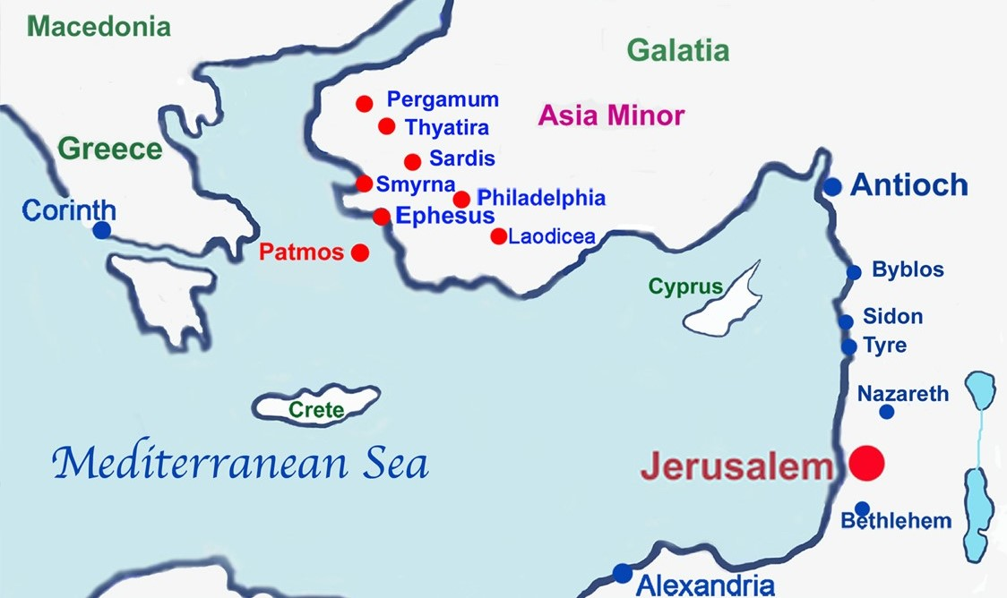

Slide 18
7-fold pattern of 7 letters to 7 churches
Each given specific description of Jesus (an aspect of the revelation of Christ that correlates to their situation)
True condition of each assembly
Commendation
Correction
Encouragement
He implores each to listen!
A promise

Slide 19
Jesus has high standards for His church
2 Corinthians 11:2-3
² I am jealous for you with a godly jealousy. I promised you to one husband, to Christ, so that I might present you as a pure virgin to Him. ³ But I am afraid that just as Eve was deceived by the serpent’s cunning, your minds may somehow be led astray from your sincere and pure devotion to Christ.

Slide 20
Jesus has high standards for His church
Revelation 19:7-8
⁷ Let us rejoice and be glad and give Him glory! For the wedding of the Lamb has come, and His bride has made herself ready. ⁸ Fine linen, bright and clean, was given her to wear.” (Fine linen stands for the righteous acts of God’s holy people.)

