Slide 1
What a Fish Story!
JOHN 21:1-17

Slide 2
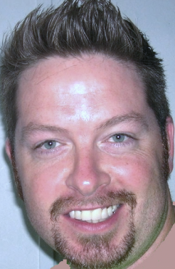
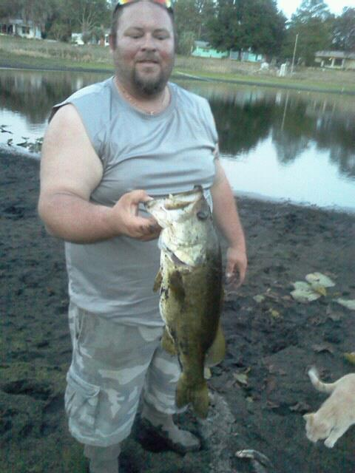

Slide 3
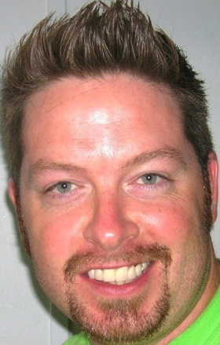

Slide 4
Turn to Luke 5:1-11
He gives them direction, they listen to His voice
Peter realized his sinfulness
The goodness of God leads you to repentance (Romans 2:4)
When we realize we can’t do it ourselves…

Slide 5
Turn to Luke 5:1-11
Jesus promised He would give them a new identity and new purpose

Slide 7
According to the Gospels
MATTHEW ends with Jesus giving the “Great Commission” charging them to go into the world and make disciples of all nations as teachers of everything He commanded. (Matthew 28:16-20)

Slide 8
According to the Gospels
MARK ends with the disciples commissioned by Jesus to go to the world as preachers, recreating the powerful signs of Jesus and bringing new believers into the community of faith. (Mark 16:15-20)

Slide 9
According to the Gospels
LUKE ends with Jesus calling them to be his witnesses in the world—empowered by the Holy Spirit, who will testify concerning the events of Jesus’ life and bring new followers into discipleship. (Luke 24:44-49)

Slide 10
According to the Gospels
JOHN ends with Jesus showing them how to be gatherers of men and shepherds of His flock. (John 21:1-17)

Slide 11
Turn to
John 21:1-17

Slide 12
What a Fish Story! John 21:1-17
He gives those direction whom will listen to his voice
As Jesus worked through the direction of the Father, so too the disciples must work at the word of Jesus. Faith comes by hearing and hearing by the Word of God (Romans 10:17)

Slide 13
What a Fish Story! John 21:1-17
Peter realized his own sinfulness and need
He covered up
He dove in to reach Jesus faster

Slide 14
What a Fish Story! John 21:1-17
Jesus promised He would give them a new identity and purpose (Luke 5:10)
They were sinners who caught fish
Jesus would make them redeemed fishers of men

Slide 15
What a Fish Story! John 21:1-17
This story is not about “one more try”
His work (salvation)– “For it is by grace you have been saved, through faith—and this is not from yourselves, it is the gift of God—not by works so that no one can boast. (Ephesians 2:8-9)

Slide 16
What a Fish Story! John 21:1-17
This story is not about “one more try”
Our work (co-laborers)— The work of the Church is through the Holy Spirit. Christ himself (through the Spirit) is ministering in and through our efforts.

Slide 17
What a Fish Story! John 21:1-17
Proverbs 3:5-6 “Trust in the Lord with all your heart and lean not on your own understanding; in all your ways submit to him, and he will direct your path.”

