Slide 3
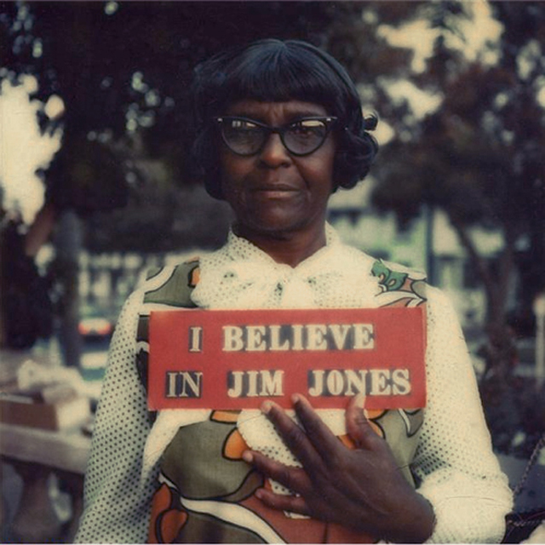
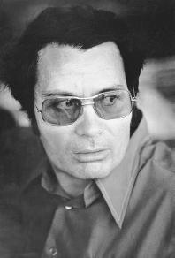
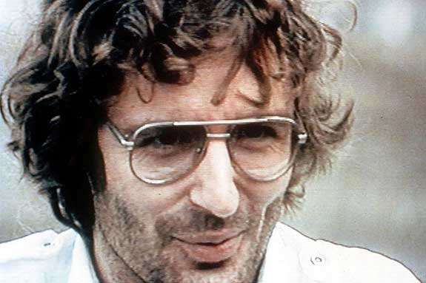
Jim Jones
David Koresh

Slide 4
“In the place of…”
(Acts 14:1-20)

Slide 5
Acts 14:1-20

Slide 6
We Were Made to Worship God
Man is the only part of God’s creation that is capable of worshipping Him
We were designed in God’s image
We were designed to reflect God back to God
“man’s supreme function through all eternity is to reflect God’s highest glory, and that God might look into the mirror called man and see His own glory shining there. Through man, God could reflect His glory to all creation.” – A.W. Tozer
Isaiah 43:21 - “The people whom ﻿I formed for Myself will declare my praise.”

Slide 7
God
Our Worship
Joy & Contentment

Slide 8
God
Our Worship
Joy & Contentment
Never Satisfied

Slide 9
Only Jesus Can Fill the Void
John 6:35 “Jesus replied, “I am the bread of life. Whoever comes to me will never be hungry again.”
John 4:13-14 ¹³ “Jesus replied, “Anyone who drinks this water will soon become thirsty again. ¹⁴ But those who drink the water I give will never be thirsty again. It becomes a fresh, bubbling spring within them, giving them eternal life.”
This THIRST and HUNGER can ONLY be filled by an authentic relationship with Jesus Christ.

Slide 10
The Pseudo-Jesus Syndrome
Placing an individual(s) in the place of authority in our lives that should only be occupied by Jesus Christ.
Pastors or Spiritual Mentors
Bible Teachers
TV Evangelists
Because many Christians do not know why they believe what they believe they will believe anything. They are spiritually lazy and would rather let someone tell them what they should believe rather than opening up scripture and proving or disproving what they hear.

Slide 11
Picking a Man over Jesus
1 Corinthians 3:1-7- 3 Dear brothers and sisters,﻿ when I was with you I couldn’t talk to you as I would to spiritual people.﻿ I had to talk as though you belonged to this world or as though you were infants in the Christian life.﻿ ² I had to feed you with milk, not with solid food, because you weren’t ready for anything stronger. And you still aren’t ready, ³ for you are still controlled by your sinful nature. You are jealous of one another and quarrel with each other. Doesn’t that prove you are controlled by your sinful nature? Aren’t you living like people of the world? ⁴ When one of you says, “I am a follower of Paul,” and another says, “I follow Apollos,” aren’t you acting just like people of the world? ⁵ After all, who is Apollos? Who is Paul? We are only God’s servants through whom you believed the Good News. Each of us did the work the Lord gave us. ⁶ I planted the seed in your hearts, and Apollos watered it, but it was God who made it grow. ⁷ It’s not important who does the planting, or who does the watering. What’s important is that God makes the seed grow.

Slide 12
False Teaching from False Teachers
2 Timothy 2:15-18 - ¹⁵ Do your best to present yourself to God as one approved, a workman who does not need to be ashamed and who correctly handles the word of truth. ¹⁶ Avoid godless chatter, because those who indulge in it will become more and more ungodly. ¹⁷ Their teaching will spread like gangrene. Among them are Hymenaeus and Philetus, ¹⁸ who have wandered away from the truth. They say that the resurrection has already taken place, and they destroy the faith of some.

Slide 13
Charge to the Teachers
James 3:1 – “Dear brothers and sisters,﻿ not many of you should become teachers in the church, for we who teach will be judged more strictly.”

Slide 14
Charge to the Learners
1 Thessalonians 5:21 – “Test all things. Hold on to the good.”
Acts 17:10-11 ¹⁰ As soon as it was night, the brothers sent Paul and Silas away to Berea. On arriving there, they went to the Jewish synagogue. ¹¹ Now the Bereans were of more noble character than the Thessalonians, for they received the message with great eagerness and examined the Scriptures every day to see if what Paul said was true.

Slide 15
The Berean Challenge

Slide 16
Berean Challenge for CWP
Foundations of Faith – 6 week class covering the foundational doctrines of Christianity with an emphasis on knowing why you believe what you believe.
How to Study the Bible Class – 4 week class covering the abc’s of studying the Bible.
Read the Bible in a Year – Year long challenge of reading Chronologically through the Bible. Includes four quarterly meetings covering topics such as the canonization of the Bible, how the Bible was preserved and an overview of the types and versions of the Bible.

