Slide 2
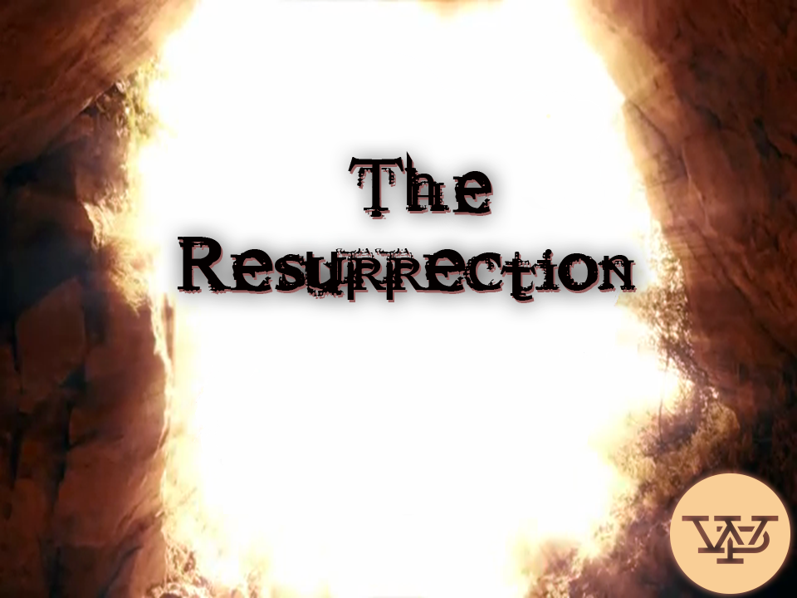

Slide 3
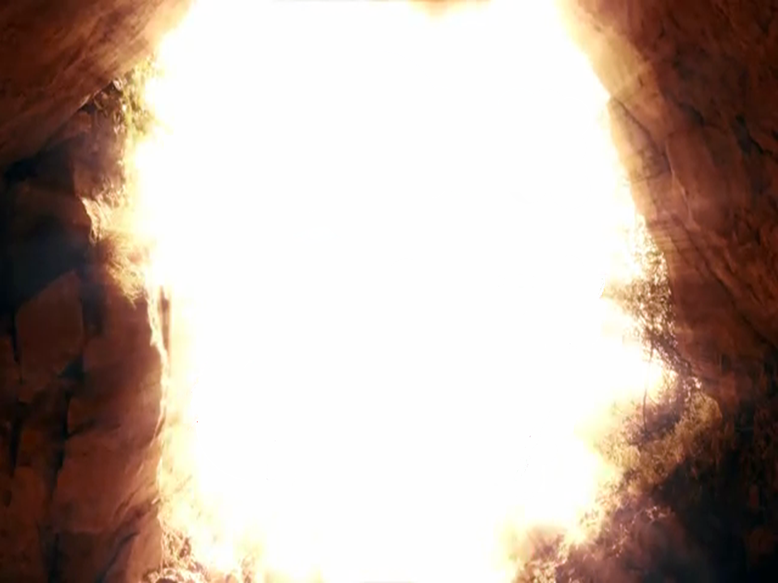
²⁵ Jesus said to her,
“I am the resurrection and the life. He who believes in me will live, even though he dies; ²⁶ and whoever lives and believes in me will never die. Do you believe this?”
(John 11:25-26)

Slide 4
Romans 6:4-5
Union
with
Christ

Slide 5
2 Corinthians 5:14-17
¹⁴ For Christ's love compels us, because we are convinced that one died for all, and therefore all died. ¹⁵ And he died for all, that those who live should no longer live for themselves but for him who died for them and was raised again…

Slide 6
2 Corinthians 5:14-17
¹⁷ Therefore, if anyone is in Christ, he is a new creation; the old has gone, the new has come!
The Message: ¹⁵ “He included everyone in His death so everyone could be included in His life.”

Slide 7
Romans 6:6-7
Death
with
Christ

Slide 8
Romans 6:6-7
Old self
(What we were in)
Body of sin
(What is in us)
Slaves to sin
(What we were
mastered by)

Slide 9
Romans 6:8-12
Jesus takes away
the PENALTY of sin
(We died in Jesus)
Jesus takes away
the SEPARATION
(We live in a restored
relationship with
God in Jesus)

Slide 10
Romans 6:8-12
Jesus takes away
the POWER of sin
(We live
resurrection
in Jesus)

Slide 11
Romans 6:8-12
Life
with
Christ

Slide 12
Philippians 3:10
I want to know Christ and the power of his resurrection and the fellowship of sharing in his sufferings, becoming like him in his death.

Slide 13
Romans 10:9-10
⁹ If you declare with your mouth, “Jesus is Lord,” and believe in your heart that God raised him from the dead, you will be saved. ¹⁰ For it is with your heart that you believe and are justified, and it is with your mouth that you profess your faith and are saved.

