Slide 2
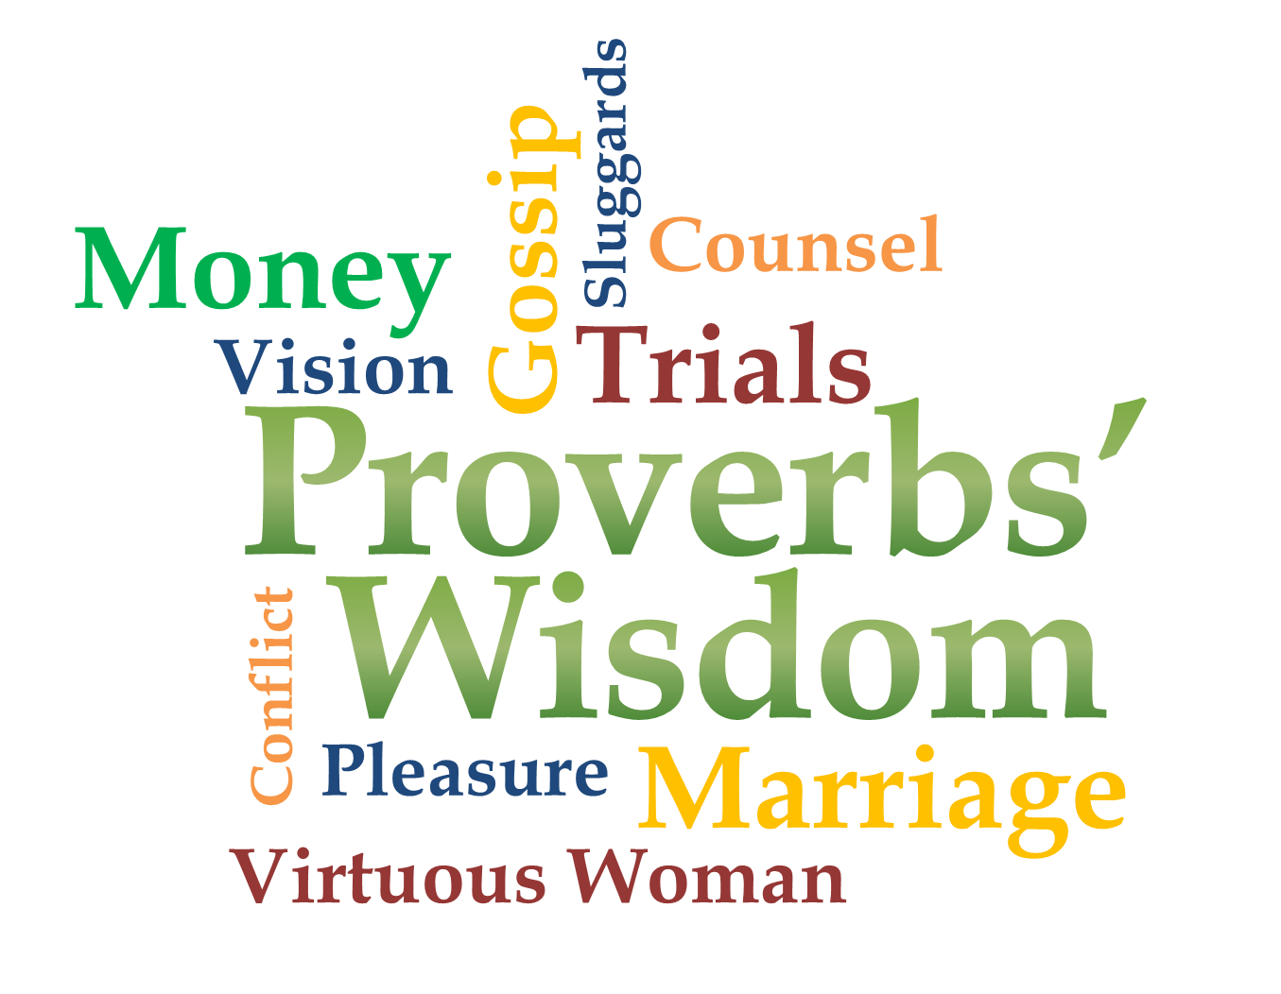
Week 8
Money

Slide 3
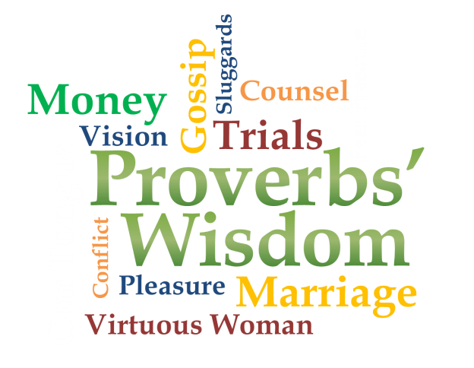
Money Matters!
Luke 12:13-21

Slide 4
Temptation of money
Proverbs 27:20
Death and Destruction are never satisfied, and neither are the eyes of man.
Proverbs 16:8
Better a little with righteousness than much gain with injustice.

Slide 5
Temptation of money
Proverbs 13:11
Dishonest money dwindles away, but he who gathers money little by little makes it grow.
Proverbs 21:6
A fortune made by a lying tongue is a fleeting vapor and a deadly snare.

Slide 6
Temptation of money
Proverbs 23:4-5
⁴ Do not wear yourself out to get rich; have the wisdom to show restraint ⁵ Cast but a glance at riches, and they are gone, for they will surely sprout wings and fly off to the sky like an eagle.

Slide 7
Money is not evil
1 Timothy 6:10
For the love of money is a root of all kinds of evil. Some people, eager for money, have wandered from the faith and pierced themselves with many griefs.

Slide 8
Money is not evil
Proverbs 30:7-9
⁷ “Two things I ask of you, O LORD; do not refuse me before I die: ⁸ Keep falsehood and lies far from me; give me neither poverty nor riches, but give me only my daily bread…

Slide 9
Money is not evil
Proverbs 30:7-9
…⁹ Otherwise, I may have too much and disown you and say, 'Who is the LORD?' Or I may become poor and steal, and so dishonor the name of my God.”

Slide 10
Honor God with your money
Proverbs 3:5-10
⁵ Trust in the Lord with all your heart and lean not on your own understanding; ⁶ in all your ways submit to him, and he will make your paths straight. ⁷ Do not be wise in your own eyes; fear the Lord and shun evil…

Slide 11
Honor God with your money
Proverbs 3:5-10
⁸ This will bring health to your body and nourishment to your bones. ⁹ Honor the Lord with your wealth, with the firstfruits of all your crops; ¹⁰ then your barns will be filled to overflowing, and your vats will brim over with new wine.

Slide 12
Honor God with your money
Deuteronomy 8:18a
But remember the LORD your God, for it is he who gives you the ability to produce wealth…
Deuteronomy 14:23b (TLB)
The purpose of tithing is to teach you always to put God first in your lives.

Slide 13
Honor God with your money
Proverbs 14:31
He who oppresses the poor shows contempt for their Maker, but whoever is kind to the needy honors God.
Proverbs 19:17
He who is kind to the poor lends to the LORD, and he will reward him for what he has done.

Slide 14
It’s about the heart!
Proverbs 11:3-4
³ The integrity of the upright guides them, but the unfaithful are destroyed by their duplicity. ⁴ Wealth is worthless in the day of wrath, but righteousness delivers from death.

Slide 15
It’s about the heart!
Matthew 6:24
No one can serve two masters. Either he will hate the one and love the other, or he will be devoted to the one and despise the other. You cannot serve both God and Money.

Slide 16
It’s about the heart!
Matthew 6:21
“For where your treasure is, there your heart will be also.”

Slide 17
Our prayer regarding money
Integrity
Our daily bread
Wisdom
Increase
Compassionate & passionate givers
Be a blessing

