Slide 2
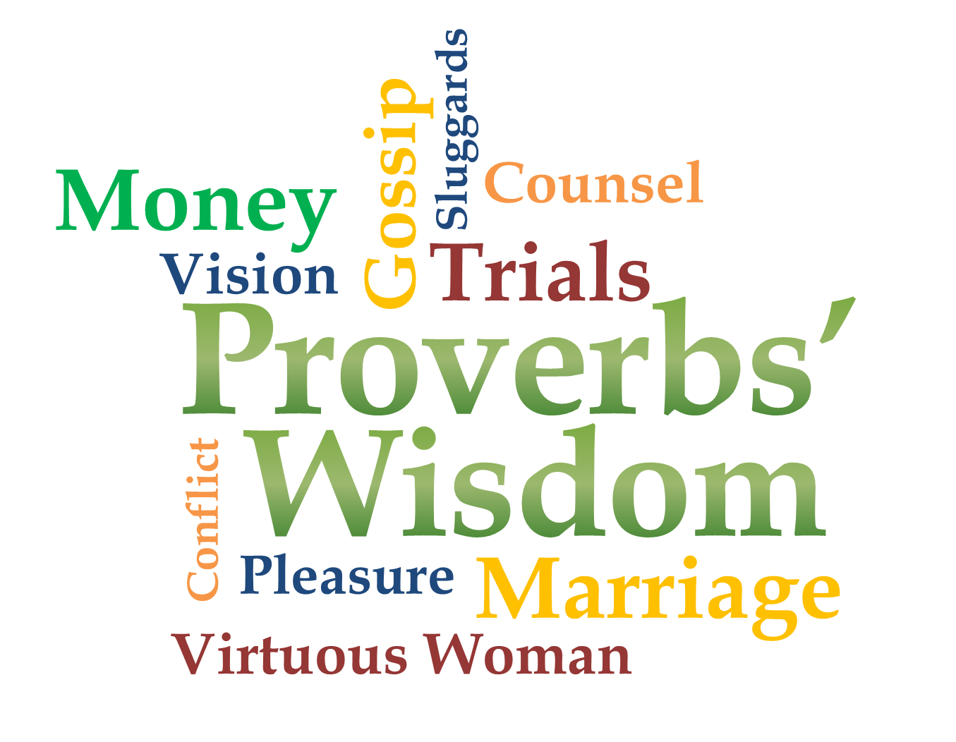
Week 6
Vision

Slide 3
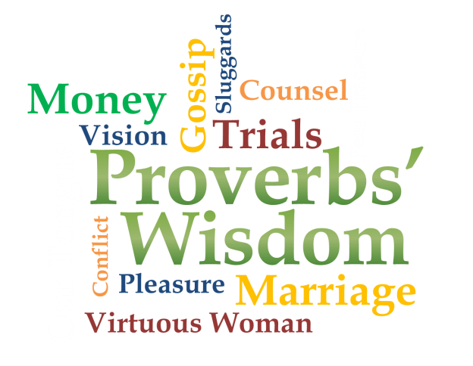
Vision
Turn to
Acts 26:9-19

Slide 4
Vision
Vision occurs when God reveals a glimpse of your purpose or what is the next step(s) you are to take
God must communicate
We must recognize His voice among many
We must listen
We must obey

Slide 5
Avoid A Void
Proverbs 29:18
Where there is no revelation, the people cast off restraint; but blessed is he who keeps the law.
no revelation = no vision
no vision = no restraint
no restraint = no blessing

Slide 6
Avoid A Void
Proverbs 29:18
Where there is no revelation, the people cast off restraint; but blessed is he who keeps the law.
(MSG) If people can’t see what God is doing, they stumble all over themselves; But when they attend to what he reveals, they are most blessed.

Slide 7
Avoid A Void
We see what God is doing
We attend when He reveals
We attend to what He reveals
We are most blessed
(MSG) If people can’t see what God is doing, they stumble all over themselves; But when they attend to what he reveals, they are most blessed.

Slide 8
We see what God is doing
Proverbs 25:2 It is the glory of God to conceal a matter; to search out a matter is the glory of kings.
Proverbs 21:1-2
¹ The king's heart is in the hand of the LORD; he directs it like a watercourse wherever he pleases. ² All a man's ways seem right to him, but the LORD weighs the heart.

Slide 9
We see what God is doing
Proverbs 19:21 Many are the plans in a man's heart, but it is the LORD's purpose that prevails.
Proverbs 3:5-6
⁵ Trust in the LORD with all your heart and lean not on your own understanding; ⁶ in all your ways acknowledge him, and he will make your paths straight.

Slide 10
We attend when He reveals
Proverbs 19:2
It is not good to have zeal without knowledge, nor to be hasty and miss the way.
Proverbs 13:12
Hope deferred makes the heart sick, but a longing fulfilled is a tree of life.

Slide 11
We attend when He reveals
Habakkuk 2:2-3 Then the LORD answered me and said: “Write the vision and make it plain on tablets, that he may run who reads it. For the vision is yet for an appointed time; but at the end it will speak, and it will not lie. Though it tarries, wait for it; because it will surely come, it will not tarry.

Slide 12
We attend when He reveals
Habakkuk 1:1
The prophecy (burden) that Habakkuk the prophet received.
Vision comes as a response to God’s communication/burden

Slide 13
We attend to what He reveals
Proverbs 16:2-4
² All a man's ways seem innocent to him, but motives are weighed by the LORD. ³ Commit to the LORD whatever you do, and your plans will succeed. ⁴ The LORD works out everything for his own ends-- even the wicked for a day of disaster.

Slide 14
We are most blessed
Proverbs 14:23
All hard work brings a profit, but mere talk leads only to poverty.
Proverbs 12:11
He who works his land will have abundant food, but he who chases fantasies lacks judgment.
Fantasy is anti-vision

Slide 15
We are most blessed
Godly vision motivates action
Godly vision is never satisfied with the status quo
Godly vision promotes faith rather than fear
Godly vision brings success in God’s economy:
His kingdom advanced
His glory known

Slide 16
Our Prayer for Vision
Vision occurs when God reveals a glimpse of your purpose or what is the next step(s) you are to take
God must communicate
We must recognize His voice among many
We must listen
We must obey

