Slide 2
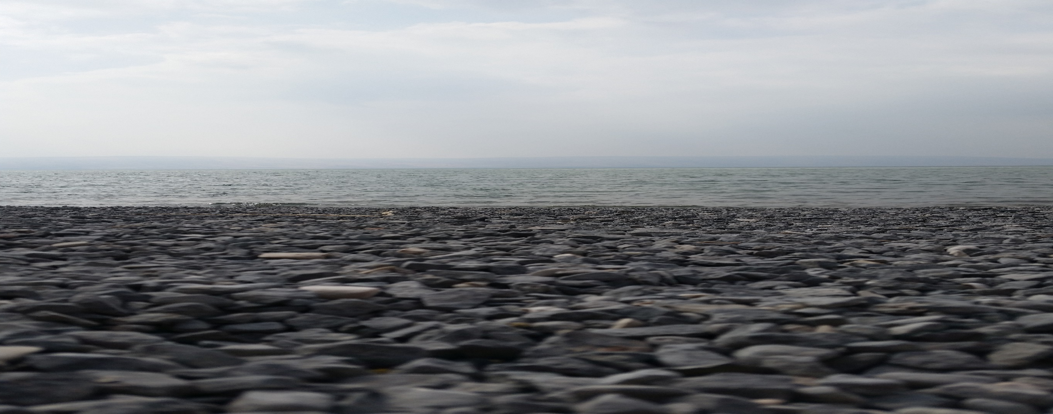
The Lost Miracles of Peter

Slide 3
According to Random House College Dictionary, a “miracle” is “an event in the physical world that surpasses all known human or natural powers and is ascribed to a divine or supernatural cause.”
In other words, “God did it!”

Slide 4
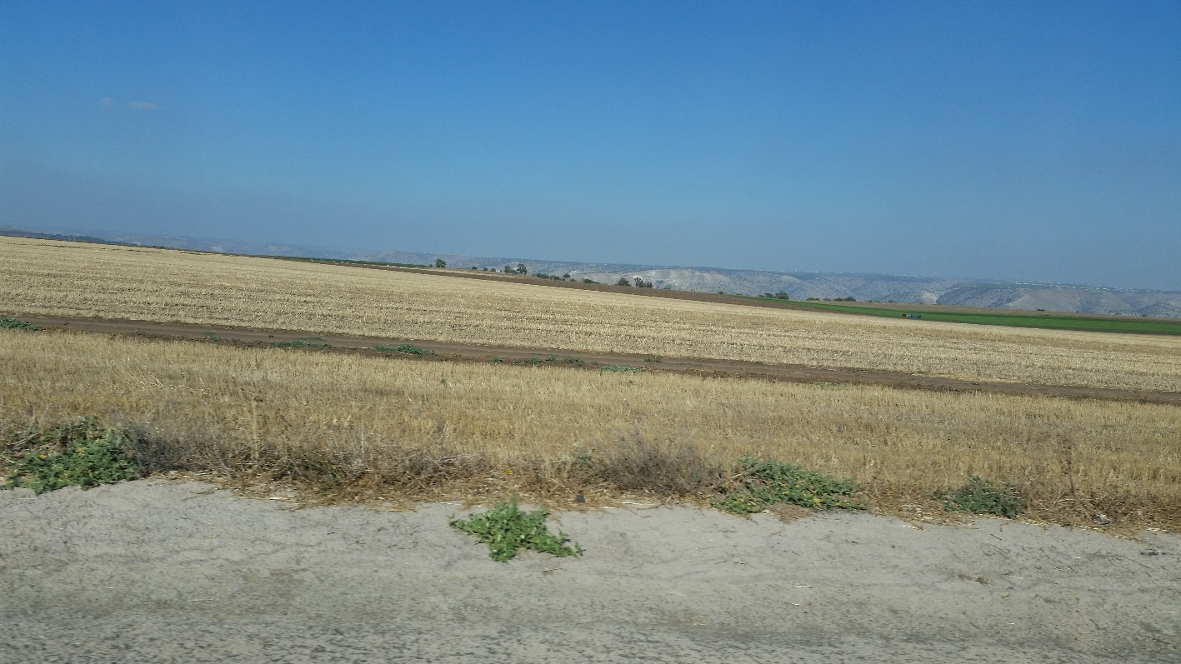
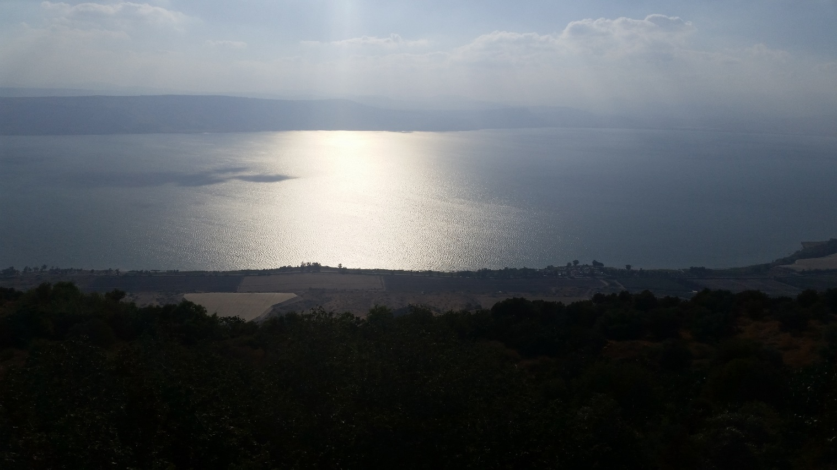
Plains of the Golan Heights
Sea of Galilee

Slide 5
Matthew 14: 23 - 33
³²And when they climbed into the boat, the wind died down.
THEY WALKED BACK TO THE BOAT TOGETHER!

Slide 6
Point 1: God gives the “Miracle of Support” when we are afraid and full of doubt

Slide 7
John 21:3
“I am going fishing.”
Greek word is “Hupago”
Means: go out/ go away/ go back

Slide 8
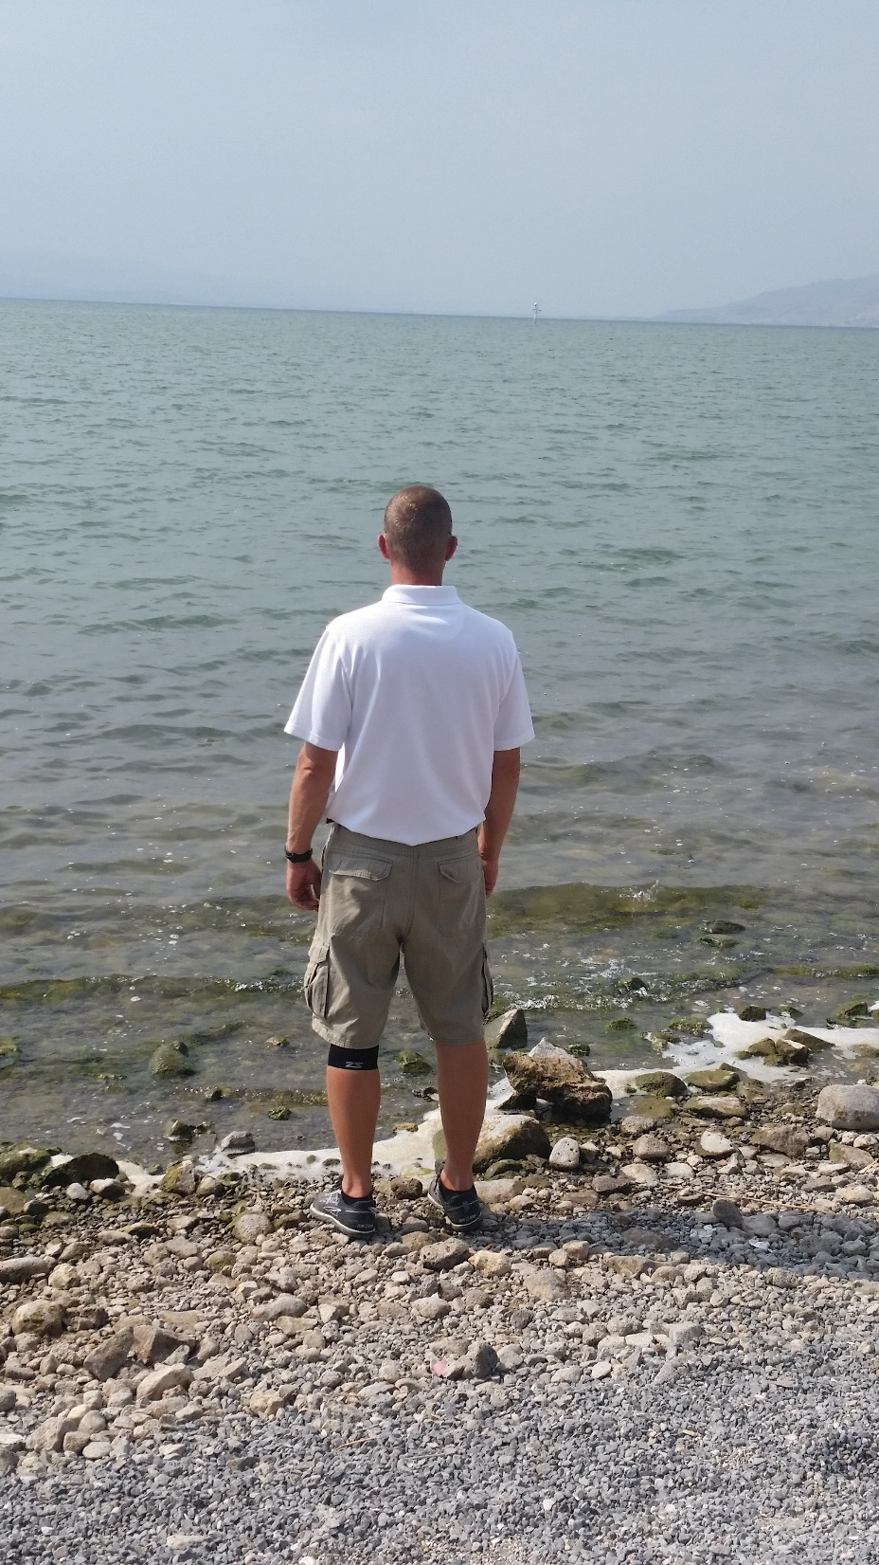
John 21: 1 - 12
¹¹Simon Peter went up and drew the net to the land, full of large fish, a hundred and fifty-three
PETER HAULED THE NET TO THE SHORE BY HIMSELF!

Slide 9
Point 2: God gives the “Miracle of Strength” in times of weakness and need.

Slide 10
Psalm 46:1
Isaiah 40: 29, 31
2 Corinthians 12: 9-10

Slide 11
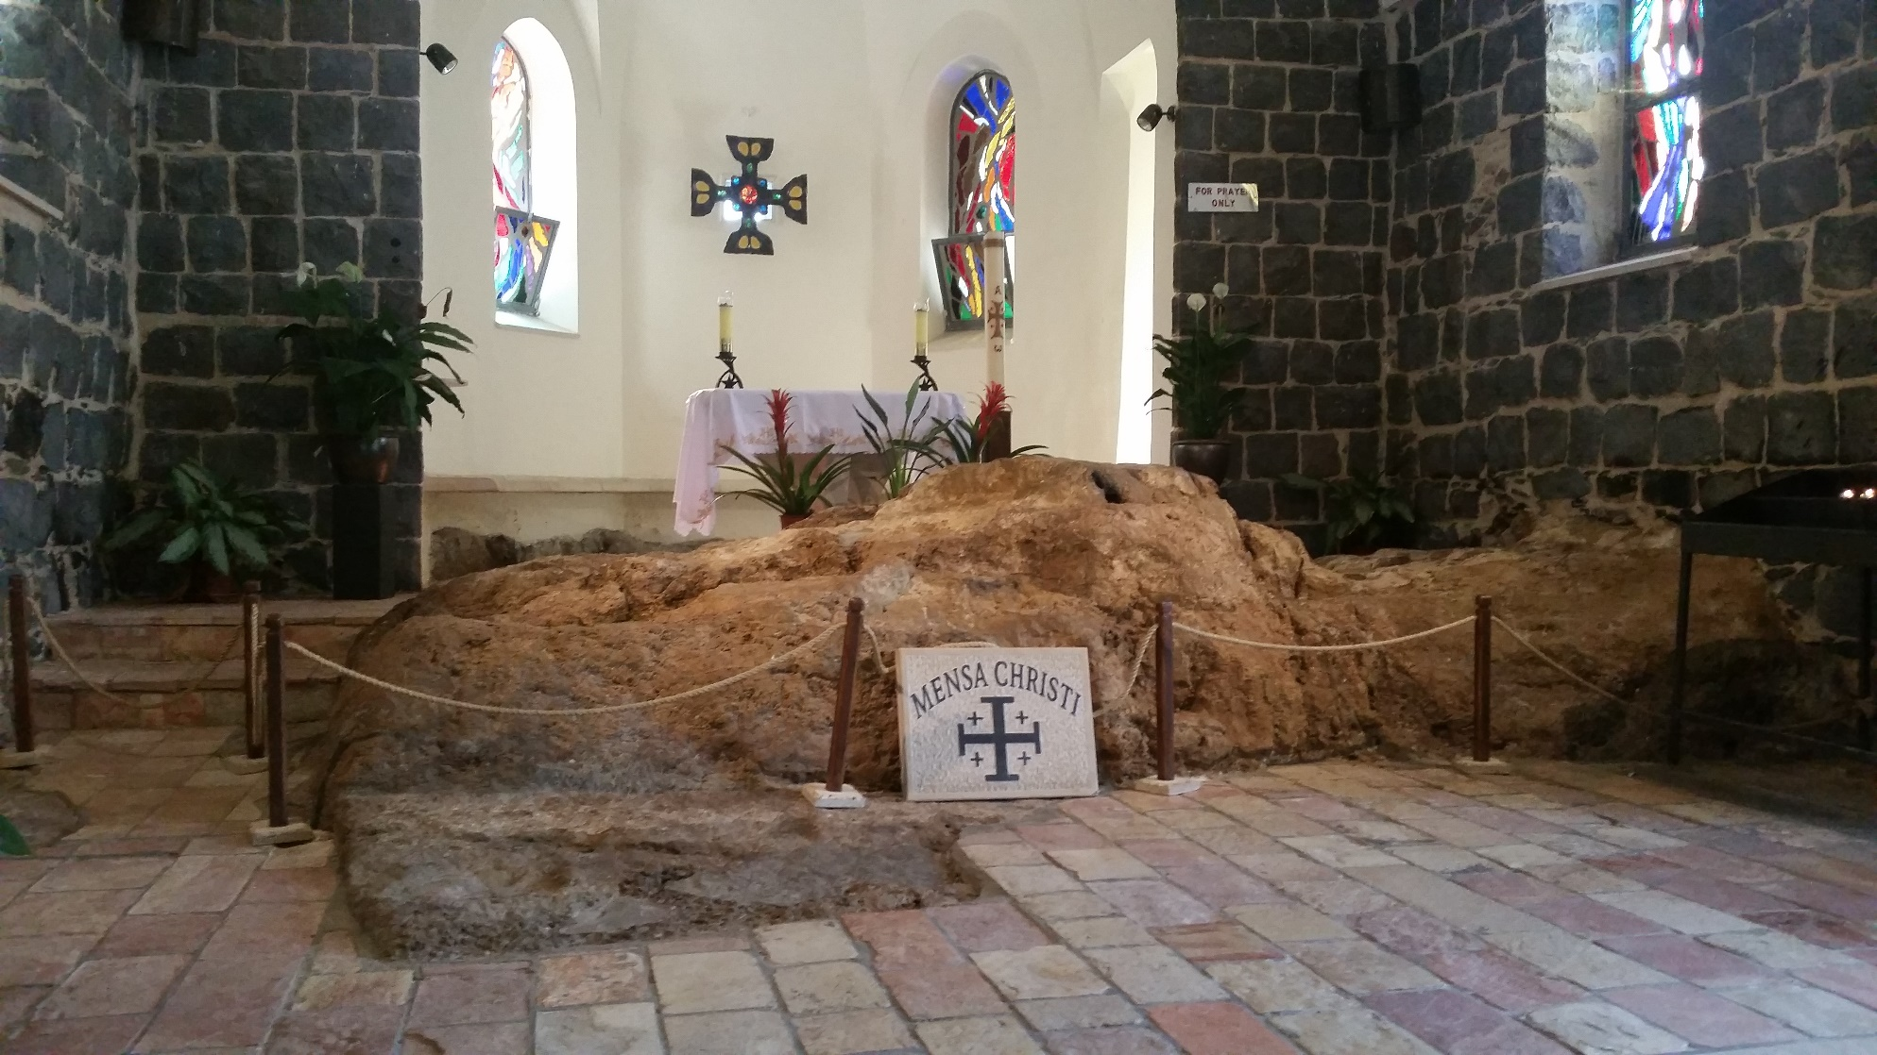
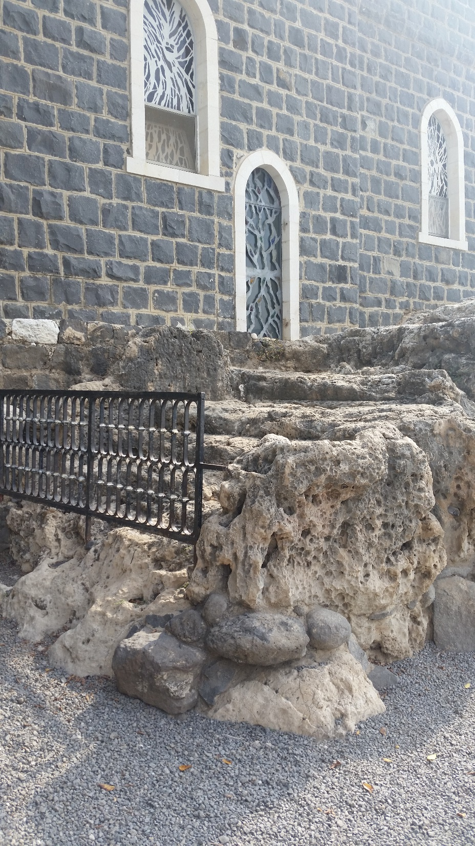
“Table” rock where Jesus and the disciples ate the fish

Slide 12
Acts 12: 6 - 12
⁶On the very night when Herod was about to bring him forward, Peter was sleeping between two soldiers…
PETER WAS SLEEPING!

Slide 13
Point 3: God gives the “Miracle of Rest” in times of stress and fatigue.

Slide 14
Isaiah 30:15
Psalm 37:7
Psalm 46:10a

Slide 15
“Miracle of Support”
“Miracle of Strength”
“Miracle of Rest”

