Slide 2

James 4:11-12
Do not speak against one another, brethren. He who speaks against a brother or judges his brother, speaks against the law and judges the law; but if you judge the law, you are not a doer of the law but a judge of it. There is only one Lawgiver and Judge, the One who is able to save and to destroy; but who are you who judge your neighbor?
Two Types of Faith
One with works (living and genuine)
One without works (dead)

Slide 3
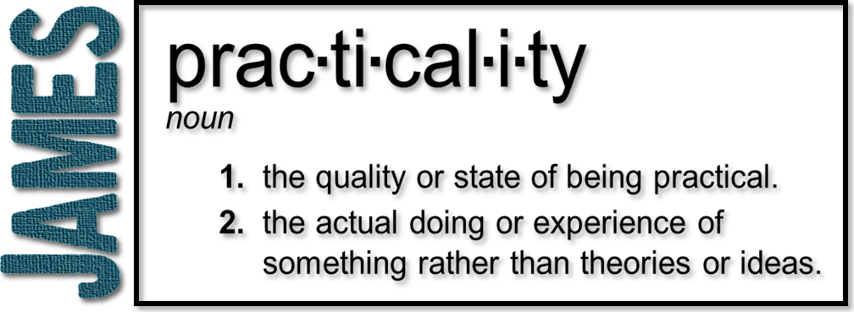
Week 6: Who Are You to Judge?
(James 4:11-12)

Slide 4
Speak Against & Judging
Vs. 11 ‘Do not speak against one another, brethren. He who speaks against a brother or judges his brother…’
Speak Against –Katalaleo (verb) – Slander, destructive verbal attacks, gossip.
Judges – Krino (verb) – Distinguishing or drawing a distinction between.
Speaking against a brother is placing yourself in a position of being their judge

Slide 5
Faith – Judgment - Mercy
FAITH – Belief in God’s mercy and his provision. God gives us good gifts
JUDGMENT – Warning against partiality which is a form of judging and not showing mercy (James 2:1-11)
Judgment and Mercy
James 2:12-13 –So speak and so act as those who are to be judged by the law of liberty. For judgment will be merciless to one who has shown no mercy; mercy triumphs over judgment.
JUSTICE – Getting what we deserve
MERCY – Not getting what we deserve
GRACE – Getting what we don’t deserve

Slide 6
Judging without Mercy
James 4:11-12 – Do not speak against one another, brethren. He who speaks against a brother or judges his brother, speaks against the law and judges the law; but if you judge the law, you are not a doer of the law but a judge of it. There is only one Lawgiver and Judge, the One who is able to save and to destroy; but who are you who judge your neighbor?
When we judge others in a slanderous way (without grace and mercy), we place ourselves in the place of Jesus Christ who is the only righteous and perfect judge.

Slide 7
Matthew 7:1-5
We all have our own faults and weak
It is not our job to judge other Christians in a harsh and grace-less manner
We are to judge in a constructive manner, with grace and mercy
  vs. 5 – ‘…you will then see clearly to take the speck out of your brother’s eye.’

Slide 8
Romans 2:1-8
We often see our faults in others
Harsh, grace-less judgment has eternal consequences
It is the kindness, tolerance and patience of God that leads to repentance

Slide 9
Is There a Right Way to Judge?
1 Corinthians 2:15 The person with the Spirit makes judgments about all things, but such a person is not subject to merely human judgments, for, “Who has known the mind of the Lord so as to instruct him?” But we have the mind of Christ. (NIV)
Judging Things – The focus is not on slander or destructive judging
The Holy Spirit – Judging is to be done with the leading and prompting of the Holy Spirit
Judgment that is done with the Holy Spirit will exhibit the characteristics of God and Jesus Christ.

Slide 10
We are to Judge - Righteously
John 7:24 – Judge with righteous judgment
1 Corinthians 5:12-13 – We are to judge those within the church (constructive, redemptive judgment)
Proverbs 31:9 – ‘’Open your mouth – judge righteously…”

Slide 11
Righteous Judgment
Is grace-filled - not hateful
Is redemptive – not destructive
Is based upon the truth – not hearsay or gossip
Is discreet – not public and ostentatious
Is based upon Biblical truths – not on opinions or
‘I believe’ statements
Is done only when needed – not randomly

Slide 12
Romans 14:12-13
So then, each of us will give an account of ourselves to God. Therefore let us stop passing judgment on one another. Instead, make up your mind not to put any stumbling block or obstacle in the way of a brother or sister.

