Slide 2
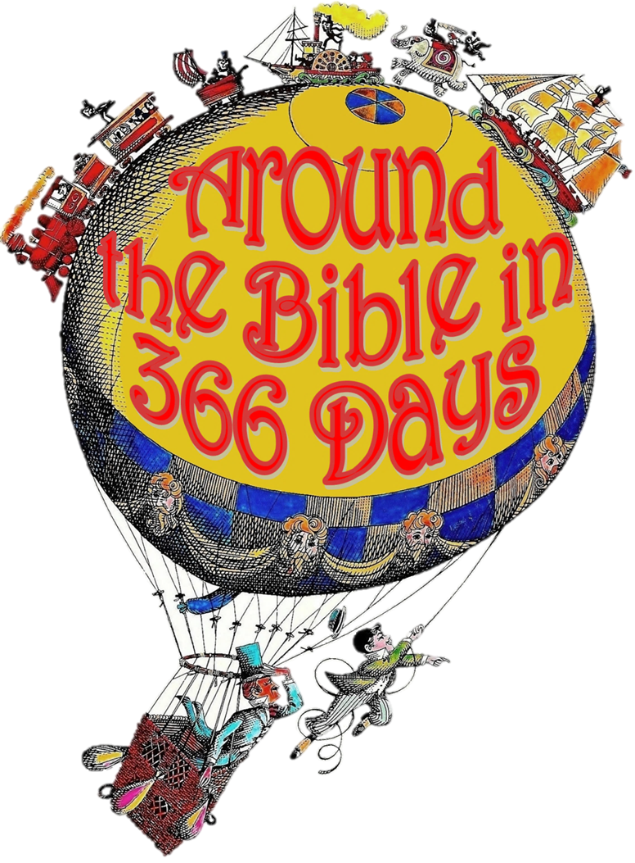
Week 16: He Delights in Us! (1 Kings 3 & 10)

Slide 3
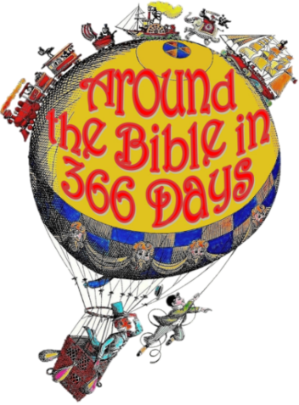
God delighted in David
2 Samuel 22:17-20
¹⁷ “He reached down from on high and took hold of me; He drew me out of deep waters. ¹⁸ He rescued me from my powerful enemy, from my foes, who were too strong for me. ¹⁹ They confronted me in the day of my disaster, but the Lord was my support. ²⁰ He brought me out into a spacious place; He rescued me because He delighted in me.”

Slide 4
God delighted in David
Deliverance
Psalm 22:8 “He trusts in the Lord,” they say, “let the Lord rescue him. Let Him deliver him, since he delights in Him.”

Slide 5
God delighted in Solomon
→ 1 Kings 3:5-15
1 Kings 10:9
“Praise be to the Lord your God, who has delighted in you and placed you on the throne of Israel. Because of the Lord’s eternal love for Israel, He has made you king to maintain justice and righteousness.”

Slide 6
He delights in us because…

Slide 7
He delights in us because…
Psalm 149:4
For the Lord takes delight in His people; He crowns the humble with victory.

Slide 8
He delights in us because…

Slide 9
He delights in us because…
Psalm 37:4
Take delight in the LORD, and He will give you the desires of your heart

Slide 10
He delights in us because…

Slide 11
He delights in us because…
Jeremiah 9:24
“But let the one who boasts boast about this: that they have the understanding to know Me, that I am the Lord, who exercises kindness, justice and righteousness on earth, for in these I delight,” declares the Lord.

Slide 12
He delights in us because…

Slide 13
He delights in us because…
Psalm 147:11
The Lord delights in those who fear Him, who put their hope in His unfailing love.

Slide 14
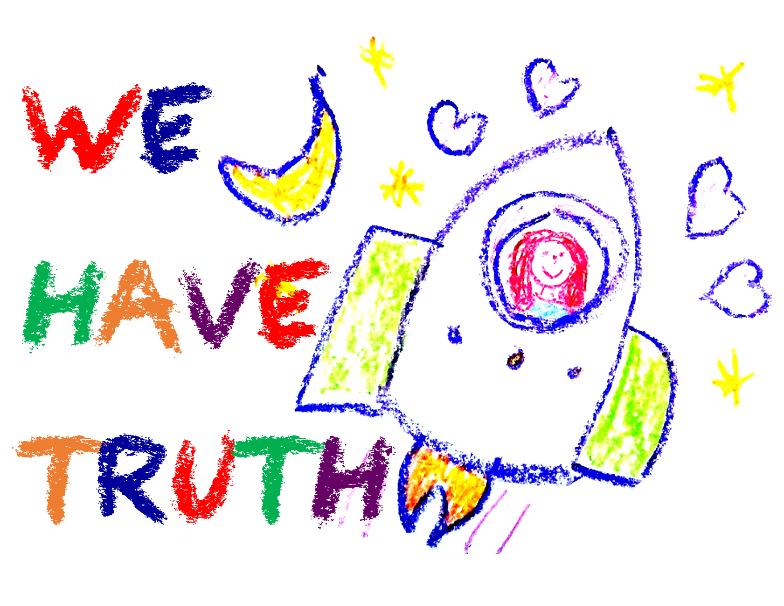
He delights in us because…

Slide 15
He delights in us because…
Proverbs 12:22
The Lord detests lying lips, but He delights in people who are trustworthy.

Slide 16
He delights in us because…

Slide 17
He delights in us because…
Proverbs 11:20 (NASB)
The perverse in heart are an abomination to the LORD, But the blameless in their walk are His delight.

Slide 18
He delights in us because…
Ephesians 2:10 (ESV)
For we are His workmanship, created in Christ Jesus for good works, which God prepared beforehand, that we should walk in them.
Philippians 2:13 (NLT)
For God is working in you, giving you the desire and the power to do what pleases Him.

Slide 19
Zephaniah 3:17
The LORD, your God is with you He is mighty to save. He will take great delight in you. He will quiet you with His love. He will rejoice over you with singing.

Slide 20
You are a delight, bringing great joy and satisfaction to the God who created you!

