Slide 2
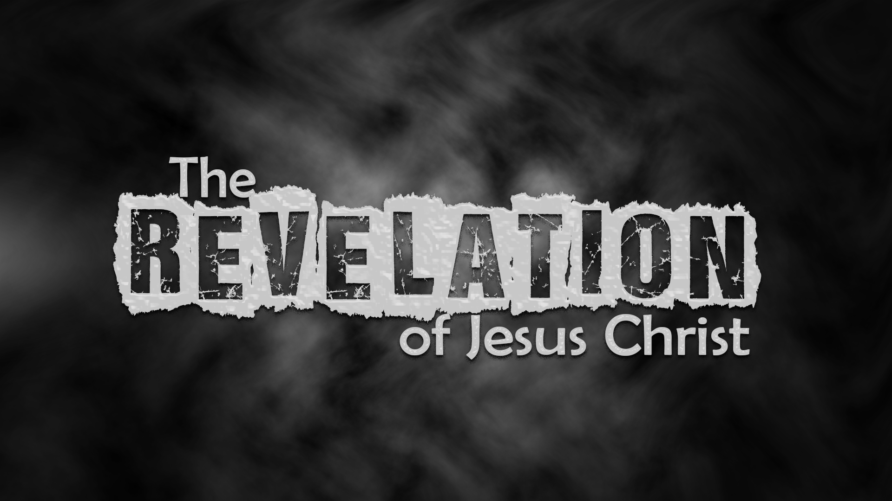

Slide 3

‘The will’ is not proof of ownership, but rather how
He will take possession

Slide 4
Seals- suffering for the church
Trumpets- God’s warnings for
the world
Bowls- the judgments of God
poured out

Slide 5
Week 12:
Four Seals, Four Horsemen (Revelation 6:1-8)

Slide 6
First seal; a white horse
The rider: holding a bow, wears a crown
Anti-Christ -OR- Christ?
Jesus Christ riding forth and conquering through the Gospel
Here’s why…

Slide 7
Jesus Christ conquering through the Gospel
Psalm 45:3-6
³ Gird your sword upon your side,
O mighty one; clothe yourself with splendor and majesty. ⁴ In your majesty ride forth victoriously in behalf of truth, humility and righteousness; let your
right hand display awesome deeds.

Slide 8
Jesus Christ conquering through the Gospel
Psalm 45:3-6
⁵ Let your sharp arrows pierce the hearts of the king’s enemies; let the nations fall beneath your feet. ⁶ Your throne, O God, will last for ever and ever; a scepter of justice will be the scepter of your kingdom.

Slide 9
Jesus Christ conquering through the Gospel
“White” always signifies purity in Rev.
Jesus has a crown (i.e. king, conqueror) (Rev. 14:14)
He has conquered!

Slide 10
­John 16:33 (NASB)
“In the world you have tribulation, but take courage; I have overcome (conquered) the world.”
­Revelation 3:21 (ESV)
“…as I also conquered and sat down
with my Father on his throne”

Slide 11
Revelation 5:5 (ESV)
“…behold, the Lion of the tribe of Judah, the Root of David, has conquered, so that he can open the scroll and its seven seals.”
­Revelation 6:2
“…and he rode out as a
conqueror bent on conquest.”

Slide 12
Jesus Christ conquering through the Gospel
“White” always signifies purity in Rev.
Jesus has a crown (i.e. king, conqueror) (Rev. 14:14)
He has conquered!
A parallel passage in the book of Revelation itself: Rev 19:11-16

Slide 13
The Gospel unleashed!
Matthew 24:14 (NASB)
"This gospel of the kingdom shall be preached in the whole world as a testimony to all the nations,
and then the end will come.”

Slide 14
Second seal; a red horse
The rider: holding a sword
War -OR- slaughter/persecution?
Sword- machaira
(used for sacrifice, not war)
Slaughter of believers/ persecution
Power to take peace

Slide 15
Matthew 10:34-39
³⁴ “Do not suppose that I have come to
bring peace to the earth. I did not come to bring peace, but a sword (machaira).
³⁵ For I have come to turn ‘a man against his father, a daughter against her mother…’ …
³⁸ Whoever does not take up their cross and follow me is not worthy of me. ³⁹ Whoever finds their life will lose it, and whoever loses their life for my sake will find it.”

Slide 16
The red horse always follows
the white horse: wherever
the Gospel is preached there
will be persecution

Slide 17
Matthew 5:10-12
¹⁰ Blessed are those who are persecuted because of righteousness, for theirs is the kingdom of heaven. ¹¹ “Blessed are you when people insult you, persecute you and falsely say all kinds of evil against you because of me. ¹² Rejoice and be glad, because great is your reward in heaven, for in the same way they persecuted the prophets who were before you.

Slide 18
Third seal; a black horse
The rider: holding a pair of scales
Famine -OR- economic hardship?
Famine is included in the fourth seal
In Scripture, to eat bread by weight is a condition of economic hardship
Another form of persecution

Slide 19
Third seal; a black horse
This will be visibly presented later- only those who take the mark of the beast can buy and sell (Rev. 13:17)
Second and third horse belong together- some believers are slaughtered; others suffer poverty and hardship

Slide 20
Fourth seal; a pale (sickly color) horse
Symbolic of disease and death
The rider: Death (Hades close behind)
Death in its most universal form
Affects both believers & unbelievers because they are both in the world
Power over a designated sphere was given to him- a fourth part, no more

Slide 21
Rooted in Ezekiel 14:21
“For this is what the Sovereign LORD says: How much worse will it be when I send against Jerusalem my four dreadful judgments—sword and famine and wild beasts and plague—to kill its men and their animals!”

Slide 22
Kill by sword: Not machaira (second seal) but rhomphaia- large sword meaning war!
In time of war, famine and plague often follows
Throughout the church age death reigns through various forms (war, famine, plague, wild beasts)

Slide 23
Summary of the four horsemen:
The rider on the white horse is Jesus Christ
The rider on the red horse represents
persecution of the Church through slaughter
The rider on the black horse represents persecution of the Church through injustice, economic hardship, and poverty
The rider on the pale horse represents Death: the sword (war), famine, plague, wild beasts

