Slide 3
Week 17:
Trumpets and Woes (Part 1) (Revelation 8:6-13)

Slide 4
Seals- suffering for the church
Trumpets- God’s warnings for the world
Bowls- the judgments of God poured out

Slide 5
Trumpets
Ezekiel 33:3 “and he sees the sword coming against the land and blows the trumpet to warn the people”
Joel 2:1 “Blow the trumpet in Zion; sound the alarm on my holy hill. Let all who live in the land tremble, for the day of the Lord is coming.”

Slide 6
Trumpets
Not a picture of total destruction
The purpose of the trumpet cycle is to warn the world through judgment and call people to repent
The first four trumpets affect man's environment; the last three will directly affect people

Slide 7
Trumpets
All are drawn from the plagues of Egypt in Exodus
God told Moses: “I have seen the affliction of my people in Egypt, and have heard their cry...and I have come down to deliver them (Ex. 3:7-8)
They do not harm believers

Slide 8
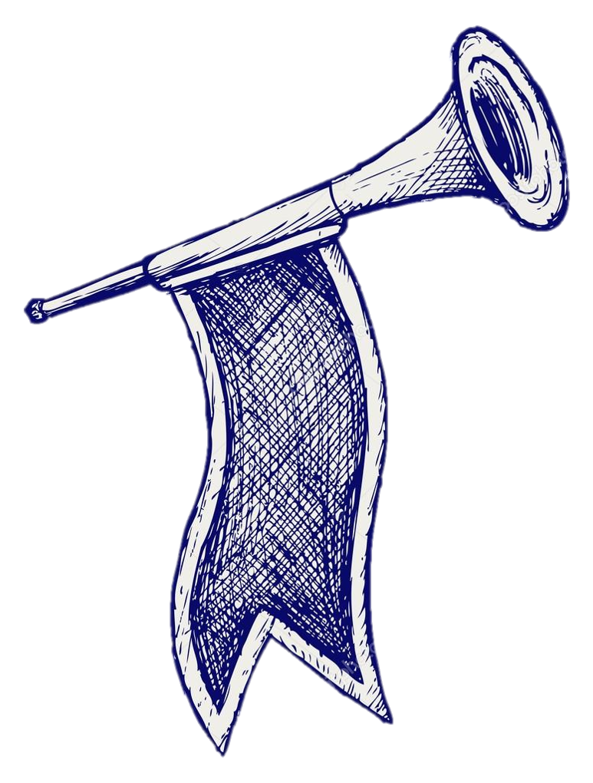
1st Trumpet- The earth stricken
Reminiscent of the 7th plague in Egypt- hail
The trumpets cannot follow the seals chronologically:
The 6th seal was total destruction of everything while the trumpets reveal only a third of everything is touched/destroyed

Slide 9
2nd Trumpet- The sea stricken
Reminiscent of the 1st plague- God turned the Nile into blood
“what looks like a mountain”
Symbolized the terror of God’s judgment upon the sea
“ships destroyed” may mean judgment directed against man’s commerce

Slide 10
3rd Trumpet- Fresh water stricken
Reminiscent of many of the plagues that affected their water source- the Nile
Wormwood was an herb which produced a bitter taste, if drank for a long time, it became lethal

Slide 11
3rd Trumpet- Fresh water stricken
Drawn from Jeremiah 9:15- “Therefore this is what the Lord Almighty, the God of Israel, says: “See, I will make this people eat bitter food and drink poisoned water.”
A metaphor for the bitterness of suffering resulting from judgment

Slide 12
4th Trumpet- The sky stricken
Again, these trumpets can’t be chronologically after the seals:
In the 6th seal the sun was blackened, the moon turned to blood, and the stars of the heaven fell to earth
Now they are only partially dimmed

Slide 13
Why?!
When God struck Egypt, he struck their gods in order to show them mercy- He continued to give them opportunity to repent

Slide 14
Revelation 9:20-21
²⁰ The rest of mankind who were not killed by these plagues still did not repent of the work of their hands; they did not stop worshiping demons, and idols of gold, silver, bronze, stone and wood—idols that cannot see or hear or walk. ²¹ Nor did they repent of their murders, their magic arts, their sexual immorality or their thefts.

Slide 15
Acts 3:19
Repent, then, and turn to God, so that your sins may be wiped out, that times of refreshing may come from the Lord.

