Slide 1
WEEK 8 ¤ LOVING THOSE WHO DON’T DESERVE IT
MATT 5:43-48

Slide 2
it is normal to love your family and friends
it is not normal to love your enemies

Slide 3
love and hate
Leviticus 19:18 “Do not seek revenge or bear a grudge against anyone among your people, but love your neighbor as yourself. I am the Lord.”
Jesus taught even one’s enemy is his neighbor

Slide 4
love and hate
Matt 5:44 (NKJV) But I say to you, love your enemies, bless those who curse you, do good to those who hate you, and pray for those who spitefully use you and persecute you.
bless here means to "speak well of" or "speak well to“
it is not easy to bless or… when they…

Slide 5
love and hate
Ephesians 6:12 (NASB)
For our struggle is not against flesh and blood, but against the rulers, against the powers, against the world forces of this darkness, against the spiritual forces of wickedness in the heavenly places.

Slide 6
love and hate
when Christians…
bless those who curse them
do good to those who hate them
pray for those who persecute them
…it presupposes forgiveness and a willingness to obey Jesus’ command

Slide 7
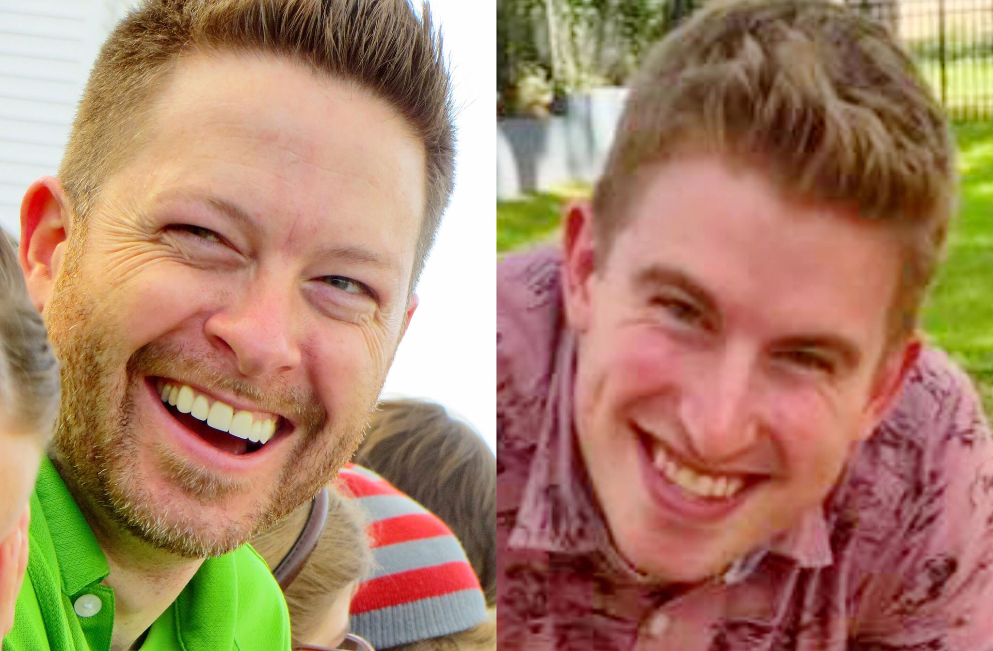
like Father like son

Slide 8
like Father like son
common grace vs. special (saving) grace
Romans 5:7-8 ⁷ Very rarely will anyone die for a righteous person, though for a good person someone might possibly dare to die. ⁸ But God demonstrates his own love for us in this: While we were still sinners, Christ died for us.

Slide 9
be indelible
“Don’t cross oceans for people who wouldn’t cross a puddle for you.”

Slide 10
Luke 6:32-36
³² “If you love those who love you, what credit is that to you? Even sinners love those who love them. ³³ And if you do good to those who are good to you, what credit is that to you? Even sinners do that. ³⁴ And if you lend to those from whom you expect repayment, what credit is that to you? Even sinners lend to sinners,

Slide 11
Luke 6:32-36
expecting to be repaid in full. ³⁵ But love your enemies, do good to them, and lend to them without expecting to get anything back. Then your reward will be great, and you will be children of the Most High, because he is kind to the ungrateful and wicked. ³⁶ Be merciful, just as your Father is merciful.

Slide 12
be indelible
“Don’t cross oceans for people who wouldn’t cross a puddle for you.”

Slide 13
be indelible
we should be sure that our attitude toward ALL people proves that our Christianity is genuine
one way to tell we are increasingly knowing our Father is when we react to others as He does!

