Slide 1
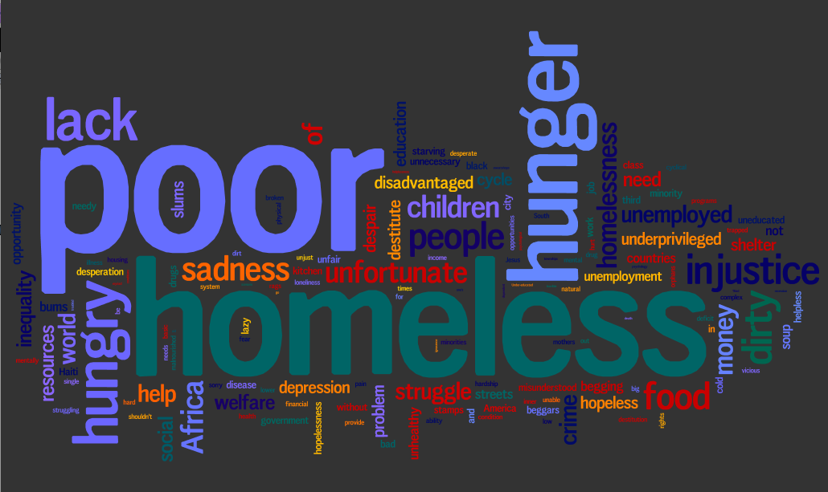
God’s heart for the needy

Slide 2
God’s heart for the needy
Proverbs
(14:31) Whoever oppresses the poor shows contempt for their Maker, but whoever is kind to the needy honors God.
(19:17) “He who is kind to the poor lends to the Lord, and he will reward him for what he has done.”
(21:13) “If a man shuts his ears to the cry of the poor, he too will cry out and not be answered.”

Slide 3
God’s heart for the needy
Matthew
25:31-46
Proverbs
Context:
Jesus is coming again!
Through parables and instructions He told His disciples to watch, wait, and be diligently prepared for His return
Judgment for those who are not

Slide 4
God’s heart for the needy
Matthew
25:31-46
Proverbs
The poor matter
greatly to the Lord!
Why the surprised reaction from those rewarded?
  They were not intentional acts of righteousness to gain access to the kingdom

Slide 5
God’s heart for the needy
Matthew
25:31-46
Proverbs
Instead, they
were external behavior (evidences) that flowed from truly being transformed by the Spirit
Kingdom life had been
produced in them
(not merely good deeds or works)

Slide 6
God’s heart for the needy
Matthew
25:31-46
Proverbs
Why the surprised
reaction from those told to depart?
They thought they were ‘okay’
They did not know the Lord’s heart and what matters to Him
No transformation life in them evidenced by it coming through them

Slide 7
God’s heart for the needy
Matthew
25:31-46
Proverbs
2:14-18
1 John
“If anyone has material possessions and sees his brother in need but has no pity on him, how can the love of God be him? Dear children, let us not love with words or tongue but with actions and in truth.”

