Slide 3
Americans and Depression
Depression afflicts 20% of the population of the United States.
15% of Americans are taking antidepressant medication (twice as many women suffer from depression as do men).
World Health Organization named depression the second most common cause of disability behind cardiovascular disease.
Onset of true depression increases sharply in the teenage years and peaks around 40.
In a congregation of around 200 about 50 will experience clinical depression at some point in their lives and at least 30 are taking antidepressant medication.
DEPRESSION IS A REALITY IN THE CHURCH

Slide 4
Depression – Week One
Depression Defined and Exposed

Slide 5
What is Depression?
Depression is a mood disorder that causes a persistent feeling of sadness and loss of interest. Also called major depressive disorder or clinical depression, it affects how you feel, think and behave and can lead to a variety of emotional and physical problems. You may have trouble doing normal day-to-day activities, and sometimes you may feel as if life isn't worth living.
Mayo Clinic

Slide 6
What is Depression?
A depressive disorder is an illness that involves the body, mood, and thoughts. It interferes with daily life, normal functioning, and causes pain for both the person with the disorder and those who care about him or her.
A depressive disorder is not the same as a passing blue mood. It is not a sign of personal weakness or a condition that can be willed or wished away. People with a depressive illness cannot merely "pull themselves together" and get better. Without treatment, symptoms can last for weeks, months, or years. Depression is a common but serious illness, and most people who experience it need treatment to get better. Appropriate treatment, however, can help most people who suffer from depression.
Psychology Today

Slide 7
Depression in the Bible
Psalm 31:9-12 – Be merciful to me, Lord, for I am in distress; my eyes grow weak with sorrow, my soul and body with grief. My life is consumed by anguish and my years by groaning; my strength fails because of my affliction, and my bones grow weak. Because of all my enemies, I am the utter contempt of my neighbors and an object of dread to my closest friends—those who see me on the street flee from me. I am forgotten as though I were dead; I have become like broken pottery.
Proverb 18:14 - The spirit of a man will sustain him in sickness, But who can bear a broken spirit?

Slide 8
Depression in the Bible
Biblical characters who suffered through bouts of depression:
Jonah – In the belly of the great fish
Job – In the depth of his loss and pain
David – Persecution from Saul and his own sin
Elijah – After his triumph over the prophets of Baal
Jeremiah – The captivity of Jerusalem

Slide 9
Causes of Depression
Genetic
Research supports depression can be handed down generationally through our DNA (genes)
Chemical
Chemical imbalances in the brain

Slide 10
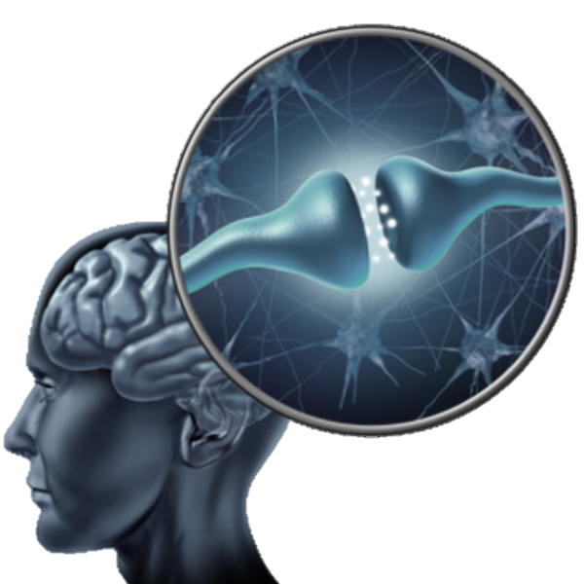
The Chemistry of the Brain
Brain communicates with itself by sending chemicals out from one neuron (nerve cell) to another
These chemicals are called ‘neuro-transmitters’
All feelings and emotions are communicated this way.
The space between neurons are called ‘Synapses’
Neurons have receptors that only receive certain neuro-transmitters from other neurons
When they don’t work right – mental disorders result
Antidepressant medications seek to address this chemical imbalance that cause the mental disorder

Slide 11
Causes of Depression
Genetic
Research supports depression can be handed down generationally in our DNA (genes)
Chemical
Chemical imbalances in the brain
Environment - Social
Stresses and trauma from our surrounding environment
Cognitive
Mental abuse and or wrong thinking
Cognitive Behavioral Therapy
Spiritual
Oppression and possession
Stress!

Slide 12
Stress & Depression
“Everyday life in 21st-century American society can be tough. The constant pressure of negotiating increasingly complex and sometimes harsh social realities takes a toll. Depression is in part a withdrawal by the weary into an inner world, an attempt to create a protective cocoon against real-world demands. Whatever personal factors contribute to an individual's depression, the broader epidemic suggests that living in disordered social conditions makes things worse.”
Dr. Dan Blazer (Christianity Today – “The Depression Epidemic”)

Slide 13
Environmental and Cognitive Causes of Stress
Death or serious illness of a friend or family member
Loss of love or attention from a friend or family member
Breakup of a romantic relationship
Family problems, especially parents' divorce
Isolation/loneliness
Rejection or teasing
Physical, verbal, and/or sexual abuse
Substance abuse
Hospitalization, especially for a chronic illness

Slide 14
Christian Myths About Depression
“Depression is solely a spiritual issue and a sign of spiritual weakness. If someone is close enough to God they would not suffer from depression.”
Some of the most powerful men and women of God over the history of Christianity suffered from depression – Charles Spurgeon
“Taking drugs to deal with depression is a lack of faith.”
Antidepressants can give the depressed person relief so they can deal with causes and seek long term solutions
“Everybody gets down. You just have to endure to the end and trust God.”
We are called to endure through trials. Depression goes far beyond a short trial most Christians experience.

Slide 15
“Do I suffer from depression?”

Slide 16
Signs of Depression
Persistent sad or anxious mood
Anger, restlessness, irritability
Sleeplessness, or not enough sleep
Reduced appetite & weight loss, or increased appetite and weight gain
Loss of pleasure and interest in things once enjoyed
Persistent physical symptoms that don't respond to treatment (such as chronic pain or digestive disorders)
Difficulty concentrating, remembering or making decisions
Fatigue or loss of energy
Feeling guilty, hopeless or worthless
Thoughts of suicide or death
No Hope

Slide 17
“Where do I go from here?”

Slide 18
Dealing with Depression
Acknowledge
To yourself, to God and to others you trust
Seek Help
From trusted, knowledgeable friends and professionals
Important for correct diagnosis of the cause, determination of a treatment plan
Hold onto Truth
Hope comes from truth

Slide 19
God Gives Hope
Psalm 34:18 – The Lord is close to the brokenhearted and saves those who are crushed in spirit.
Jeremiah 29:11-12 – “For I know the plans I have for you,” declares the Lord, “plans to prosper you and not to harm you, plans to give you hope and a future.”
The word of God and the truth it contains is one of the most powerful tools to combating the hopelessness of depression.
Hope!

