Slide 3
Depression Part 1 - Stats
Depression afflicts 20% of the population of the United States.
15% of Americans are taking antidepressant medication (twice as many women suffer from depression as do men).
In a congregation of around 200 about 50 will experience clinical depression at some point in their lives and at least 30 are taking antidepressant medication.
DEPRESSION IS A REALITY IN THE CHURCH

Slide 4
Depression Part 1
What is Depression?
Depression is a mood disorder that causes a persistent feeling of sadness and loss of interest. Also called major depressive disorder or clinical depression, it affects how you feel, think and behave and can lead to a variety of emotional and physical problems. You may have trouble doing normal day-to-day activities, and sometimes you may feel as if life isn't worth living.
Mayo Clinic

Slide 5
Depression Part 1
5 Causes
Genetic, Chemical, Environment – Social, Cognitive, Spiritual
Signs of Depression
Persistent sad or anxious mood, Anger, restlessness, irritability, Sleeplessness, Changes in Appetite, Fatigue, Feeling hopeless or worthless, Thoughts of Suicide
Myths in the Church About Depress
Not spiritual enough, suck it up, taking antidepressants is a lack of faith

Slide 6
Depression Part 1
How to Deal with Depression
Acknowledge
Seek Help
Hold onto Truth
Psalm 34:18 – The Lord is close to the brokenhearted and saves those who are crushed in spirit.
Jeremiah 29:11-12 – “For I know the plans I have for you,” declares the Lord, “plans to prosper you and not to harm you, plans to give you hope and a future.”
Hope!

Slide 7
Depression – Week Two
How To Help

Slide 8
Why We Must Help
Galatians 6:2 – Bear one another’s burdens, and thereby fulfill the law of Christ.
If we turn a blind eye to the believer struggling with depression we are failing to fulfill the law of Christ.
1 John 3:17 - But whoever has the world’s goods, and sees his brother in need and closes his heart against him, how does the love of God abide in him?

Slide 9
The Initial Response
Frustration – Depressed person not pulling their weight
Anger – Depressed person’s behavior can cause conflict which results in anger
Confusion – Don’t understand the limitations of the depressed person and what they can and can’t do
Denial – Pretend it really isn’t depression
Anxiety – Wondering if they will ever get better
Guilt – Were we a cause or THE cause?

Slide 10
How Can I Help?
Recognize the Symptoms – Don’t expect the depressed person to self-diagnose.
Commitment to Healing – Depression = hopelessness and aloneness. ‘We are in this together’

Slide 11
Testimony ‘Depression Sucks’ Koren Obispo

Slide 12
How Can I Help?
Recognize the Symptoms – Don’t expect the depressed person to self-diagnose.
Commitment to Healing – Depression = hopelessness and aloneness. ‘We are in this together’
Be There and Listen – Most common advice given by those suffering from depression

Slide 13
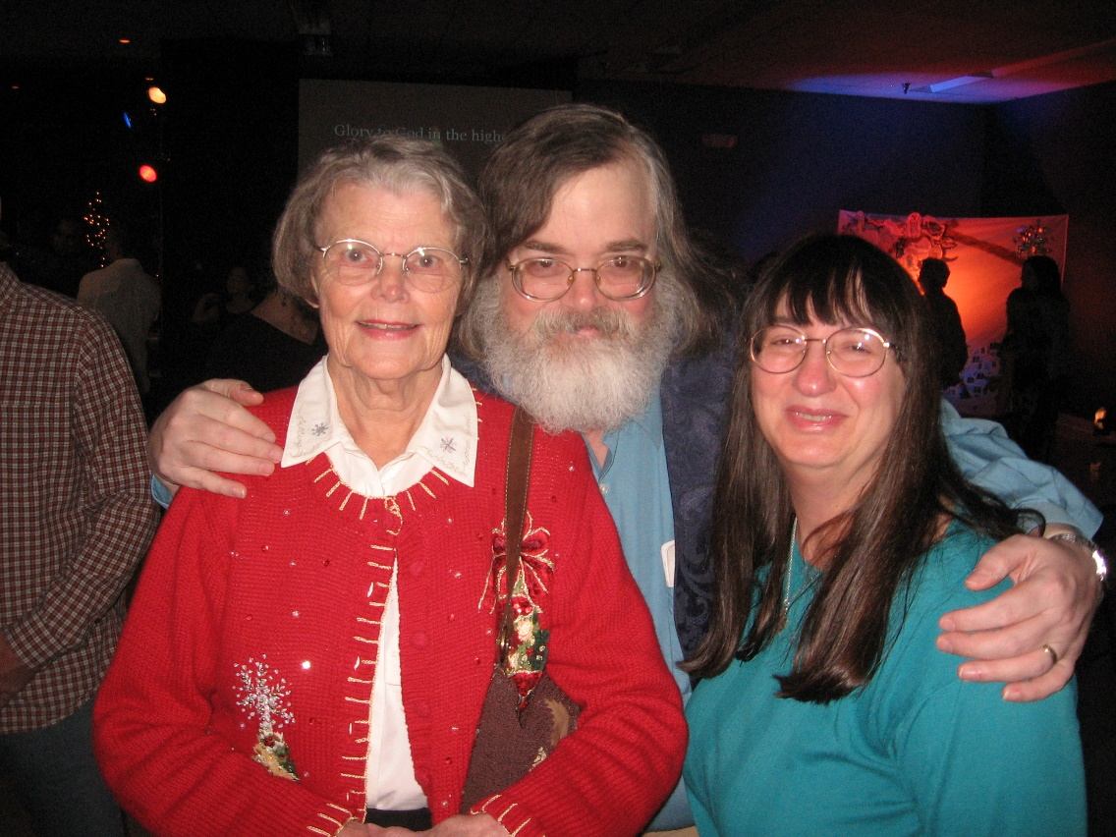
Testimony ‘A Depressing Little Essay’ Gilbert Head

Slide 14
How Can I Help?
Recognize the Symptoms – Don’t expect the depressed person to self-diagnose.
Commitment to Healing – Depression = hopelessness and aloneness. ‘We are in this together’
Be There and Listen – Most common advice given by those suffering from depression
Encourage Them to Seek Help – You may need to facilitate this as they may not be able to by themselves.
Help them Get Physically Active – Exercise helps
Love them Unconditionally – They may say things that hurt you but love them anyway

Slide 15
Where Do We Go From Here?
1 Peter 3:8 - Finally, all of you, be like-minded, be sympathetic, love one another, be compassionate and humble

Slide 16
Depression Resources
www.wingofmadness.com
www.helphorizons.com
www.healingwell.com
www.samhsa.com
www.power2u.org
www.mhselfhelp.org
www.stigmanet.net
www.ifred.org
www.christianhelpfordepression.org

Slide 17
Depression Resources
I’m Not Supposed to Feel Like This – Chris Williams
Dealing with Depression – Sarah Collins and Jayne Haynes
A Practical Workbook for the Depressed Christian - Dr. John Lockley
Overcoming Spiritual Depression – Arie Elshout
Depression: Looking Up From the Stubborn Darkness – Ed Welch
D is for Depression – Michael Lawson
Spiritual Depression: It’s Causes and Cure – D. Martyn Lloyd-Jones
Broken Minds – Steve and Robyn Bloem
Christians Get Depressed Too: Hope and Help for the Depressed – David Murray
When The Darkness Will Not Life – John Piper

