Slide 2

Divorce - Week Two
Parents & Children

Slide 3
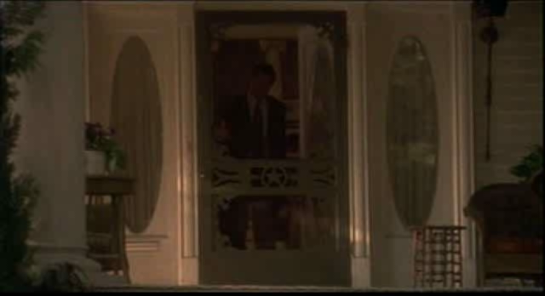

Slide 4

Malachi 2:13-16 NLT
¹³ Here is another thing you do. You cover the Lord’s altar with tears, weeping and groaning because he pays no attention to your offerings and doesn’t accept them with pleasure. ¹⁴ You cry out, “Why doesn’t the Lord accept my worship?” I’ll tell you why! Because the Lord witnessed the vows you and your wife made when you were young. But you have been unfaithful to her, though she remained your faithful partner, the wife of your marriage vows.

Slide 5
Malachi 2:13-16 NLT
¹⁵ Didn’t the Lord make you one with your wife? In body and spirit you are his. And what does he want? Godly children from your union. So guard your heart; remain loyal to the wife of your youth. ¹⁶ “For I hate divorce!” says the Lord, the God of Israel. “To divorce your wife is to overwhelm her with cruelty,” says the Lord of Heaven’s Armies. “So guard your heart; do not be unfaithful to your wife.”

Slide 6
Modern day fatherless & orphans
James 1:27
Religion that God our Father accepts as pure and faultless is this: to look after orphans and widows in their distress and to keep oneself from being polluted by the world.

Slide 7
Modern day fatherless & orphans
Psalm 68:5-6
⁵ A father to the fatherless, a defender of widows, is God in his holy dwelling.
⁶ God gives lonely people a family. He sets prisoners free, and they go out singing…

Slide 8
Modern day fatherless & orphans
Psalm 10:14
But you, God, see the trouble of the afflicted; you consider their grief and take it in hand. The victims commit themselves to you; you are the helper of the fatherless.

Slide 9
Modern day fatherless & orphans
Their lives are filled with changes that they did not ask for:
new houses and neighborhoods
new friends and schools
new schedules
new men and women coming in and out of their parents’ lives
new step-parent
new siblings
reduced role of grandparents

Slide 10
Modern day fatherless & orphans
Children of Divorce must be encouraged to go to God and ask that He would meet their physical, emotional and spiritual needs.
John 14:16-18 ¹⁶ And I will ask the Father, and he will give you another Counselor to be with you forever-- ¹⁷ the Spirit of truth… he lives with you and will be in you. ¹⁸ I will not leave you as orphans; I will come to you.

Slide 11
Modern day fatherless & orphans
Luke 11:11-13
¹¹ "Which of you fathers, if your son asks for a fish, will give him a snake instead? ¹² Or if he asks for an egg, will give him a scorpion? ¹³ If you then, though you are evil, know how to give good gifts to your children, how much more will your Father in heaven give the Holy Spirit to those who ask him!"

Slide 12
Hedie Wiens
Wheat Among the Tares

Slide 13
Respond
Malachi 2:15-16 NLT
And what does he want? Godly children from your union. So guard your heart; remain loyal to the wife of your youth. “For I hate divorce!” says the Lord, the God of Israel. “To divorce your wife is to overwhelm her with cruelty,” says the Lord of Heaven’s Armies.
Not an easy out!
Seek counsel
Seek God’s face

