Slide 2

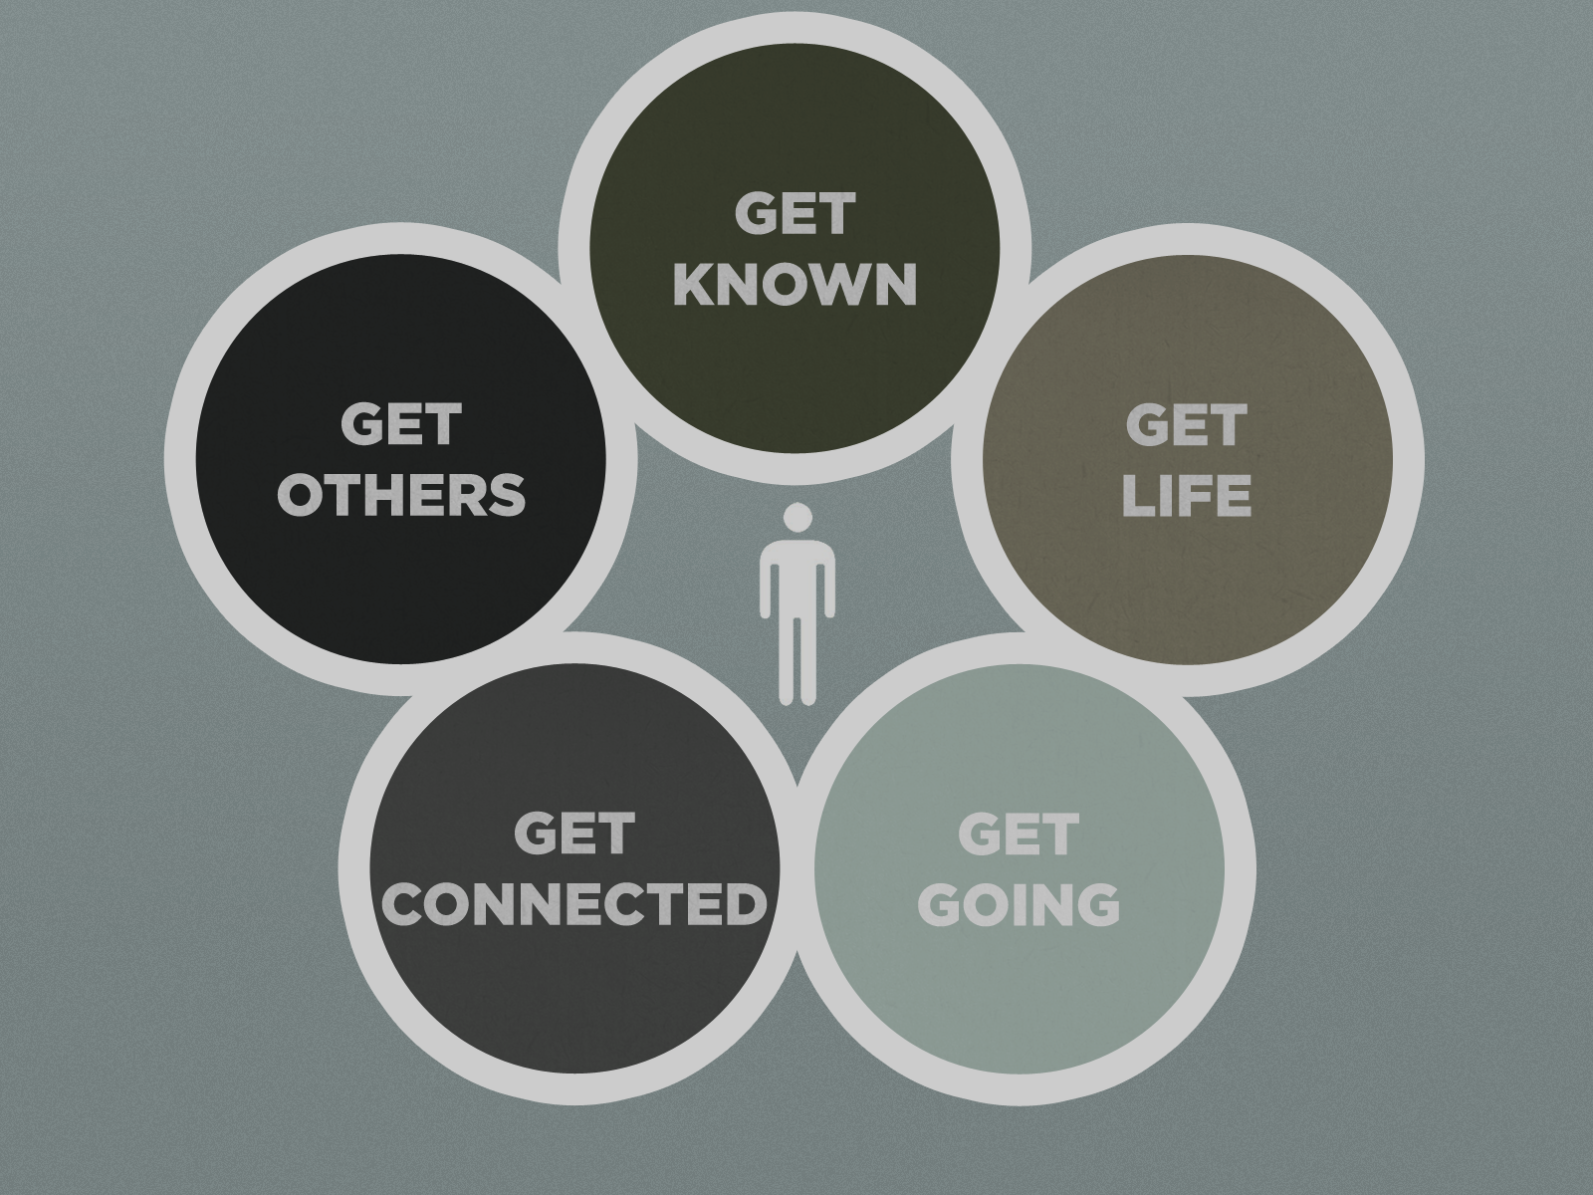

Slide 3
Repairing Your Altar
1 Kings 18:16-40

Slide 4
Your Altar
In the patriarchal period altars were markers of place, commemorating an encounter with God, or physical signs of habitation
“Altar” is distinct from “temple.” Whereas temple implies a building or roofed structure, altar implies an open structure

Slide 5
Your Altar
Altars are places where God and man meet and interact
Altars are places of offering, sacrifice, exchange, communication, and surrender
Place of internal and external worship
God responds actively to altar activity

Slide 6
1 Kings 16:29-18:15
Ahab
Jezebel
Deuteronomy 6:13-15
¹³ Fear the Lord your God, serve him only and take your oaths in his name. ¹⁴ Do not follow other gods, the gods of the peoples around you; ¹⁵ for the Lord your God, who is among you, is a jealous God…

Slide 7
Baal
The word Baal means “lord”
Baal was a fertility god who was believed to enable the earth to produce crops and people to produce children
The Canaanites worshiped Baal as the sun god and as the storm god, who defeated enemies and produced crops

Slide 8
Baal
Baal worship was rooted in sensuality
The priests of Baal appealed to their god in rites of wild abandon which included loud, ecstatic cries and self-inflicted injury
Different regions worshiped Baal in different ways, and Baal proved to be a highly adaptable god

Slide 9
1 Kings 16:29-18:15
Ahab
Jezebel
Elijah
Obadiah

Slide 10
1 Kings 18:16-40

Slide 11
^{Verse 21} How long will you waver between two opinions?

Slide 12
^{Verse 30} He repaired the altar of the Lord which was in ruins

Slide 13
Turn to Revelation 2:1-5

Slide 14
^{Verse 38} Then the fire of the Lord fell…

