Slide 3
1 John 1 (NIRV)
¹ Here is what we announce to everyone about the Word of life. He was already here from the beginning. We have heard him. We have seen him with our eyes. We have looked at him. Our hands have touched him.

Slide 4
1 John 1 (NIRV)
² That life has appeared. We have seen him. We give witness about him. And we announce to you that same eternal life. He was already with the Father. He has appeared to us.

Slide 5
When Jesus went about announcing the “Gospel of the Kingdom,” He was inviting fragmented humanity to enter into something it could not experience elsewhere.

Slide 6
1 John 1 (NIRV)
³ We announce to you what we have seen and heard. We do it so you can share life together with us. And we share life with the Father and with his Son, Jesus Christ. ⁴ We are writing this to make our joy complete.

Slide 7
1 John 1 (NIRV)
⁵ Here is the message we have heard from him and announce to you. God is light. There is no darkness in him at all. ⁶ Suppose we say that we share life with God but still walk in the darkness. Then we are lying. We are not living by the truth.

Slide 8
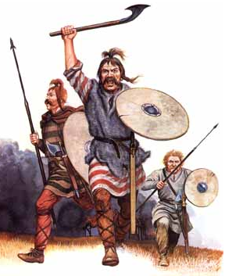

Slide 9
1 John 1 (NIRV)
⁷ But suppose we walk in the light, just as he is in the light. Then we share life with one another. And the blood of Jesus, his Son, makes us pure from all sin.

Slide 10
Koinonia
The Greek word for fellowship comes from a root meaning common or shared. So fellowship means common participation and partnership in something either by giving what you have to the other person or receiving what he or she has.

Slide 11
Give and Take
As iron sharpens iron, so one person sharpens another.
Proverbs 27:17
“One can acquire anything in solitude except character.” ~Unknown

Slide 12
Give and Take
“Sanctification is usually a corporate process in the New Testament. It is something that happens in community.” ~Wayne Grudem

Slide 13
Ecclesiastes 4:9-12

Slide 14
3 Fundamental Needs
transcendence (the need to connect with the Creator)
significance (the need to have a purpose in life and do something meaningful)
community (the need to connect with others through deeply satisfying relationships)

Slide 15
Life Groups…
…enable the entering into one another’s life and sharing the life of Christ together; authentic community.
…are our primary environment for fellowship, developing deep relationships, and discipleship. It’s how we do church!

