Slide 2
Some See Giants! Numbers 13

Slide 3
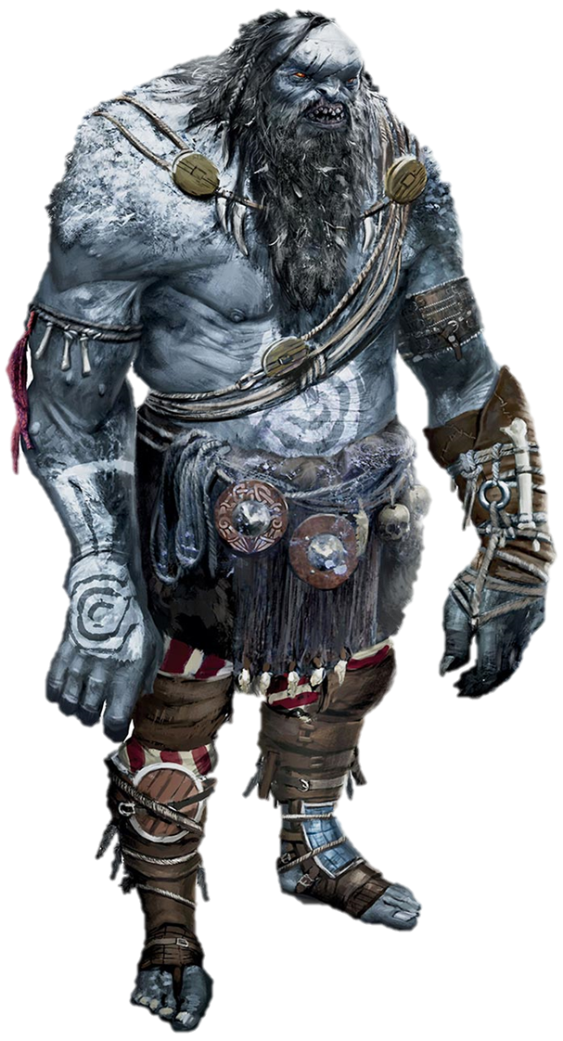
Numbers 13:33
“We saw the Nephilim there… We seemed like grasshoppers in our own eyes, and we looked the same to them.”

Slide 4
Our Giant…
Obstacles & Circumstances
Sin
Great Need
Worry & Fear
Limitations

Slide 5
How to face our Giant…

Slide 6
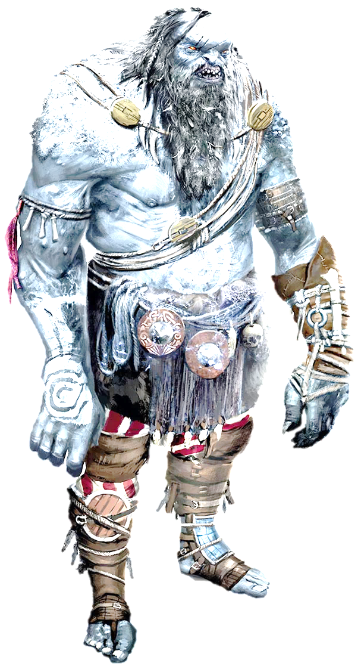
How to face our Giant…
We need a spiritual perspective

Slide 7
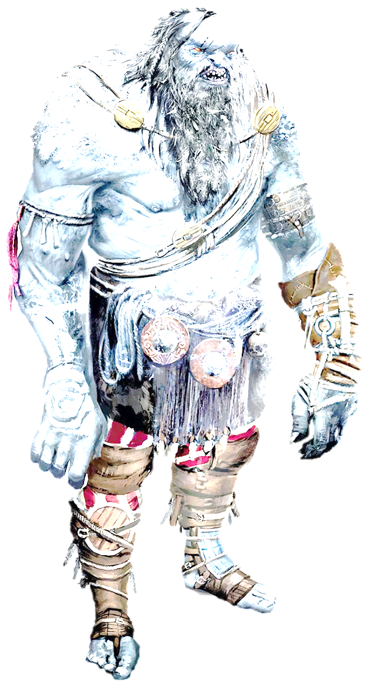
How to face our Giant…
We need a spiritual perspective
We need to see God as bigger

Slide 8
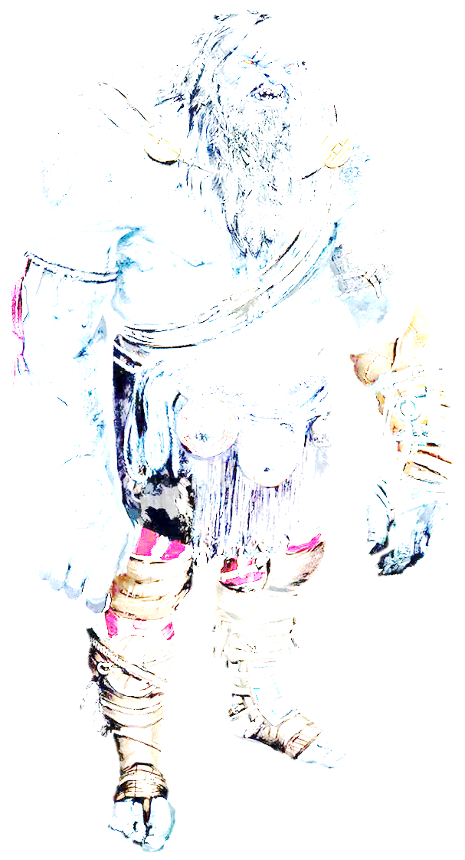
How to face our Giant…
We need a spiritual perspective
We need to see God as bigger
We need faith with legs

Slide 9
Joshua 14:7-8
⁷ I was forty years old when Moses the servant of the Lord sent me from Kadesh Barnea to explore the land. And I brought him back a report according to my convictions, ⁸ but my brothers who went up with me made the hearts of the people melt with fear. I, however, followed the Lord my God wholeheartedly.

Slide 10
How to face our Giant…
We need a spiritual perspective
We need to see God as bigger
We need faith with legs

Slide 11
How to face our Giant…
We need a spiritual perspective
We need to see God as bigger
We need faith with legs
We need to follow the Lord wholeheartedly

Slide 12
How to face our Giant…
2 Corinthians 12:9a
But he said to me, “My grace is sufficient for you, for my power is made perfect in weakness.”

