Slide 2
Top 10 Things You Shouldn’t Say Without Thinking…
“Of course, bring the kids.”
“Call me any time at all.”
“I will blow up this plane if I don't get bumped to first class!”
“Aw, look at the cute kitten.”
“We have plenty of room.”

Slide 3
Top 10 Things You Shouldn’t Say Without Thinking…
“Does this dress make me look fat?”
“Do you need help with anything?”
A preacher saying, “In closing…”
“Does this rag smell like chloroform to you?”
“Over my dead body, you will!”

Slide 4
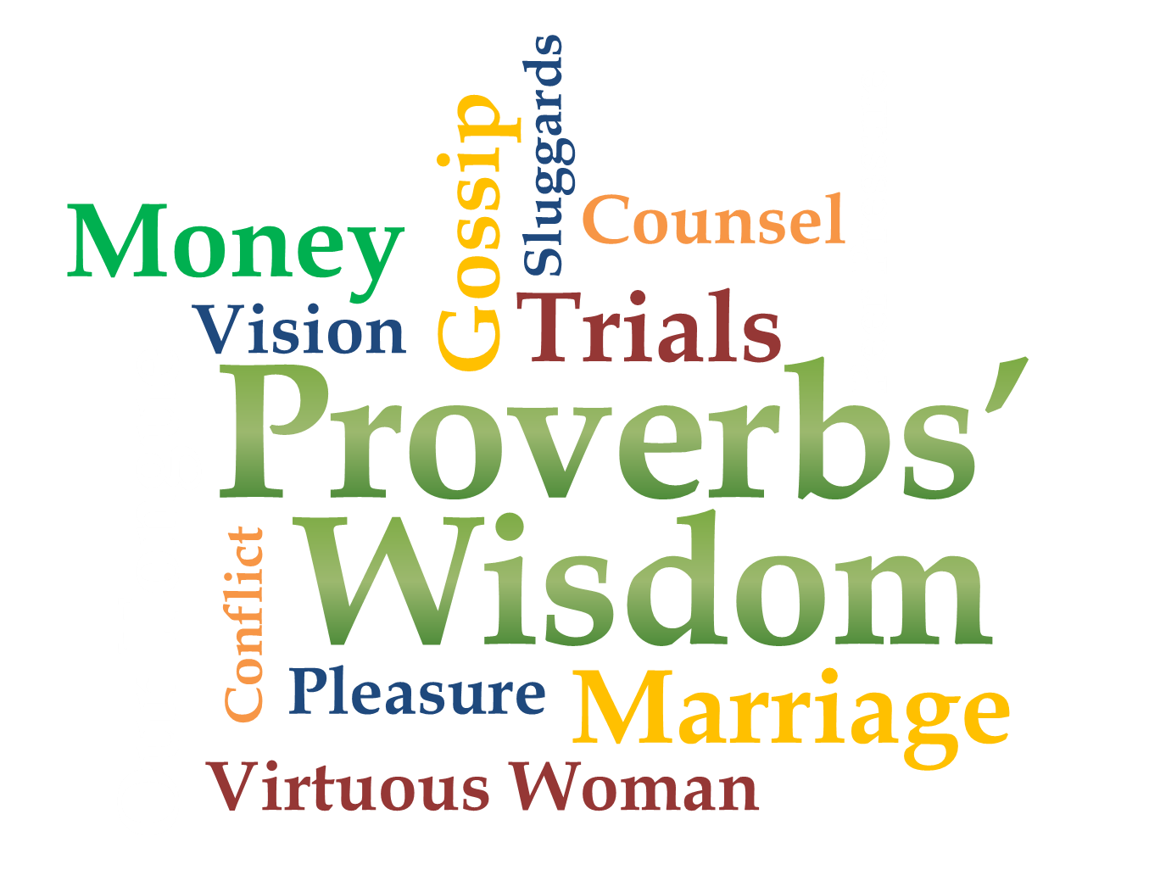
Week 1
Our
Tongue

Slide 5
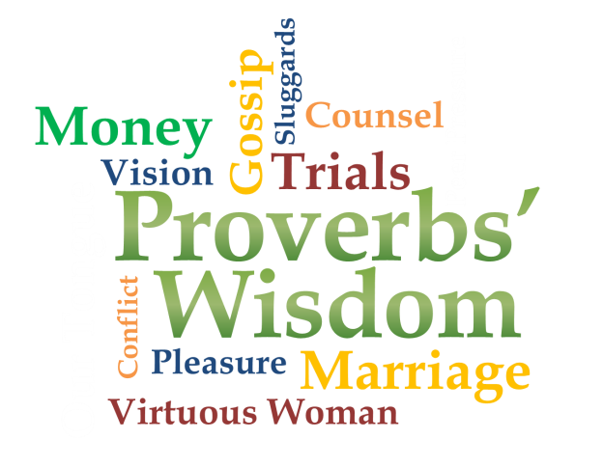
Words Get Us Into Trouble
Proverbs 18:2
A fool finds no pleasure in understanding but delights in airing his own opinions.
Proverbs 20:25 (NLT)
Don’t trap yourself by making a rash promise to God and only later counting the cost.

Slide 6
Words Get Us Into Trouble
Proverbs 15:28
The heart of the righteous weighs its answers, but the mouth of the wicked gushes evil.
Proverbs 18:13
He who answers before listening-- that is his folly and his shame.

Slide 7
Power in the Tongue
Proverbs 15:1-4
¹ A gentle answer turns away wrath, but a harsh word stirs up anger. ² The tongue of the wise commends knowledge, but the mouth of the fool gushes folly. ³ The eyes of the LORD are everywhere,

Slide 8
Power in the Tongue
Proverbs 15:1-4
…keeping watch on the wicked and the good. ⁴ The tongue that brings healing is a tree of life, but a deceitful tongue crushes the spirit.

Slide 9
Power in the Tongue
Proverbs 12:18
Reckless words pierce like a sword, but the tongue of the wise brings healing.

Slide 10
Power in the Tongue
Proverbs 18:6-7
⁶ A fool's lips bring him strife, and his mouth invites a beating. ⁷ A fool's mouth is his undoing, and his lips are a snare to his soul.

Slide 11
Power in the Tongue
Proverbs 18:20-21
²⁰ From the fruit of his mouth a man's stomach is filled; with the harvest from his lips he is satisfied. ²¹ The tongue has the power of life and death, and those who love it will eat its fruit.

Slide 12
Control Your Tongue
Proverbs 10:19
When words are many, sin is not absent, but he who holds his tongue is wise.
Proverbs 21:23
He who guards his mouth and his tongue keeps himself from calamity.

Slide 13
Control Your Tongue
Proverbs 17:27-28
²⁷ A man of knowledge uses words with restraint, and a man of understanding is even-tempered. ²⁸ Even a fool is thought wise if he keeps silent, and discerning if he holds his tongue.

Slide 14
Loosen Your Tongue
Proverbs 12:25
An anxious heart weighs a man down, but a kind word cheers him up.
Proverbs 15:23
A man finds joy in giving an apt reply-- and how good is a timely word!

Slide 15
Loosen Your Tongue
Proverbs 27:5
An open rebuke is better than hidden love!
Proverbs 20:15
Gold there is, and rubies in abundance, but lips that speak knowledge are a rare jewel.

Slide 16
Words Start in the Heart
Matthew 12:34b (NKJV)
For out of the abundance of the heart the mouth speaks.
Proverbs 16:1
To man belong the plans of the heart, but from the LORD comes the reply of the tongue.

Slide 17
Our Prayer for Our Tongue
Forgiveness
Deliverance
Restoration
Redemption
Freedom
Opportunity
Fruit

