Slide 2
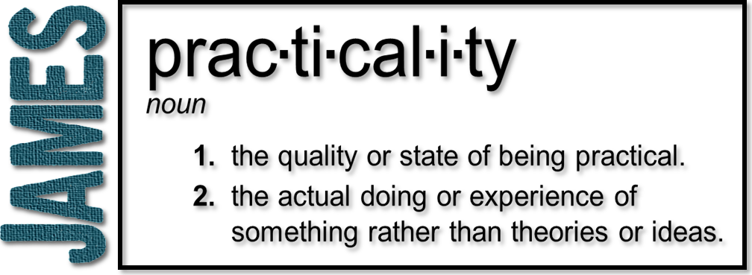
Week 1: Testing of Your Faith
(James 1:1-4)

Slide 3
James 1:1-4 (NIV)
¹ James, a servant of God and of the Lord Jesus Christ, To the twelve tribes scattered among the nations: Greetings. ² Consider it pure joy, my brothers , whenever you face trials of many kinds, ³ because you know that the testing of your faith produces perseverance. ⁴ Perseverance must finish its work so that you may be mature and complete, not lacking anything.

Slide 4
7 Concepts or Themes
1
2
¹ James, a servant of God and of the Lord Jesus Christ, To the twelve tribes scattered among the nations: Greetings. ² Consider it pure joy, my brothers, whenever you face trials of many kinds, ³ because you know that the testing of your faith produces perseverance. ⁴ Perseverance must finish its work so that you may be mature and complete, not lacking anything.
3
4
5
6
7

Slide 5
7 Concepts or Themes
1
¹ James…
Had an experience with the resurrected Jesus! (1 Cor 15:7)
Had “camel knees”
Leader of the Jerusalem church (Acts 12,15)
Martyred in 62 A.D.

Slide 6
7 Concepts or Themes
2
¹ James, a servant of God and of the Lord Jesus Christ…
His declaration—a bond-slave (doulos)
A slave who when set free says, “I love my master and do not want to leave you”

Slide 7
Philippians 2:5-8 (NIV)
⁵ In your relationships with one another, have the same mindset as Christ Jesus:
⁶ Who, being in very nature God, did not consider equality with God something to be used to his own advantage; ⁷ rather, he made himself nothing by taking the very nature of a doulos, being made in human likeness.
⁸ And being found in appearance as a man, he humbled himself by becoming obedient to death—even death on a cross!

Slide 8
7 Concepts or Themes
3
¹…To the twelve tribes scattered among the nations: Greetings.
Written to those scattered during the persecution (Acts 8:1-4)

Slide 9
Acts 8:1-4 (NIV)
¹ ... On that day a great persecution broke out against the church at Jerusalem, and all except the apostles were scattered throughout Judea and Samaria. ² Godly men buried Stephen and mourned deeply for him. ³ But Saul began to destroy the church. Going from house to house, he dragged off men and women and put them in prison. ⁴ Those who had been scattered preached the word wherever they went.

Slide 10
7 Concepts or Themes
² Consider it pure joy, my brothers, whenever you face trials of many kinds…
Why do we have trials?
Why does God allow trials in our lives?
How are we to respond to them?
Trials are inevitable
4

Slide 11
Psalm 42:11 (NASB)
Why are you in despair, O my soul?
And why have you become disturbed within me?
Hope in God, for I shall yet praise Him, The help of my countenance and my God.

Slide 12
Luke 22:31-32 (NIV)
“Simon, Simon, Satan has asked to sift all of you as wheat. But I have prayed for you, Simon, that your faith may not fail. And when you have turned back, strengthen your brothers.”

Slide 13
God will do something through you when you first allow Him to do something in you!

Slide 14
7 Concepts or Themes
5
³ because you know that the testing of your faith…
“Now faith is confidence in what we hope for and assurance about what we do not see.” (Hebrews 11:1 NIV)
Faith = reliance on God
“And without faith it is impossible to please God…” (Hebrews 11:6 NIV)

Slide 15
7 Concepts or Themes
5
³ because you know that the testing of your faith…
Faith is tested through trials, not produced by trials
Isaiah 48:10 (NIV)
“See, I have refined you, but not as silver; I have tested you in the furnace of affliction.”

Slide 16
7 Concepts or Themes
5
³ because you know that the testing of your faith…
James 1:3 (The Message)
You know that under pressure, your faith-life is forced into the open and shows its true colors.

Slide 17
7 Concepts or Themes
³ because you know that the testing of your faith produces perseverance.
This word does not describe a passive waiting but an active endurance
“To remain under”
6

Slide 18
7 Concepts or Themes
⁴ Perseverance must finish its work so that you may be mature and complete, not lacking anything.
Development of character within us
James 1:12 (NIV) Blessed is the one who perseveres under trial because, having stood the test, that person will receive the crown of life that the Lord has promised to those who love him.
7

Slide 19
