Slide 2
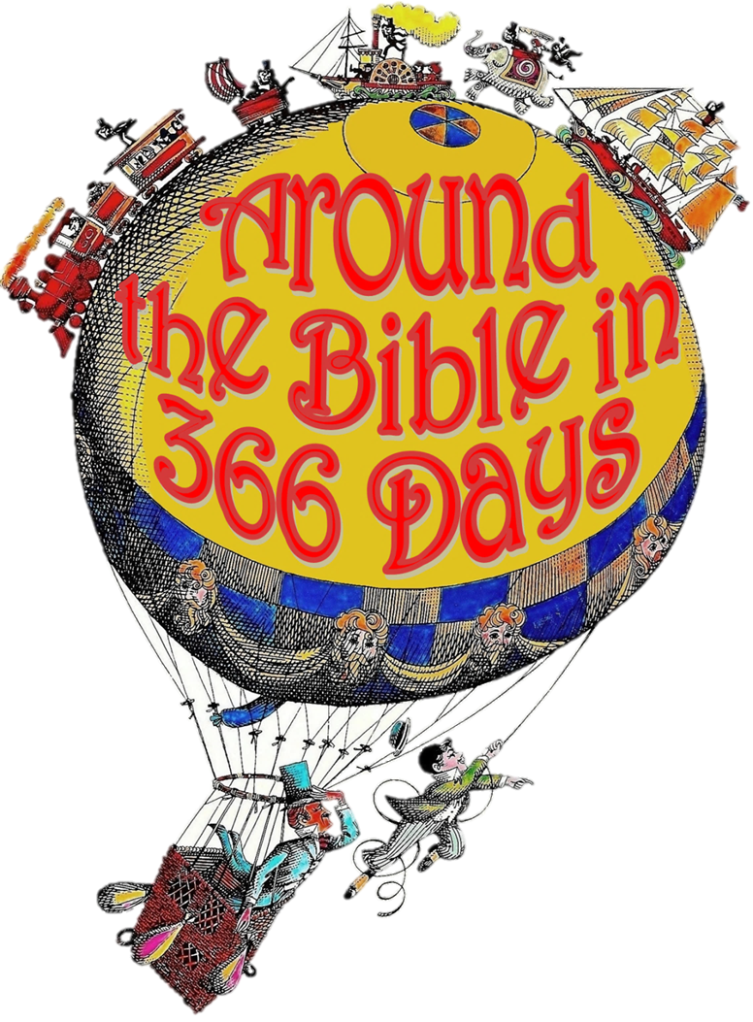
Week 1: The Transformative Word of God

Slide 3
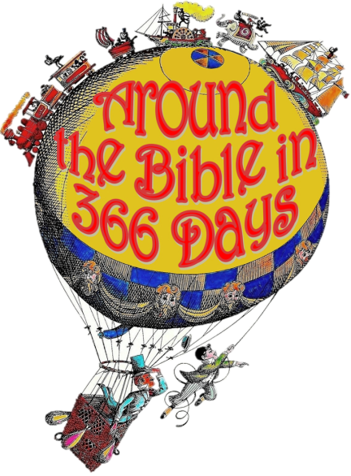
The Word of God
The foundation of any healthy relationship is communication
2 Peter 1:16-21

Slide 4
2 Timothy 3:14-17
¹⁴ But as for you, continue in what you have learned and have firmly believed, knowing from whom you learned it ¹⁵ and how from childhood you have been acquainted with the sacred writings, which are able to make you wise for salvation through faith in Christ Jesus. ¹⁶ All Scripture is breathed out by God and profitable for teaching, for reproof, for correction, and for training in righteousness, ¹⁷ that the man of God may be competent, equipped for every good work.

Slide 5
Hebrews 4:12-13
¹² For the word of God is alive and active. Sharper than any double-edged sword, it penetrates even to dividing soul and spirit, joints and marrow; it judges the thoughts and attitudes of the heart. ¹³ Nothing in all creation is hidden from God’s sight. Everything is uncovered and laid bare before the eyes of him to whom we must give account.

Slide 6
John 12:47-48
⁴⁷ “If anyone hears my words but does not keep them, I do not judge that person. For I did not come to judge the world, but to save the world. ⁴⁸ There is a judge for the one who rejects me and does not accept my words; the very words I have spoken will condemn them at the last day.”

Slide 7
John 8:31-32 (NASB)
³¹ So Jesus was saying to those Jews who had believed Him, “If you continue in My word, then you are truly disciples of Mine; ³² and you will know the truth, and the truth will make you free.”

Slide 8
John 8:31-32 (NASB)
³¹ So Jesus was saying to those Jews who had believed Him, “If you continue in My word, then you are truly disciples of Mine; ³² and you will know the truth, and the truth will make you free.”

Slide 9
Transformative nature
It’s important to read Scripture

Slide 10
Transformative nature
It’s important to read Scripture
It’s important to study Scripture
Best elements for Bible study:
Whenever & wherever you can be consistent
Where you can concentrate
Where you have tools
When you can be alert and not tired
Routines are often helpful (just so long as it does not become ‘works’)

Slide 11
Transformative nature
It’s important to read Scripture
It’s important to study Scripture
Written in different literary styles:
Historical narratives
Prophecy
Poetry & Wisdom
Wisdom Literature
Epistles
Apocalyptic Literature

Slide 12
Transformative nature
It’s important to read Scripture
It’s important to study Scripture
It’s important to memorize Scripture
Psalm 119:11
I have hidden your word in my heart that I might not sin against you.

Slide 13
Transformative nature
It’s important to read Scripture
It’s important to study Scripture
It’s important to memorize Scripture
It’s important to meditate on Scripture
It’s important to pray Scripture
It’s important to listen to Scripture
Romans 10:17 (NASB) So faith comes from hearing, and hearing by the word of Christ.

Slide 14
Transformative nature
It’s important to read Scripture
It’s important to study Scripture
It’s important to memorize Scripture
It’s important to meditate on Scripture
It’s important to pray Scripture
It’s important to listen to Scripture
It’s important to respond to Scripture
It’s important to teach Scripture

Slide 15
What’s the use of reading the Bible?

