Slide 2

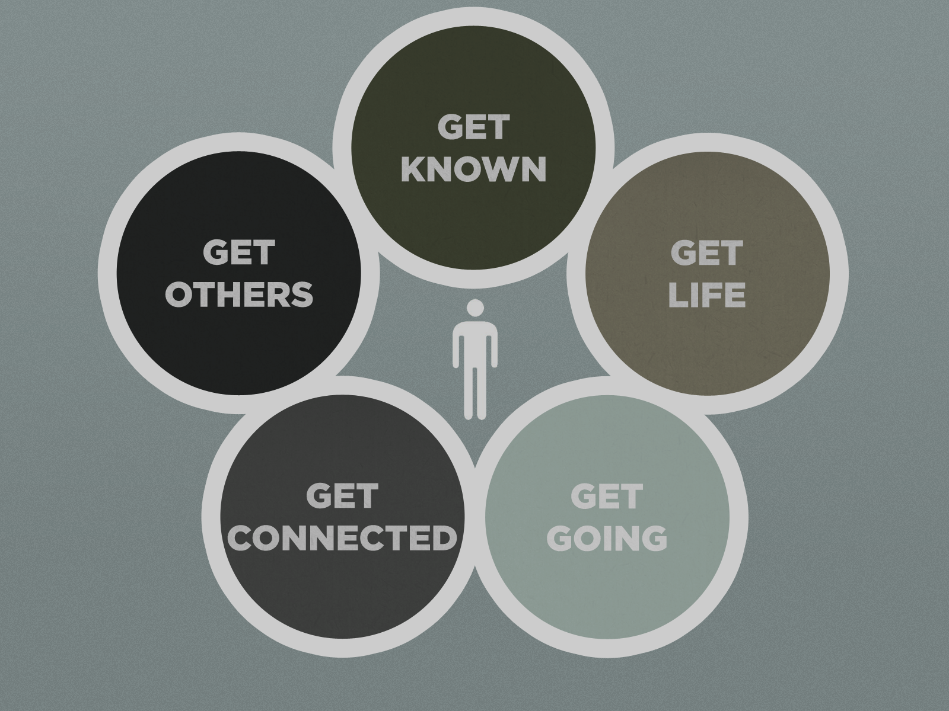
5pm Sunday, October 20th

Slide 3


Hanging with Jesus
Acts 4:5-22

Slide 4
¹³ When they saw the courage/boldness of Peter and John…
They did not allow ‘fear of man’ to overtake them
Peter had just 7+ weeks earlier denied Jesus in fear

Slide 5
¹³ When they saw the courage/boldness of Peter and John…
Moses (Ex. 4:1-17)
“What if they don’t believe me or listen?”
“I’m not eloquent… I’m slow of speech.”
“Please send someone else.”
Joshua (Josh. 1:1-9)
God tells him 3 times to “Be strong and very courageous”
“Do not be afraid; do not be discouraged, for the Lord your God will be with you wherever you go.”

Slide 6
¹³ When they saw the courage/boldness of Peter and John…
Gideon (Judg. 6:11-17, 25-27)
“How can I save Israel?”
“My clan is the weakest and I am the least in my family.”
“Give me a sign that it is really you talking”
When told to tear down the altar to Baal, it says, “But because he was afraid of his family and the townspeople, he did it at night rather than in the daytime.

Slide 7
¹³ When they saw the courage/boldness of Peter and John…
Jeremiah (Jer. 1:4-10, 17-19)
“I do not know how to speak.”
“I am too young.”
God answers, “Do not say, ‘I am too young.’ …Do not be afraid of their faces, for I am with you to deliver you”
“Get yourself ready! Stand up and say to them whatever I command you. Do not be terrified by them, or I will terrify you before them.”

Slide 8
¹³ When they saw the courage/boldness of Peter and John…
Timothy (2 Tim. 1:6-9; 1 Tim. 4:12) Paul admonishes Timothy:
“I remind you to stir up the gift of God which is in you.”
“For God has not given us a spirit of fear, but of power and of love and of a sound mind.”
“Do not be ashamed of the testimony of our Lord, nor of me His prisoner, but share with me in the sufferings for the gospel.”
“Don’t let anyone despise your youth.”

Slide 9
¹³ When they saw the courage/boldness of Peter and John…
They did not allow ‘fear of man’ to overtake them
Proverbs 29:25 (NKJV) The fear of man brings a snare, But whoever trusts in the Lord shall be safe.

Slide 10
¹³ When they saw the courage/boldness of Peter and John…
1 John 4:16-18 (NLT) ¹⁶ We know how much God loves us, and we have put our trust in his love. God is love, and all who live in love live in God, and God lives in them. ¹⁷ And as we live in God, our love grows more perfect. So we will not be afraid on the day of judgment, but we can face him with confidence because we live like Jesus here in this world. ¹⁸ Such love has no fear, because perfect love expels all fear. If we are afraid, it is for fear of punishment, and this shows that we have not fully experienced his perfect love.

Slide 11
¹³ …and realized that they were unschooled, ordinary men…
This does not disqualify education in a spirit-filled minister’s life
This is a testament to the power of discipleship

Slide 12
¹³ …they were astonished and took note that these men had been with Jesus.
They recognized:
His words
His teaching with authority
His boldness
His character
His miracle working power
They thought they got rid of Him, but here He is in His followers

Slide 13
¹⁴ But since they could see the man who had been healed standing there with them, there was nothing they could say.
Luke 21:12-15 (NIV) ¹²…they will seize you and persecute you. They will hand you over to synagogues and put you in prison, and you will be brought before kings and governors, and all on account of my name. ¹³ And so you will bear testimony to me. ¹⁴ But make up your mind not to worry beforehand how you will defend yourselves. ¹⁵ For I will give you words and wisdom that none of your adversaries will be able to resist or contradict.

Slide 14
The Sanhedrin’s decision
They could not deny the miracle, so they decided to silence the message
The enemy wants to either silence our proclamation, or silence our demonstration
BOTH active together are life changing!

Slide 15
²⁰ “For we cannot help speaking about what we have seen AND heard.”
Why?
They had been with Jesus

