Slide 2
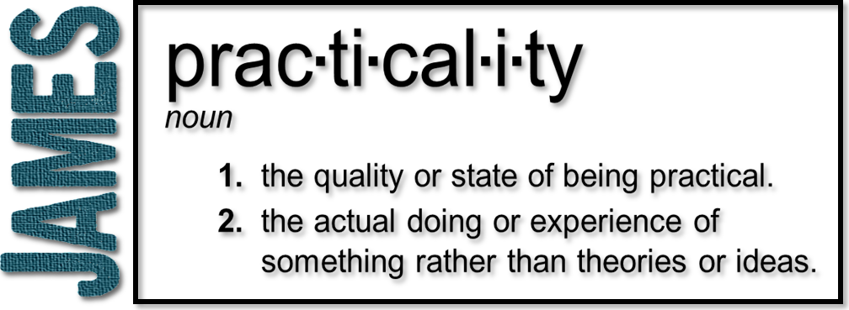
Week 11: Patience in Suffering
(James 5:1-12)

Slide 4
Patience
Difficult circumstances…
are considered normal
require patience and endurance
are a necessary part of the process of spiritual growth

Slide 5
Patience
Everything is temporal; including the suffering that we at times endure
We are told to be patient (not a suggestion)
Should be in effect until the Lord’s return
Patience is a spiritual discipline

Slide 6
2 Peter 1:3-8 (NLT)
³ By his divine power, God has given us everything we need for living a godly life. We have received all of this by coming to know him, the one who called us to himself by means of his marvelous glory and excellence. ⁴ And because of his glory and excellence, he has given us great and precious promises. These are the promises that enable you to share his divine nature and escape the world’s corruption caused by human desires.

Slide 7
2 Peter 1:3-8 (NLT)
⁵ In view of all this, make every effort to respond to God’s promises. Supplement your faith with a generous provision of moral excellence, and moral excellence with knowledge, ⁶ and knowledge with self-control, and self-control with patient endurance, and patient endurance with godliness, ⁷ and godliness with brotherly affection, and brotherly affection with love for everyone.

Slide 8
2 Peter 1:3-8 (NLT)
⁸ The more you grow like this, the more productive and useful you will be in your knowledge of our Lord Jesus Christ.

Slide 9
Imitate the farmer
He waits knowing he can’t always see the growth and the harvest is not immediate
He waits depending on things out of his own power
He waits aware of how seasons work

Slide 10
Imitate the farmer
He waits despite changing circumstances and many uncertainties
He waits knowing that the harvest is worth it
He waits because it does no good to give up

Slide 11
⁸ You too, be patient and stand firm, because the Lord's coming is near.

Slide 12
2 Peter 3:8-10
⁸ But do not forget this one thing, dear friends: With the Lord a day is like a thousand years, and a thousand years are like a day. ⁹ The Lord is not slow in keeping his promise, as some understand slowness. Instead he is patient with you, not wanting anyone to perish, but everyone to come to repentance. ¹⁰ But the day of the Lord will come like a thief. The heavens will disappear with a roar; the elements will be destroyed by fire, and the earth and everything done in it will be laid bare.

Slide 13
Do not grumble!
Complaining; to be critical; bad-tempered comments
Despite the abuse you have endured
Impatience with each other
This is spiritual maturity
The judge is at the door

Slide 14
More examples of patience
Imitate the prophets
Imitate Job
Illustration given not just to point to Job’s suffering, but to remind us of what the Lord finally brought out of it
Afterwards, he was better in character, more humble, and more blessed than before

Slide 15
Patience in us
Patience helps forge our spiritual character
James wants us to shift our attention from what is happening to us to what God is forming in us
patience in suffering brings the dross to the surface
strengthens us
allows us to minister to others

Slide 16
Patience in us
Galatians 6:9
Let us not become weary in doing good, for at the proper time we will reap a harvest if we do not give up.

