Slide 2
What About The Water?
Exploring the depths of the events
of Easter

Slide 3
1 Corinthians 10:1-4
For I do not want you to be ignorant of the fact, brothers, that our forefathers were all under the cloud and that they all passed through the sea. They were all baptized into Moses in the cloud and in the sea. They all ate the same spiritual food and drank the same spiritual drink; for they drank from the spiritual rock that accompanied them, and that rock was Christ.

Slide 4
Luke 22:14-16
When the hour came, Jesus and his apostles reclined at the table. And he said to them, “I have eagerly desired to eat this Passover with you before I suffer. For I tell you, I will not eat it again until it finds fulfillment in the kingdom of God.”

Slide 5
Exodus 6:6-7
“Therefore, say to the Israelites: ‘I am the Lord, and I will bring you out from under the yoke of the Egyptians. I will free you from being slaves to them, and I will redeem you with an outstretched arm and with mighty acts of judgment. I will take you as my own people, and I will be your God. Then you will know that I am the Lord your God, who brought you out from under the yoke of the Egyptians.

Slide 6
Exodus 12:13
When I see the blood, I will pass over you.

Slide 7
Luke 22:35-37
Then Jesus asked them, “When I sent you without purse, bag or sandals, did you lack anything?” “Nothing,” they answered.
He said to them, “But now if you have a purse, take it, and also a bag; and if you don’t have a sword, sell your cloak and buy one. It is written: ‘And he was numbered with the transgressors’; and I tell you that this must be fulfilled in me. Yes, what is written about me is reaching its fulfillment.”

Slide 8
Luke 22:45
When he rose from prayer and went back to the disciples, he found them asleep, exhausted from sorrow.

Slide 9
Luke 22:6
He consented, and watched for an opportunity to hand Jesus over to them when no crowd was present.

Slide 10
Luke 21:37-38
Each day Jesus was teaching at the temple, and each evening he went out to spend the night on the hill called the Mount of Olives, and all the people came early in the morning to hear him at the temple.
Luke 22:39
Jesus went out as usual to the Mount of Olives, and his disciples followed him.

Slide 11
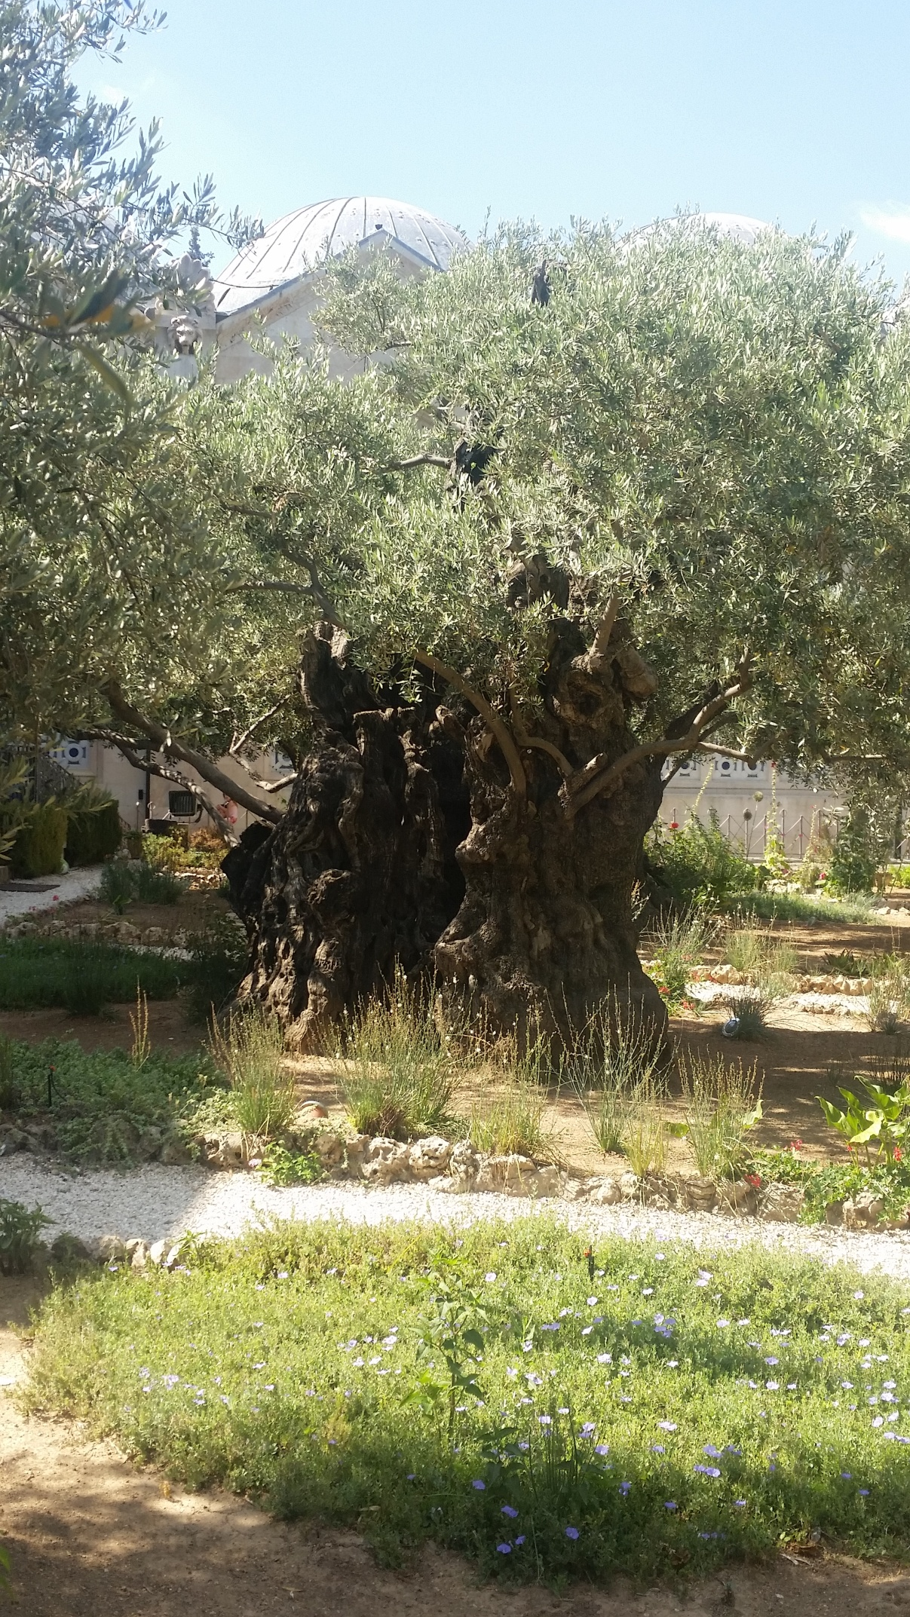

Slide 12
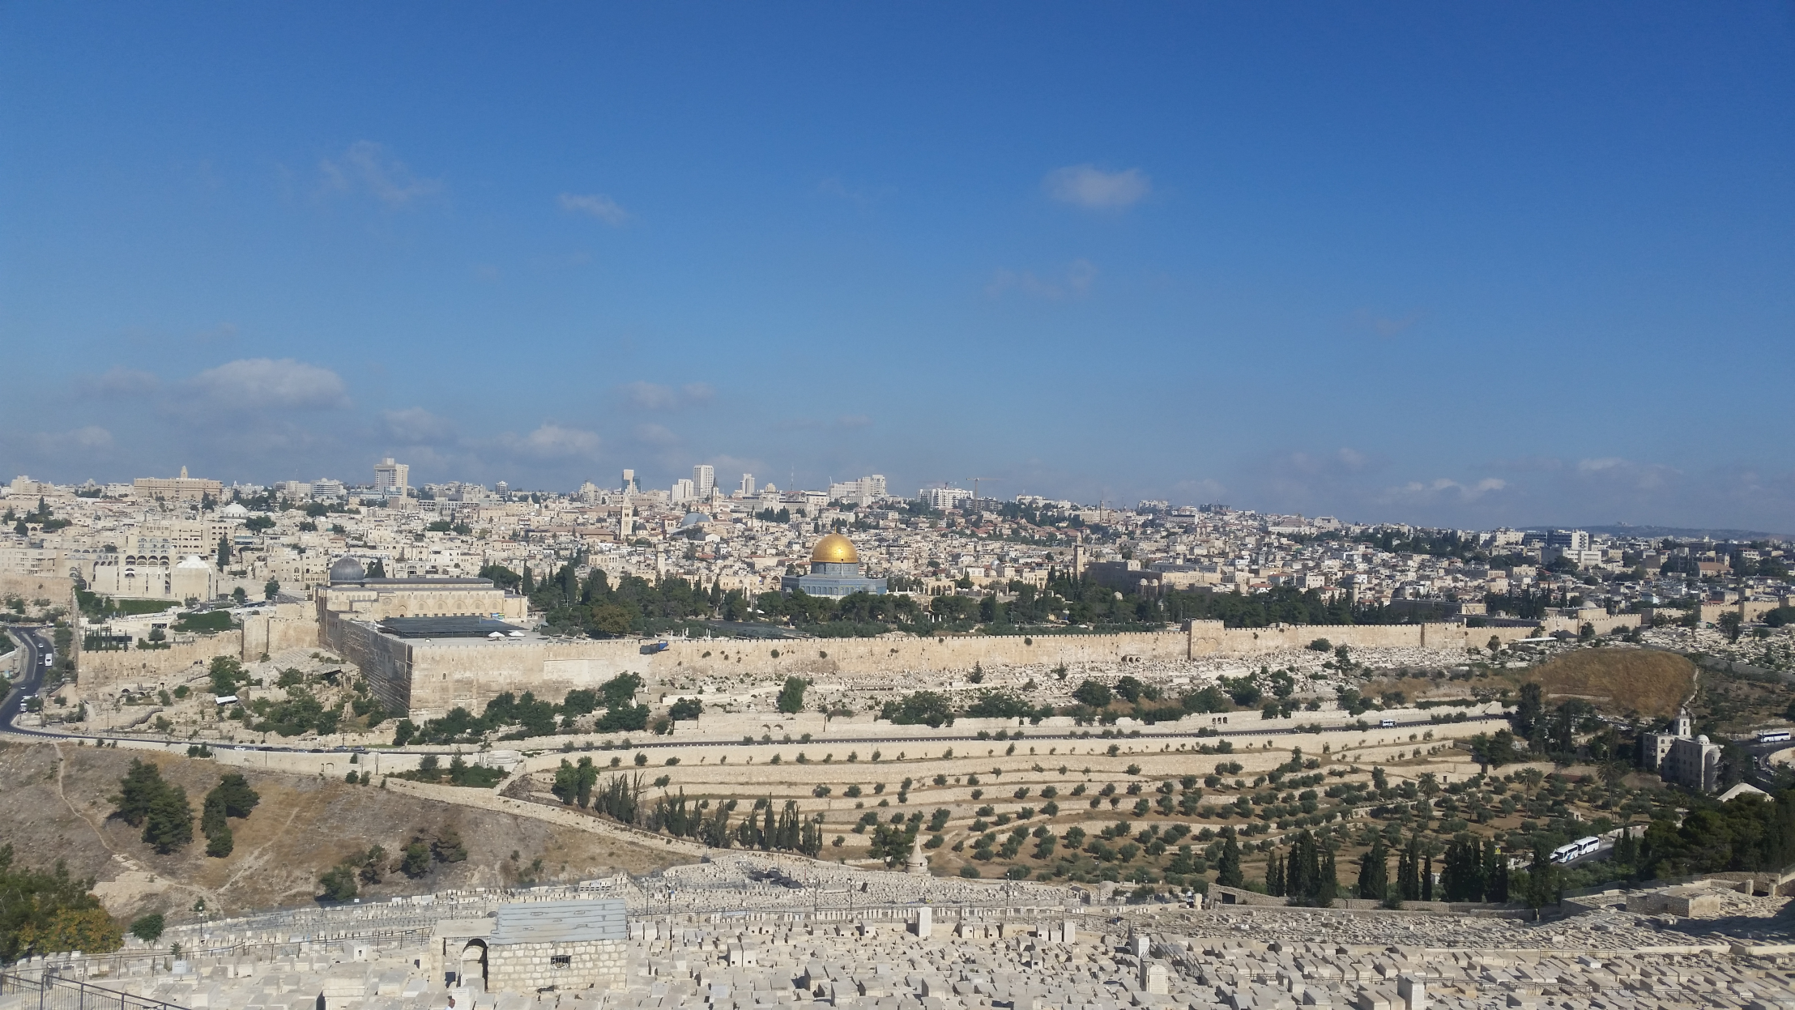

Slide 13
Luke 22:54
Then seizing him, they led him away and took him into the house of the high priest.

Slide 14
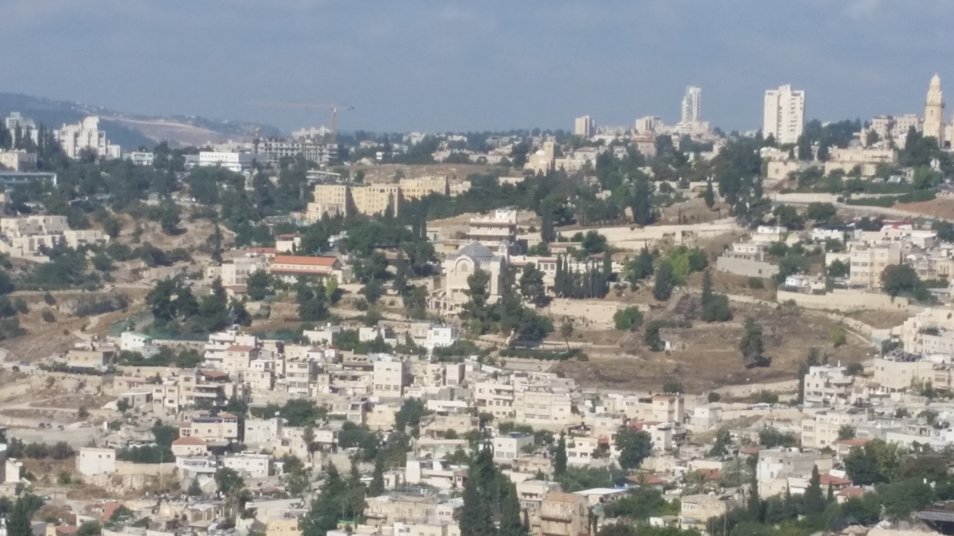

Slide 15
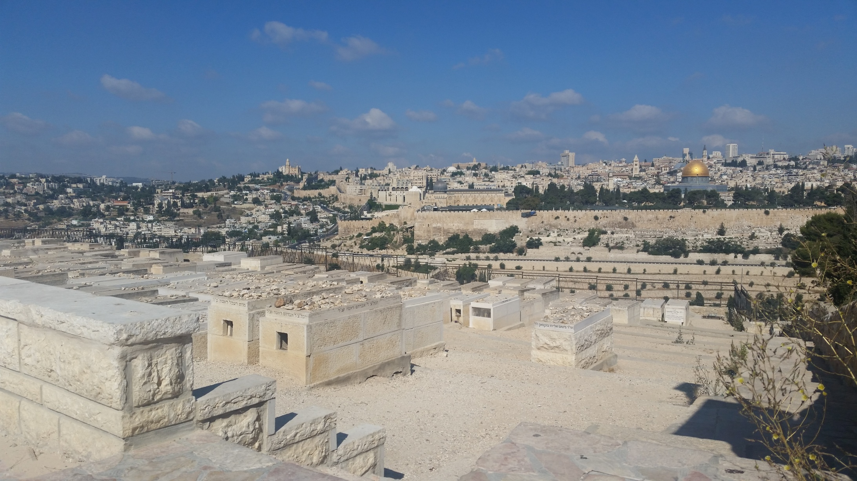

Slide 16
Luke 22:66
At daybreak the council of the elders of the people, both the chief priests and teachers of the law, met together, and Jesus was led before them.
Mark 15:1
Very early in the morning, the chief priests, with the elders, the teachers of the law and the whole Sanhedrin, reached a decision. They bound Jesus, led him away and handed him over to Pilate.

Slide 17
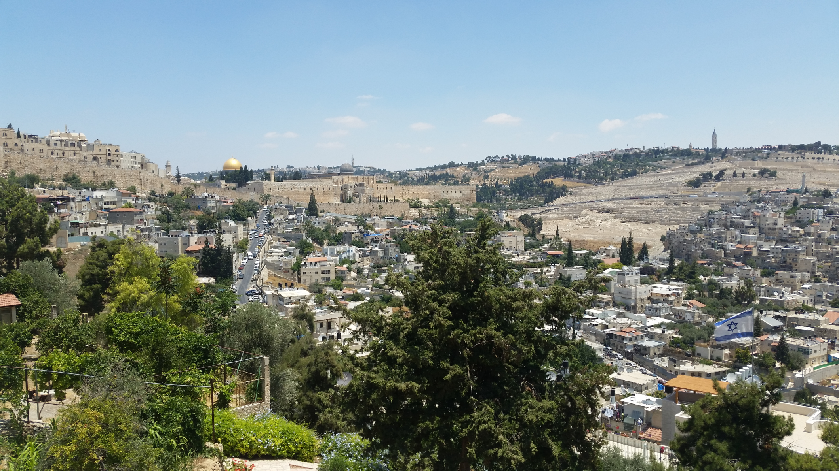

Slide 18
Mark 15:16-20
The soldiers led Jesus away into the palace (that is, the Praetorium) and called together the whole company of soldiers. They put a purple robe on him, then twisted together a crown of thorns and set it on him. And they began to call out to him, “Hail, king of the Jews!” Again and again they struck him on the head with a staff and spit on him. Falling on their knees, they paid homage to him. And when they had mocked him, they took off the purple robe and put his own clothes on him. Then they led him out to crucify him.

Slide 19
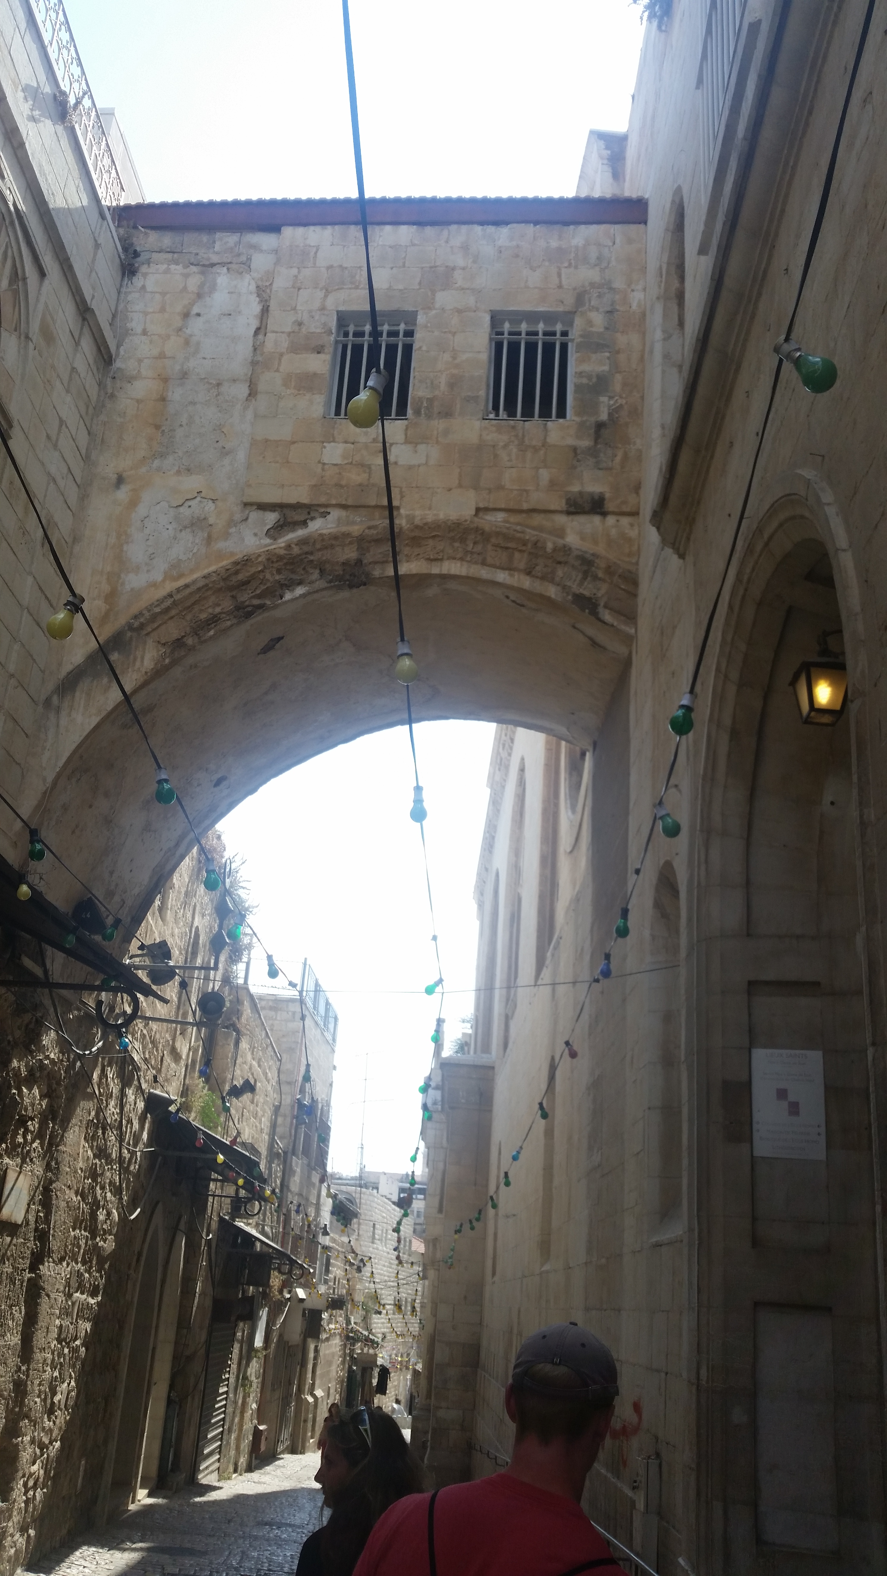

Slide 20
Luke 23:26-27
As they led him away, they seized Simon from Cyrene, who was on his way in from the country, and put the cross on him and made him carry it behind Jesus. A large number of people followed him, including women who mourned and wailed for him.

Slide 21
Luke 23:28-31
Jesus turned and said to them, “Daughters of Jerusalem, do not weep for me; weep for yourselves and for your children. For the time will come when you will say, ‘Blessed are the barren women, the wombs that never bore and the breasts that never nursed!’ Then “‘they will say to the mountains, “Fall on us!” and to the hills, “Cover us!”’ For if men do these things when the tree is green, what will happen when it is dry?”

Slide 22
Mark 15:25
It was the third hour when they crucified him.

Slide 23
Luke 23:44
It was now about the sixth hour, and darkness came over the whole land until the ninth hour
Amos 8:9
“In that day,” declares the Sovereign Lord, “I will make the sun go down at noon and darken the earth in broad daylight.

Slide 24
Luke 23:46
Jesus called out with a loud voice, “Father, into your hands I commit my spirit.” When he had said this, he breathed his last.

Slide 25
