Slide 2
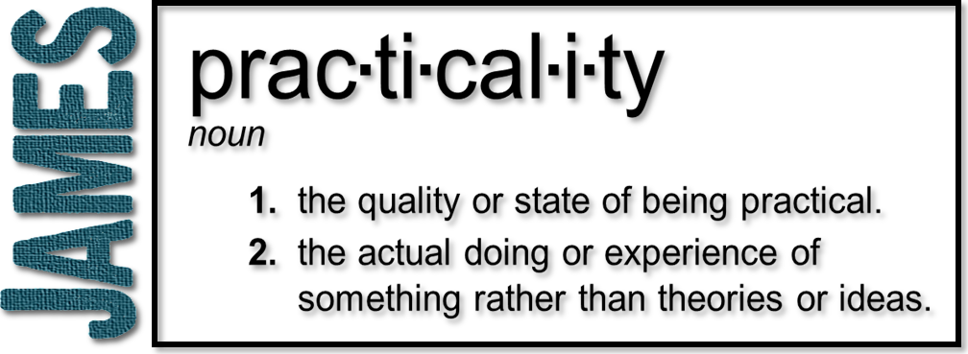
Week 12: The Power and Role of Prayer
(James 5:13-20)

Slide 3
1) Is anyone in trouble?
He should pray
(Individually)
Psalm 50:15 (NASB) “Call upon Me in the day of trouble; I shall rescue you, and you will honor Me.”

Slide 4
2) Is anyone happy?
He should sing songs of praise
(Individually)
Same advice, go to the Lord
Prayers and praise in both difficult and pleasant times

Slide 5
3) Is anyone sick?
He should call for the elders to pray over him
(Prayer of the elders)
Anointing oil
James may be directing the use of natural means while praying for a supernatural healing

Slide 6
Prayer’s role in healing
¹⁵ And the prayer offered in faith will make the sick person well; the Lord will raise them up. If they have sinned, they will be forgiven.
Believing in the power of God
Believing in the power of God through prayer
Believing in the power of God when I pray

Slide 7
Prayer’s role in healing
¹⁵ And the prayer offered in faith will make the sick person well; the Lord will raise them up. If they have sinned, they will be forgiven.
God does not grant immediate healing for every prayer of faith
But, many are not healed simply because there is no prayer of faith offered

Slide 8
Prayer’s role in healing
¹⁵ And the prayer offered in faith will make the sick person well; the Lord will raise them up. If they have sinned, they will be forgiven.
Some sin can cause sickness
Prayer offered in faith for forgiveness of sins
Tied to vs. 16

Slide 9
Prayer’s role in healing
¹⁶ Therefore confess your sins to each other and pray for each other so that you may be healed. The prayer of a righteous person is powerful and effective.
(The role of others)
Confess: The root form means literally to say the same thing; we agree to identify it by its true name and admit that it is sin

Slide 10
Prayer’s role in healing
¹⁶ Therefore confess your sins to each other and pray for each other so that you may be healed. The prayer of a righteous person is powerful and effective.
The “righteous man” is the one who is committed to doing God’s will
Cultivates a relationship with God, that knows God’s heart

Slide 11
Prayer’s role in healing
¹⁶ Therefore confess your sins to each other and pray for each other so that you may be healed. The prayer of a righteous person is powerful and effective.
“Powerful” and “effective” because the righteous person has discerned God’s leading already
Elijah, a man just like us, is the example

Slide 12
Our role
We have an opportunity AND a responsibility to…
Pray fervently/earnestly
Confess to one another
Pray for one another
Bring back those who wander

Slide 13
1 Corinthians 11:27-30
²⁷ So then, whoever eats the bread or drinks the cup of the Lord in an unworthy manner will be guilty of sinning against the body and blood of the Lord. ²⁸ Everyone ought to examine themselves before they eat of the bread and drink from the cup. ²⁹ For those who eat and drink without discerning the body of Christ eat and drink judgment on themselves. ³⁰ That is why many among you are weak and sick, and a number of you have fallen asleep.

