Slide 2
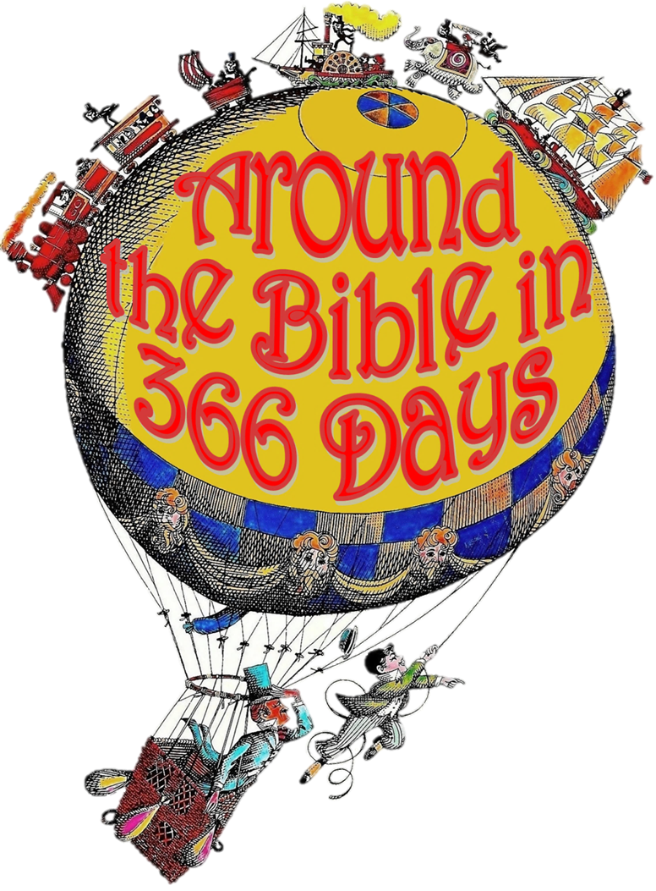
Redemption Resurrection &Ruth

Slide 3
Chapter One

Slide 4
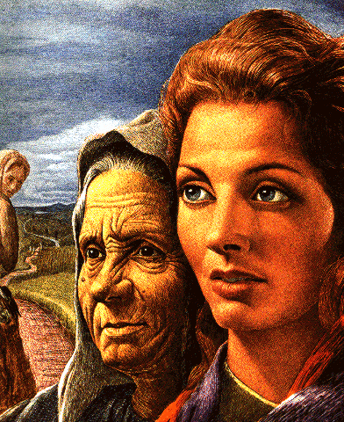
Famine! Bethlehem Naomi Ruth Mara

Slide 5
Chapter Two

Slide 6
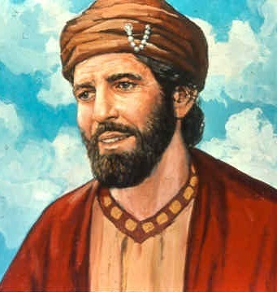
Boaz
“Who’s that?!”
“Who Am I?”
Refuge

Slide 7
³ When I consider your heavens, the work of your fingers, the moon and the stars, which you have set in place, ⁴ what is mankind that you are mindful of them, human beings that you care for them?
Psalm 8:3-4

Slide 8
Chapter Three

Slide 9
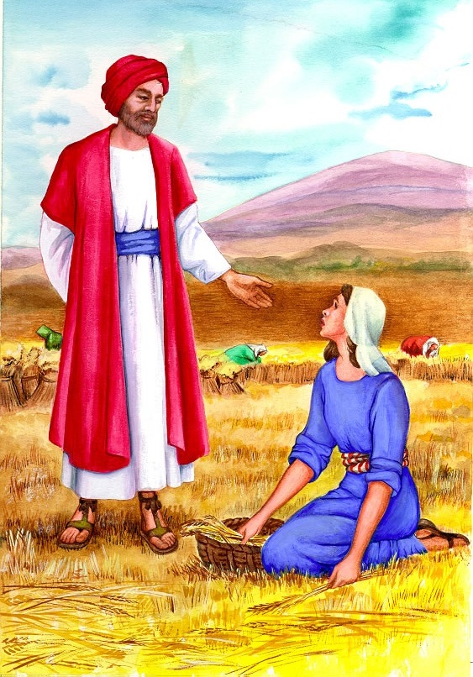
Proposal
Authority
Kinsman-Redeemer
Rest

Slide 10
Chapter Four

Slide 11
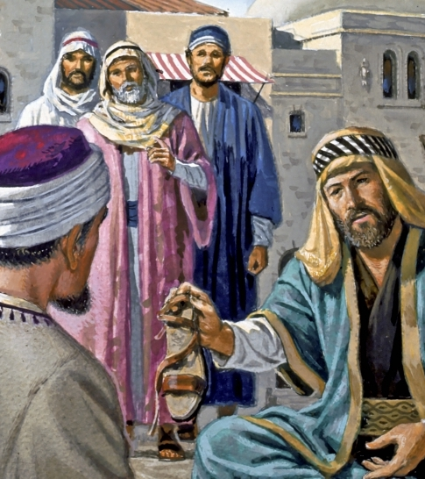
Boaz is the Lord of the Harvest
Ruth is his Gentile bride

Slide 12
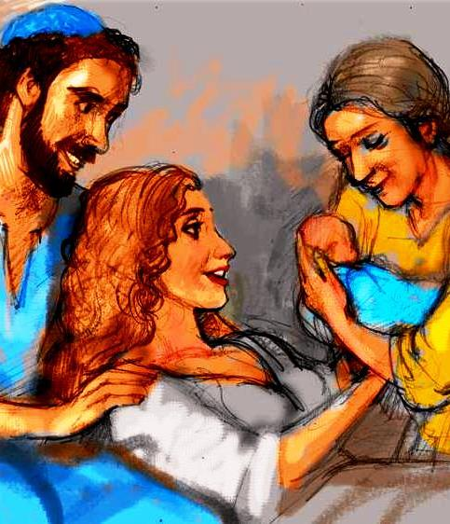
Resurrection
Obed
Jesse
David
Jesus

Slide 13
How is the ending to your story?

