Slide 1
CONVERSATIONS WITH JOHN
Spirit
and
Truth
JOHN 4:19-26

Slide 2
John 4:20-24 (NLT)
²⁰ So tell me, why is it that you Jews insist that Jerusalem is the only place of worship, while we Samaritans claim it is here at Mount Gerizim, where our ancestors worshiped?” ²¹ Jesus replied, “Believe me, dear woman, the time is coming when it will no longer matter whether you worship the Father on this mountain or in Jerusalem.

Slide 3
John 4:20-24 (NLT)
²² You Samaritans know very little about the one you worship, while we Jews know all about him, for salvation comes through the Jews. ²³ But the time is coming—indeed it’s here now—when true worshipers will worship the Father in spirit and in truth. The Father is looking for those who will worship him that way.

Slide 4
Worship
proskuneo (pros-koo-neh'-o) (to adore; to lay prostrate; to throw kisses; to kiss like a dog licking its master’s hand)

Slide 5
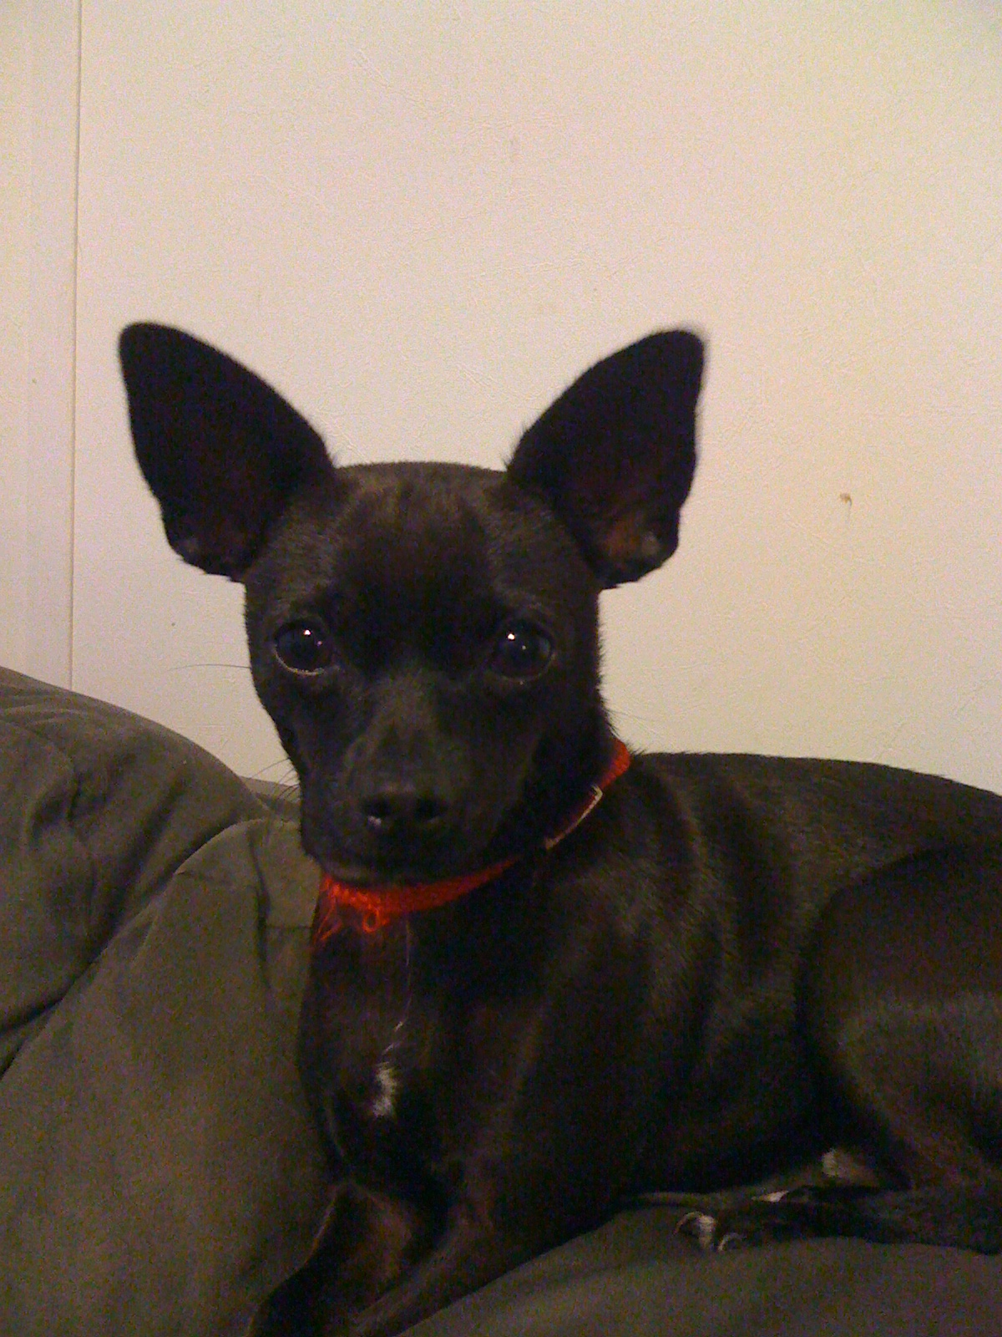

Slide 6
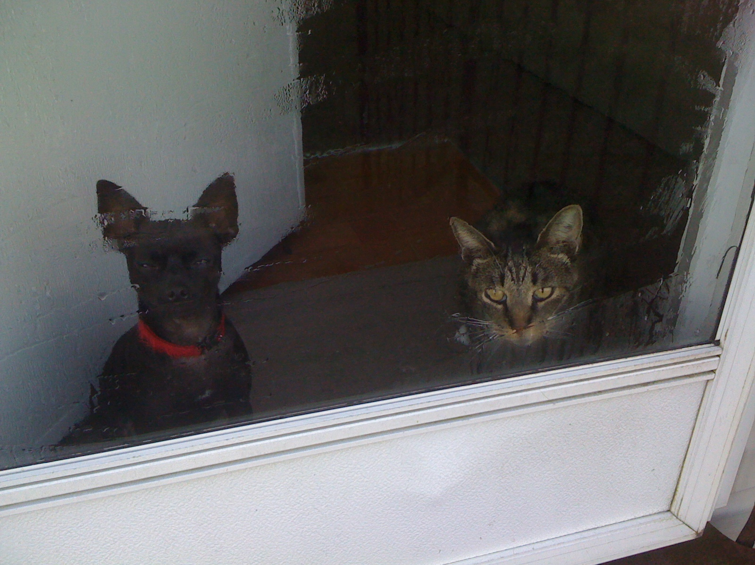

Slide 7
Spirit
pneuma (pnyoo'-mah) (God breath or blast; the spiritual entity in man)
Genesis 2:7 Then the LORD God formed the man of dust from the ground and breathed into his nostrils the breath of life, and the man became a living creature.

Slide 8
Truth
aletheia (al-ay'-thi-a) (the manifested; the essence of matter; sincerity; unveiled reality as opposed to mere appearance; free from all falsehood)

Slide 9
Luke 4:14-21 (NIV)
¹⁴ Jesus returned to Galilee in the power of the Spirit, and news about him spread through the whole countryside. ¹⁵ He was teaching in their synagogues, and everyone praised him. ¹⁶ He went to Nazareth, where he had been brought up, and on the Sabbath day he went into the synagogue, as was his custom. He stood up to read, ¹⁷ and the scroll of the prophet Isaiah was handed to him. Unrolling it, he found
the place where it is written:

Slide 10
Luke 4:14-21 (NIV)
¹⁸ “The Spirit of the Lord is on
me, because he has anointed me to proclaim good news to the poor. He has sent me to proclaim freedom for the prisoners and recovery of sight for the blind, to set the oppressed free, ¹⁹ to
proclaim the year of the
Lord’s favor.”

Slide 11
Luke 4:14-21 (NIV)
²⁰ Then he rolled up the scroll, gave it back to the attendant and sat down. The eyes of everyone in the synagogue were fastened on him. ²¹ He began by saying to them, “Today this scripture is fulfilled in your hearing.”

Slide 12
Proclamation and Demonstration

Slide 13
Follow-through

Slide 14
Matthew 11:4-5 (NIV)
⁴ Jesus replied, “Go back and report to John what you hear and see: ⁵ The blind receive sight, the lame walk, those who have leprosy are cleansed, the deaf hear, the dead are raised, and the good news is proclaimed to the poor.

Slide 15
Amos 5:21-24 (MSG)
"I can't stand your religious meetings. I'm fed up with your conferences and conventions. I want nothing to do with your religion projects, your pretentious slogans and goals. I'm sick of your fund-raising schemes, your public relations and image making. I've had all I can take of your noisy ego-music. When was the last time you sang to me? Do you know what I want? I want justice— oceans of it. I want fairness—rivers of it. That's what I want. That's all I want.

Slide 16
John 4:23-24 (NLT)
²³ …true worshipers will worship the Father in spirit and in truth. The Father is looking for those who will worship him that way. ²⁴ For God is Spirit, so those who worship him must worship in spirit and in truth.”

Slide 17
Worshiping God in both the spiritual and physical aspects of life is true worship.

