Slide 2
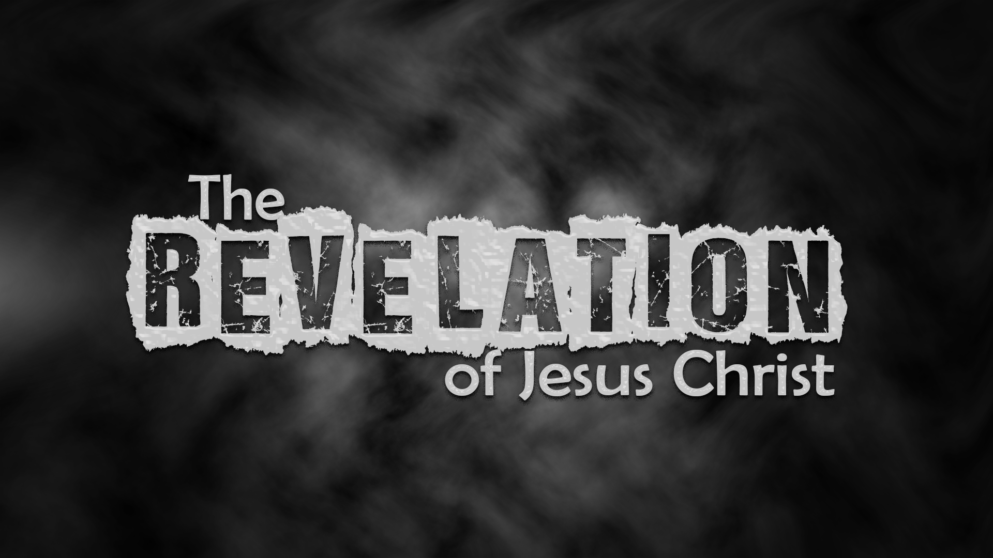

Slide 3
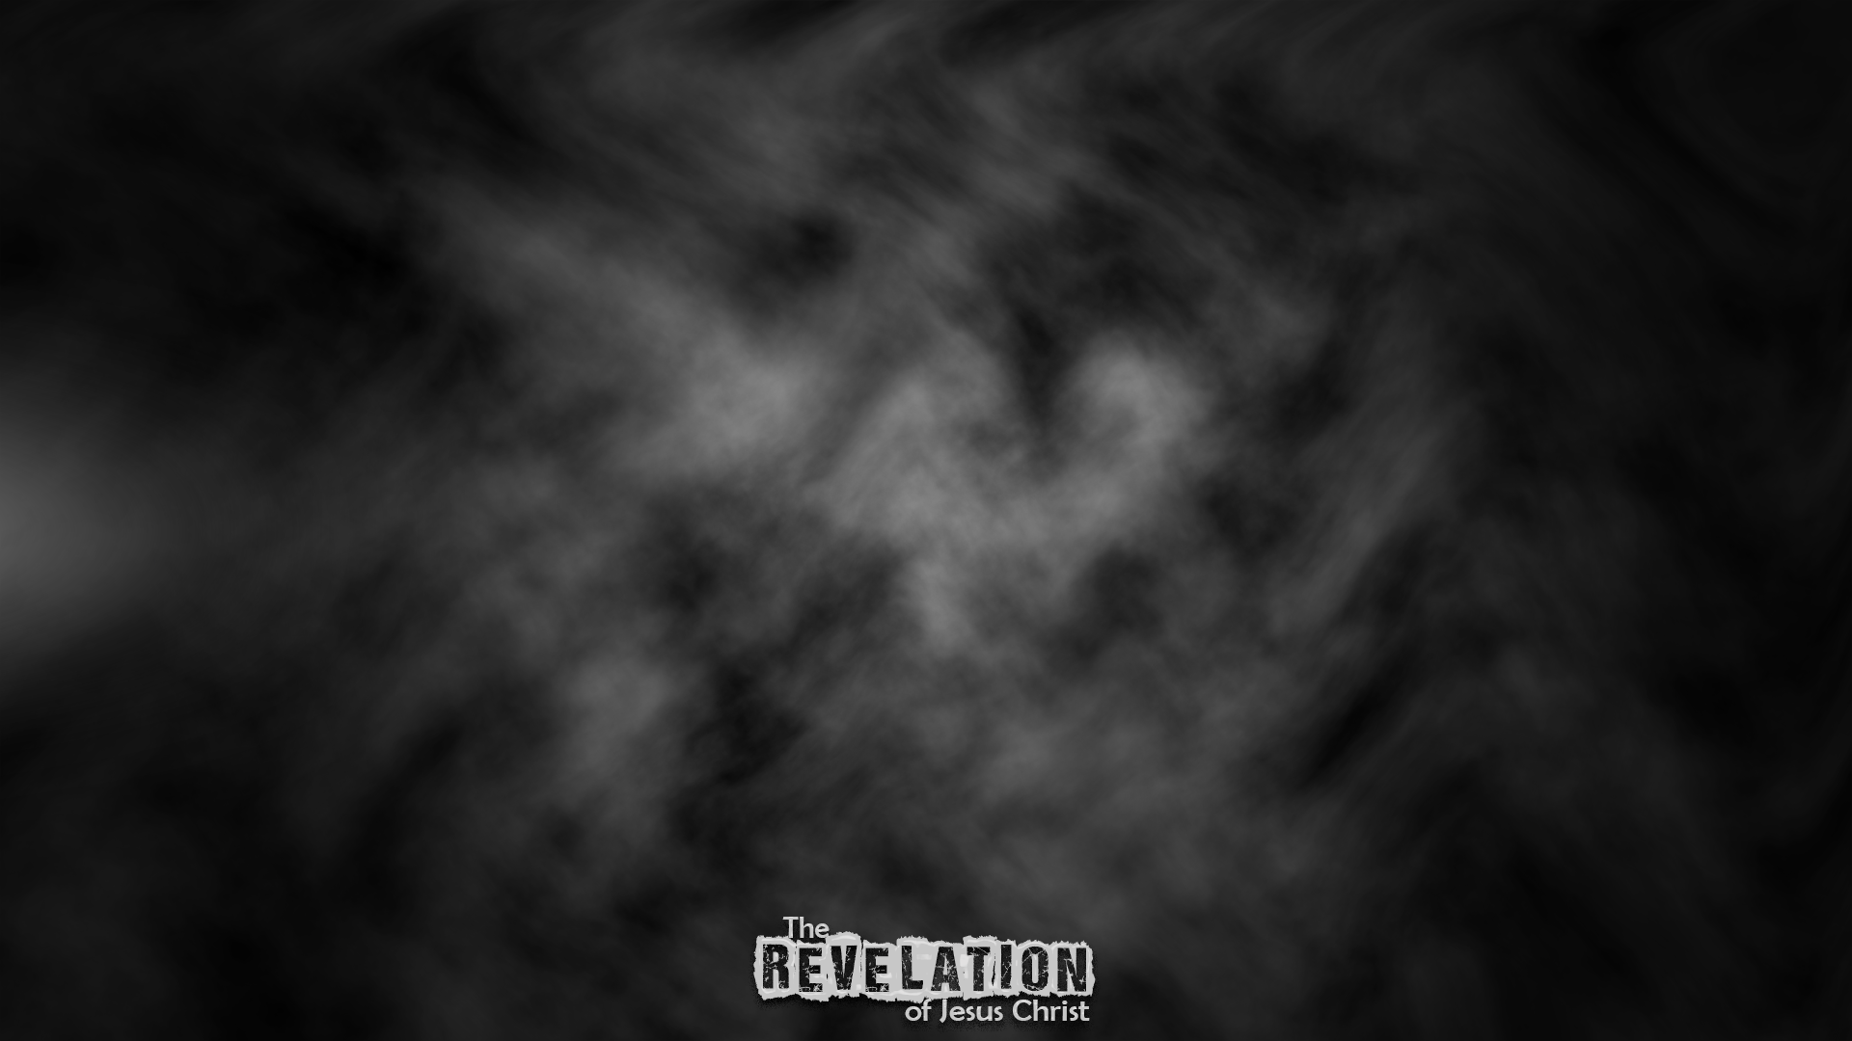
Week 15:
Marking the Servants of God (Revelation 7)

Slide 4

“Who can stand?”
Seal on their foreheads
Protection
Ownership

Slide 5
Ephesians 1:13-14
¹³ And you also were included in Christ when you heard the message of truth, the gospel of your salvation. When you believed, you were marked in him with a seal, the promised Holy Spirit, ¹⁴ who is a deposit guaranteeing our inheritance until the redemption of those who are God’s possession—to the praise of his glory.

Slide 6
Seal on their foreheads
Ownership
Protection
In Rev. 14:1 we read again of the servants of God who are sealed, it says that “the name of the Lamb and His Father’s name” were written on their foreheads

Slide 7
Who are these servants?
John heard their number
144,000 Rev.- numbers represent ideas
In Rev. 21, the new Jerusalem has 12 gates with the names of the 12 tribes written on them and 12 foundations, with the names of the 12 apostles of the Lamb written on them. The wall is 144 cubits in height

Slide 8
Who are these servants?
12 x 12= 144- The completed number of God's servants from OT and NT
Not just a certain group, but the whole church of God
144 is multiplied by 1000
1000 is 10 x 10 x 10- a perfect cube

Slide 9
Who are these servants?
10 is the number of trial-this is that company that have been perfected through trial (vs. 14 “These are they who come out of the great tribulation”)
144,000 is giving an idea, not an actual number
12 tribes of natural Israel ?

Slide 10
Who are these servants?
Language used in Revelation 5:9-
“With your blood you purchased men for God from every tribe and language and people and nation.”
In chapter 14; same 144,000- We are told that they are those who have been purchased out of the earth…those who follow the Lamb wherever He goes

Slide 11
Who are these servants?
John saw multitude no one could count
Every nation, tribe, people, and language
What he hears beforehand is a foreshadow, what he sees afterwards is the reality!
  Lion/Lamb

Slide 12
Who are these servants?
  Holding palm branches:
Allusion to Feast of Tabernacles- celebrated protection in the wilderness after the Exodus
Allusion to Triumphant Entry of Christ- “Save now”

Slide 13
Who are these servants?
Those who have “Come out of the great tribulation”
“Great tribulation” is referring to either:
  a ‘seven-year period’ (Daniel 9) or
  tribulations God’s people go through that tempt them to forsake Jesus

Slide 14
A glimpse of eternity!
No matter what happens to the church in this world, her eternal well-being is never in question!

