Slide 2



Slide 3


The Full Message of the Gospel
Part 1 (Acts 5:17-32)
Part 2 (Acts 5:33-42)

Slide 4
The Full Message of the Gospel
Part 1 (Acts 5:17-32)

Slide 5

…“tell the people the full message of this new life”…

Slide 6
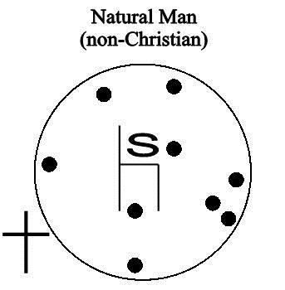
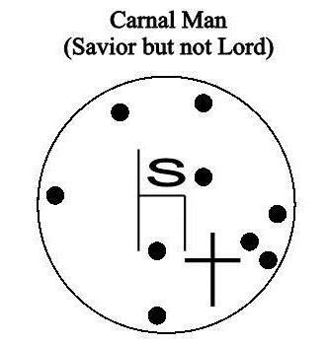
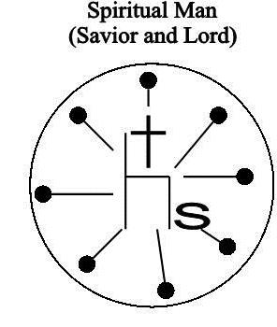

Slide 7
…“tell the people the full message of this new life”…
they began to teach the people

Slide 8
We must learn

Slide 9
Jesus said, “Blessed are the poor in spirit, for theirs is the kingdom of heaven.” (Matt 5:3)
“those who are poor and realize their need for him” (NLT)

Slide 10
The Gospel must be learned
2 Timothy 1:9-10 (NLT)
⁹ For God saved us and called us to live a holy life. He did this, not because we deserved it, but because that was his plan from before the beginning of time—to show us his grace through Christ Jesus. ¹⁰ And now he has made all of this plain to us by the appearing of Christ Jesus, our Savior. He broke the power of death and illuminated the way to life and immortality through the Good News (the Gospel).

Slide 11
The Gospel must be learned
2 Timothy 1:9-10 (NLT)
⁹ For God saved us and called us to live a holy life. He did this, not because we deserved it, but because that was his plan from before the beginning of time—to show us his grace through Christ Jesus. ¹⁰ And now he has made all of this plain to us by the appearing of Christ Jesus, our Savior. He broke the power of death and illuminated the way to life and immortality through the Good News (the Gospel).

Slide 12
The Gospel must be learned
2 Timothy 1:9-10 (NLT)
⁹ For God saved us and called us to live a holy life. He did this, not because we deserved it, but because that was his plan from before the beginning of time—to show us his grace through Christ Jesus. ¹⁰ And now he has made all of this plain to us by the appearing of Christ Jesus, our Savior. He broke the power of death and illuminated the way to life and immortality through the Good News (the Gospel).

Slide 13
The Gospel must be learned
Removes the penalty of sin (Justification)
Removes the separation caused by sin (Reconciliation)
Removes the power of sin (Sanctification)
All are concerned with the human condition: sin

Slide 14
Let’s be clear, sin is:
1 John 3:4
Whoever commits sin also commits lawlessness, and sin is lawlessness.
James 4:17
Therefore, to him who knows to do good and does not do it, to him it is sin.

Slide 15
Let’s be clear, sin is:
Isaiah 59:1-2 (NIV)
¹ Surely the arm of the Lord is not too short to save, nor his ear too dull to hear. ² But your iniquities have separated you from your God; your sins have hidden his face from you, so that he will not hear.

Slide 16
The Gospel:
Removes the penalty of sin (Justification)
Romans 3:22-24 (NIV) ²² This righteousness from God comes through faith in Jesus Christ to all who believe. There is no difference, ²³ for all have sinned and fall short of the glory of God, ²⁴ and are justified freely by his grace through the redemption that came by Christ Jesus.
Romans 4:25 (NIV) He was delivered over to death for our sins and was raised to life for our justification.

Slide 17
The Gospel:
Removes the separation caused by sin (Reconciliation)
2 Corinthians 5:17-21 (NIV) ¹⁷ Therefore, if anyone is in Christ, the new creation has come: The old has gone, the new is here! ¹⁸ All this is from God, who reconciled us to himself through Christ and gave us the ministry of reconciliation: ¹⁹ that God was reconciling the world to himself in Christ, not counting people’s sins against them. And he has committed to us the message of reconciliation.

Slide 18
The Gospel:
Removes the power of sin (Sanctification)
Ecclesiastes 8:8 (NIV) No man has power over the wind to contain it; so no one has power over the day of his death. As no one is discharged in time of war, so wickedness will not release those who practice it.

Slide 19
The Gospel:
Removes the power of sin (Sanctification)
Romans 8:1-4 (NLT)
¹ So now there is no condemnation for those who belong to Christ Jesus. ² And because you belong to him, the power of the life-giving Spirit has freed you from the power of sin that leads to death. ³ The law of Moses was unable to save us because of the weakness of our sinful nature…

Slide 20
The Gospel:
Removes the power of sin (Sanctification)
Romans 8:1-4 (NLT)
…So God did what the law could not do. He sent his own Son in a body like the bodies we sinners have. And in that body God declared an end to sin’s control over us by giving his Son as a sacrifice for our sins. ⁴ He did this so that the just requirement of the law would be fully satisfied for us, who no longer follow our sinful nature but instead follow the Spirit.

Slide 21
The Gospel:
LIFE Removes the penalty of sin (Justification)
RELATIONSHIP Removes the separation caused by sin (Reconciliation)
FREEDOM Removes the power of sin (Sanctification)

Slide 22
The Gospel:
LIFE
RELATIONSHIP
FREEDOM

