Slide 2


Slide 3


Four Part Series
Jesus as Prophet (Dec. 1st)
Jesus as Priest (Dec. 8th)
Jesus as King (Dec. 15th)
Jesus is Incarnated God (Dec. 22nd)

Slide 4

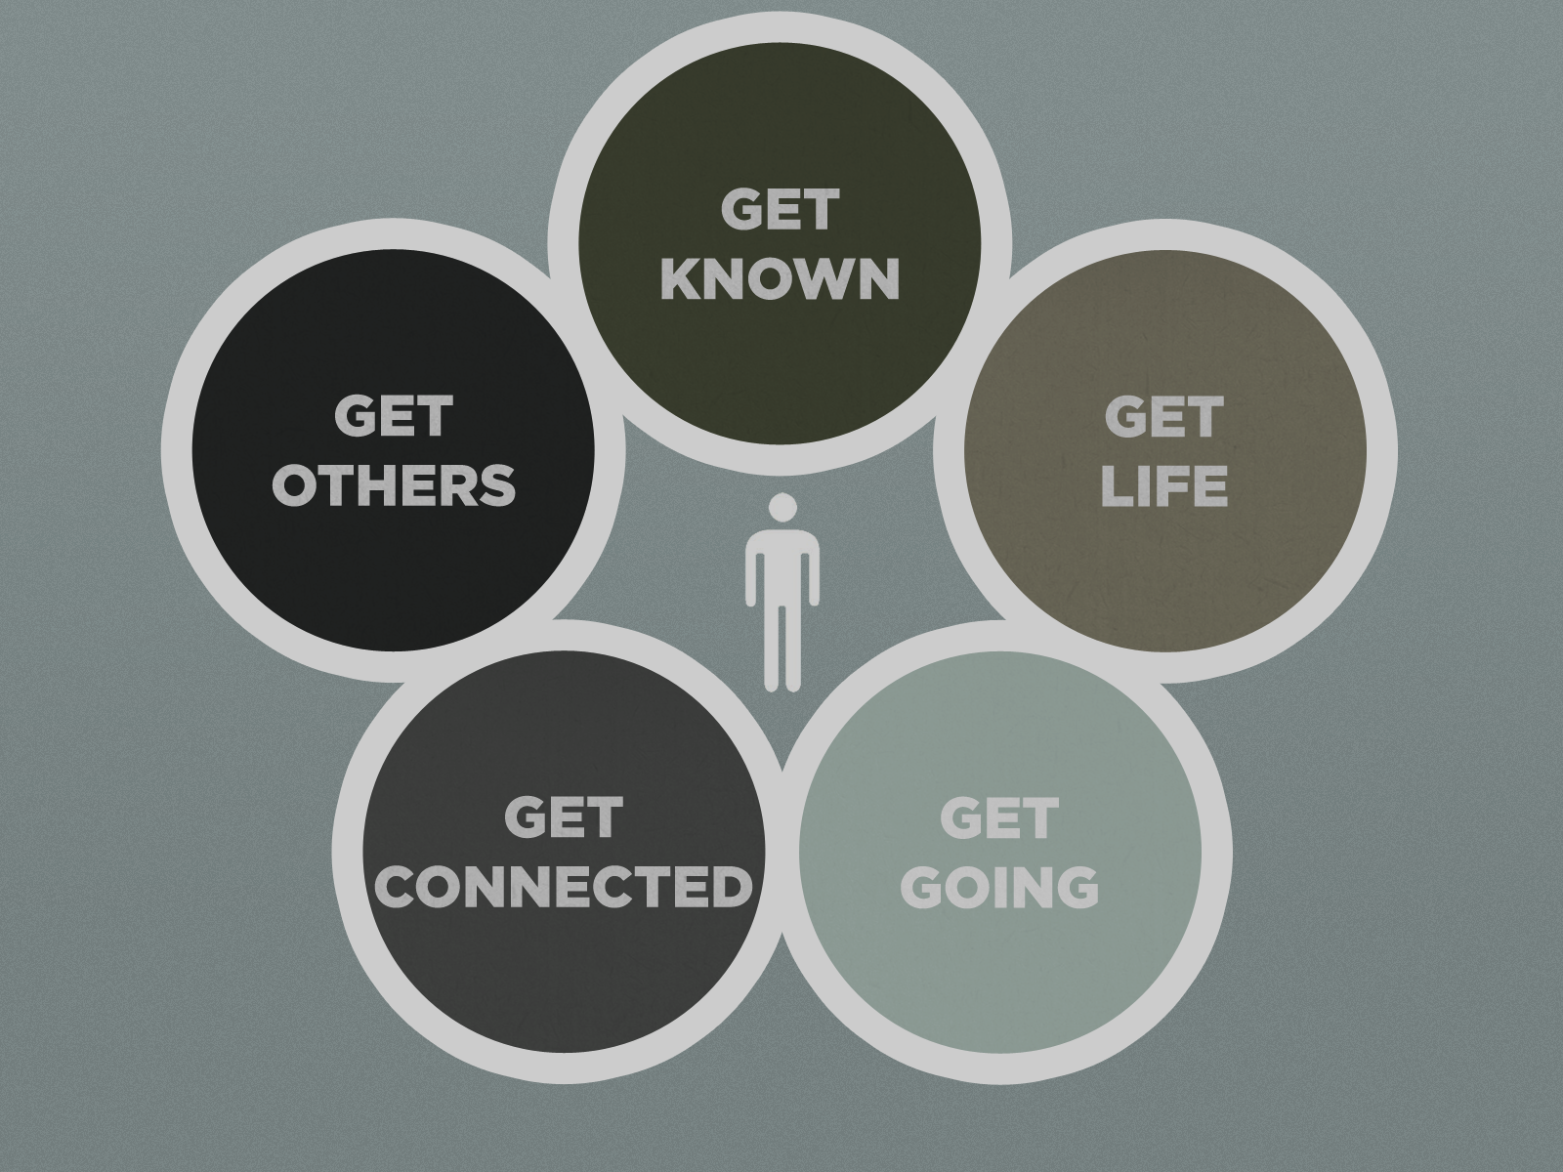

Slide 5


The Full Message of the Gospel
Part 2 (Acts 5:33-42)

Slide 6

…“tell the people the full message of this new life”…
they began to teach the people

Slide 7
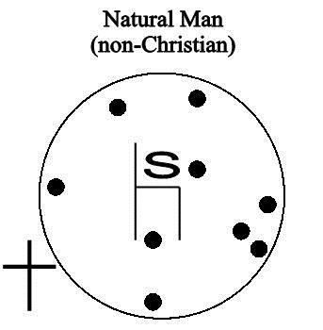
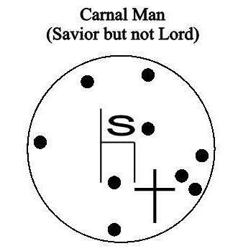
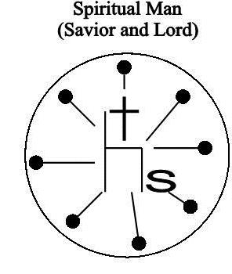
Gospel not accepted
Gospel only partially accepted
The full Gospel accepted

Slide 8
The Gospel:
LIFE
Removes the penalty of sin (Justification)
RELATIONSHIP
Removes the separation caused by sin (Reconciliation)
FREEDOM
Removes the power of sin (Sanctification)

Slide 9
The Gospel:
We need to understand how the Gospel works functionally
Where a confrontation with the Gospel is needed
Acts 5:33-42

Slide 10
The Gospel:
³⁸ …For if their purpose or activity is of human origin, it will fail.
³⁹ But if it is from God, you will not be able to stop these men; you will only find yourselves fighting against God.”

Slide 11
The Gospel needs to confront:
Being Idol-ruled
Devoting time and adoration
towards something else
“This ……. will fulfill me”
Forming God in the image that
best suits us
Giving a relationship too much importance

Slide 12
The Gospel needs to confront:
Being Idol-ruled
The Gospel proclaims:
I can know and have a relationship with the one true God!
All other gods are inferior.

Slide 13
The Gospel needs to confront:
Being Image-ruled
Being Men-pleasers
  I need their adoration
  I need their acceptance
  I need their approval

Slide 14
Galatians 2:11-14 (NLT)
¹¹ But when Peter came to Antioch, I had to oppose him to his face, for what he did was very wrong. ¹² When he first arrived, he ate with the Gentile Christians, who were not circumcised. But afterward, when some friends of James came, Peter wouldn’t eat with the Gentiles anymore. He was afraid of criticism from these people who insisted on the necessity of circumcision. ¹³ As a result, other Jewish Christians followed Peter’s hypocrisy, and even Barnabas was led astray by their hypocrisy. ¹⁴ When I saw that they were not following the truth of the gospel message…

Slide 15
The Gospel needs to confront:
Being Image-ruled
The Gospel proclaims:
I don’t need to try to get horizontally, what
I already have vertically!

Slide 16
The Gospel needs to confront:
Being Emotion-ruled
I am a victim
I have it worse than anyone else
I deserve better
I want to do what feels good
  Addictions
  Giving into temptation

Slide 17
1 Corinthians 10:13 (ESV)
No temptation has overtaken you that is not common to man. God is faithful, and he will not let you be tempted beyond your ability, but with the temptation he will also provide the way of escape, that you may be able to endure it.

Slide 18
The Gospel needs to confront:
Being Emotion-ruled
The Gospel proclaims:
God is faithful.
I am not the only one.
He will provide the way of escape for every temptation!

Slide 19
The Gospel needs to confront:
Being Circumstance-ruled
Having more awe for problems than for The Solution
Being anxious
What happens if I…?
What if there isn’t enough?
Where is God?

Slide 20
The Gospel needs to confront:
Being Circumstance-ruled
The Gospel proclaims:
God says,
“I will be with you!”

Slide 21
The Gospel needs to confront:
Being Self-ruled
I don’t need help
I can be good enough
I do not need rescuing
I’m in control

Slide 22
Colossians 2:6-14 (NIV)
⁶ So then, just as you received Christ Jesus as Lord, continue to live your lives in him,
⁷ rooted and built up in him, strengthened in the faith as you were taught, and overflowing with thankfulness. ⁸ See to it that no one takes you captive through hollow and deceptive philosophy, which depends on human tradition and the elemental spiritual forces of this world rather than on Christ. ⁹ For in Christ all the fullness of the Deity lives in bodily form, ¹⁰ and in Christ you have been brought to fullness. He is the head over every power and authority.

Slide 23
Colossians 2:6-14 (NIV)
¹¹ In him you were also circumcised with a circumcision not performed by human hands. Your whole self-ruled by the flesh was put off when you were circumcised by Christ, ¹² having been buried with him in baptism, in which you were also raised with him through your faith in the working of God, who raised him from the dead. ¹³ When you were dead in your sins and in the uncircumcision of your flesh, God made you alive with Christ. He forgave us all our sins, ¹⁴ having canceled the charge of our legal indebtedness, which stood against us and condemned us; he has taken it away, nailing it to the cross.

Slide 24
The Gospel needs to confront:
Being Self-ruled
The Gospel proclaims:
Jesus perfectly measured up
on my behalf.
My righteousness will never be based on my performance but on Christ’s!

Slide 25
The Gospel needs to confront:
Being Idol-ruled
Being Image-ruled
Being Emotion-ruled
Being Circumstance-ruled
Being Self-ruled

Slide 26
Acts 5:42
Day after day, in the temple courts and from house to house, they never stopped teaching and proclaiming the good news that Jesus is the Christ.

