Slide 2
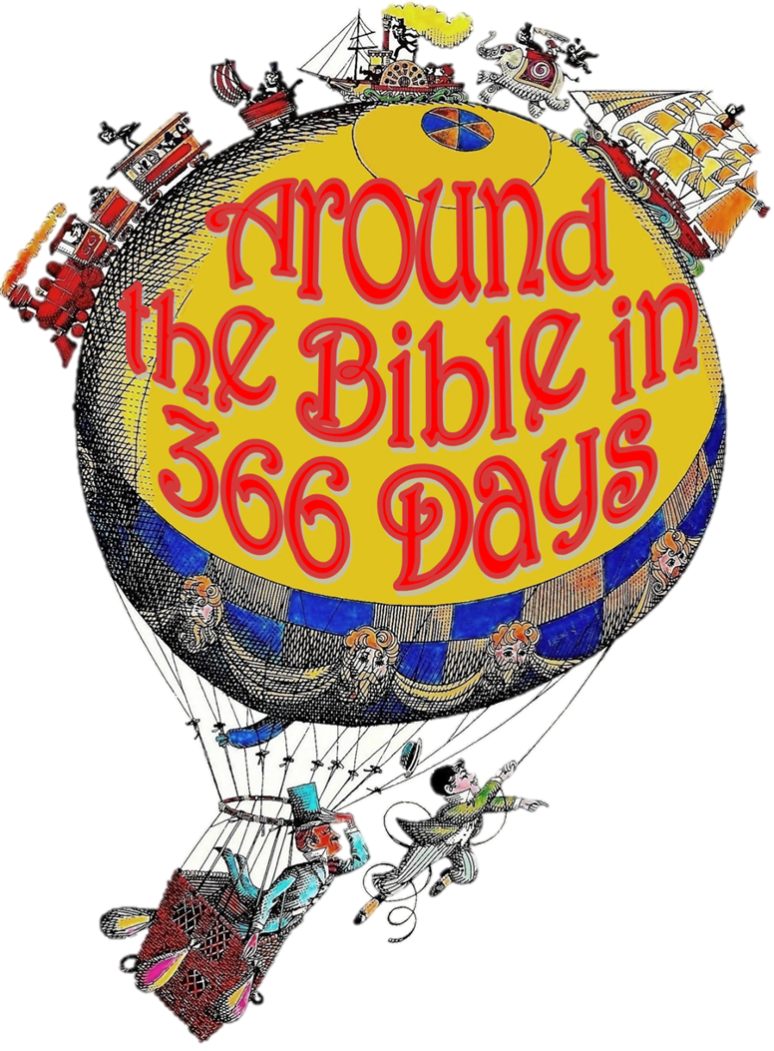
Week 18:
Mixed Worship
(1 Kings 17)

Slide 3
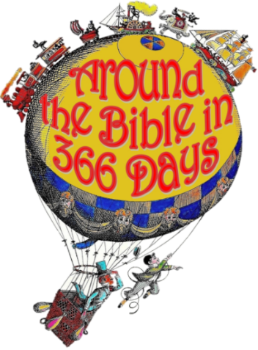
Leviticus 18:24-28
²⁴ “‘Do not defile yourselves in
any of these ways, because this
is how the nations that I am going
to drive out before you became defiled. ²⁵ Even the land was defiled;
so I punished it for its sin, and the land vomited out its inhabitants. ²⁶ But you must keep my decrees and my laws. The native-born and the foreigners residing among you must not do any
of these detestable things,

Slide 4
Leviticus 18:24-28
²⁷ for all these things were done
by the people who lived in the
land before you, and the land
became defiled. ²⁸ And if you defile the land, it will vomit you out as it vomited out the nations that were before you.

Slide 5
2 Kings 17
³³ They worshiped the Lord, but
they also served their own gods
in accordance with the customs
of the nations from which they had been brought. ³⁴ To this day they persist in their former practices. They neither worship the Lord nor adhere to the decrees and regulations, the laws and commands that the Lord gave…

Slide 6
2 Kings 17
⁴⁰ They would not listen,
however, but persisted in their
former practices. ⁴¹ Even while these people were worshiping the Lord, they were serving their idols.
Isaiah 29:13
The Lord says: “These people come near to me with their mouth and honor me with their lips, but their hearts are far from me. Their worship of me is based on merely human rules they have been taught.

Slide 7
2 Timothy 3:1-5
¹ But mark this: There will be terrible
times in the last days. ² People will be
lovers of themselves, lovers of money, boastful, proud, abusive, disobedient to their parents, ungrateful, unholy, ³ without love, unforgiving, slanderous, without self-control, brutal, not lovers of the good, ⁴ treacherous, rash, conceited, lovers of pleasure rather than lovers of God—
⁵ having a form of godliness but denying its power. Have nothing to do with such people.
  (NLT) They will act religious, but they will reject the power that could make them godly.

Slide 8
What about you and me?
⁴¹ Even while these people
were worshiping the Lord,
they were serving their idols…

Slide 9
Luke 9:57-62
⁵⁷ As they were walking along
the road, a man said to him, “I
will follow you wherever you go.”
⁵⁸ Jesus replied, “Foxes have dens and birds have nests, but the Son of Man has no place to lay his head.” ⁵⁹ He said to another man, “Follow me.” But he replied, “Lord, first let me go and bury my father.” ⁶⁰ Jesus said to him, “Let the dead bury their own dead, but you go and proclaim the kingdom of God.”

Slide 10
Luke 9:57-62
⁶¹ Still another said, “I will
follow you, Lord; but first let
me go back and say goodbye to
my family.” ⁶² Jesus replied, “No one who puts a hand to the plow and looks back is fit for service in the kingdom of God.

