Slide 2
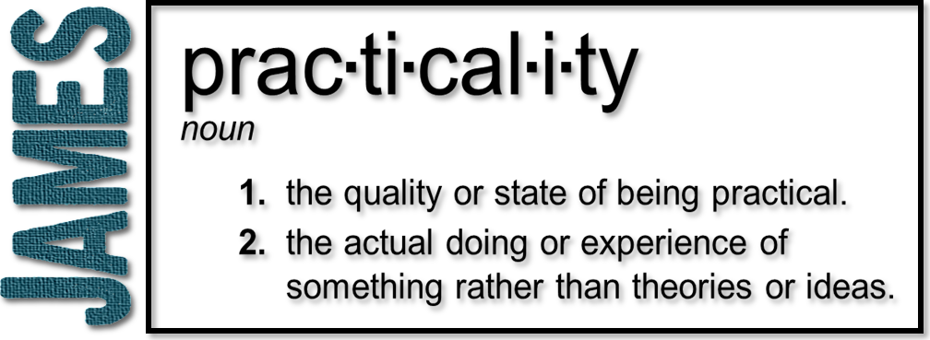
Week 2: How Do We Ask God?
(James 1:5-12)

Slide 3
Trials

Slide 4
Wisdom
Knowledge
Raw information
Intelligence
Factual & Technical
Enables awareness
“What”
Wisdom
What to do with info
Insight
Applicable & Practical
Enables decisions
“How” and “Why”

Slide 5
Wisdom
1 Corinthians 13:2
If I have the gift of prophecy and can fathom all mysteries and all knowledge, and if I have a faith that can move mountains, but do not have love, I am nothing.
Information without transformation leads to frustration!

Slide 6
Wisdom
Proverbs 9:10
The fear of the Lord is the beginning of wisdom, and knowledge of the Holy One is understanding.
Wisdom provides a clear view of our situation from God’s perspective
Wisdom is obtained through prayer

Slide 7
Asking God
Mark 11:24
Therefore I tell you, whatever you ask for in prayer, believe that you have received it, and it will be yours.
1 John 5:14
This is the confidence we have in approaching God: that if we ask anything according to his will, he hears us.

Slide 8
Asking God
“In faith”
Two options:
Effective prayer is made with confidence and conviction, spoken boldly by faith. Knowing “how” to pray
Effective prayer is coming to God, believing that He is able to do a certain thing; without doubting God's ability or desire. Knowing “who” we pray to

Slide 9
Asking God
Too extreme of a view of faith’s role or the believer’s authority playing a role in healing, prosperity or any other condition is cleverly disguised ‘works-based’ theology!
God gives generously
This cannot be rectified with the image of God only giving to those with sufficient confidence or authority
Given without regard to merit

Slide 10
Asking God
John 14:13-14
¹³ And I will do whatever you ask in my name, so that the Father may be glorified in the Son. ¹⁴ You may ask me for anything in my name, and I will do it.

Slide 11
Doubting
Hesitating
Wavering, not trusting
Asking God for wisdom and then proceed to battle with the wisdom of your own mind, and often end up doing what you wanted to do before you asked!

Slide 12
Doubting
Mark 9:14-27
²¹ Jesus asked the boy’s father, “How long has he been like this?” “From childhood,” he answered. ²² “It has often thrown him into fire or water to kill him. But if you can do anything, take pity on us and help us.” ²³ “‘If you can’?” said Jesus. “Everything is possible for one who believes.” ²⁴ Immediately the boy’s father exclaimed, “I do believe; help me overcome my unbelief!”

Slide 13
Doubting
Double-minded: literally two-souled
To be in the middle ground between faith and unbelief is to be double-minded
Person who is unsettled and not at rest
Not committing
Person who does not receive from God

Slide 14
⁵ If any of you lacks wisdom, he should ask God…

