Slide 1
Jesus as High Priest

Slide 2
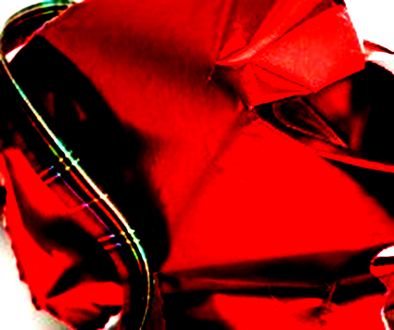
Hebrews 2:16-17a
¹⁶ We also know that the Son did not come to help angels; he came to help the descendants of Abraham. ¹⁷ Therefore, it was necessary for him to be made in every respect like us, his brothers and sisters,﻿ so that he could be our merciful and faithful High Priest before God.

Slide 3
Four Part Christmas Series
Jesus as Prophet
Jesus as Priest
Jesus as King
Jesus is Incarnated God

Slide 4
The Price of Sin
Fall of man – Sin Entered the World
Romans 5:12 – “When Adam sinned, sin entered the world. Adam’s sin brought death, so death spread to everyone, for everyone sinned.”
Consequences of Sin
Romans 6:23 – “For the wages of sin is death…”
Hebrews 9:22 – “In fact, the law requires that nearly everything be cleansed with blood, and without the shedding of blood there is no forgiveness.
Jesus Fore-Ordained
1 Peter 1:20 – “He was chosen before the foundations of the world”

Slide 5
Substitutionary Sacrifice
How did God chose to deal with sin until Jesus?
A ‘Substitutionary’ system of sacrifice that pointed to the ultimate sacrifice – Jesus Christ, the Son of God
A LIFE for a LIFE – Blood had to be shed
Leviticus 1:4 –Lay your hand on the animal’s head, and the Lord will accept its death in your place to purify you, making you right with him.﻿
Exodus 29:35-46 – Sacrificial system set in place

Slide 6
Power of the Substitutionary System
Showed God’s people that sin had REAL consequences
Hebrews 9:22 - “In fact, the law requires that nearly everything be cleansed with blood, and without the shedding of blood there is no forgiveness.”

Slide 7
The Priesthood
Aaron and his sons dedicated as priests
Exodus 29
Levites assigned to assist Aaron and his sons - Numbers 3:1-13
Responsible For Carrying out the sacrifices in the tabernacle and then, once built, the temple.

Slide 8
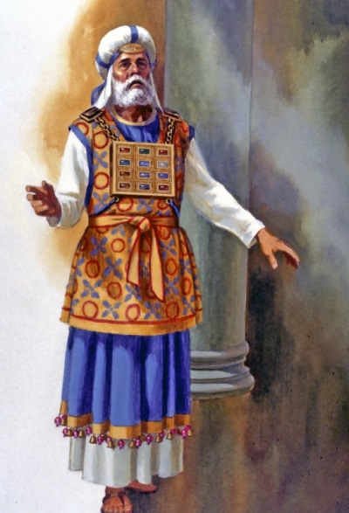
The High Priest

Slide 9
The Roles of Prophets and Priests
God
Prophets spoke to the people on behalf of God
Priests represented the people in the reconciliation process with God
Prophets
Priests
God’s People
The Nation of Israel

Slide 10
Jesus as Our High Priest
Levitical High Priests | Jesus as High Priest

Slide 11
Jesus as Our High Priest
Levitical High Priests | Jesus as High Priest
Many Priests | Only One Priest

Slide 12
Hebrews 7:23-24
²³ Now there have been many of those priests, since death prevented them from continuing in office; ²⁴ but because Jesus lives forever, he has a permanent priesthood.

Slide 13
Jesus as Our High Priest
Levitical High Priests | Jesus as High Priest
Many Priests | Only One Priest
Temporary | Permanent - Eternal

Slide 14
Hebrews 9:12
“He did not enter by means of the blood of goats and calves; but he entered the Most Holy Place once for all by his own blood, having obtained eternal redemption.”

Slide 15
Jesus as Our High Priest
Levitical High Priests | Jesus as High Priest
Many Priests | Only One Priest
Temporary | Permanent, eternal
Sacrificed Daily | Sacrificed Once for All

Slide 16
Hebrews 7:27
“Unlike the other high priests, he does not need to offer sacrifices day after day, first for his own sins, and then for the sins of the people. He sacrificed for their sins once for all when he offered himself.”

Slide 17
Jesus as Our High Priest
Levitical High Priests | Jesus as High Priest
Many Priests | Only One Priest
Temporary | Permanent, eternal
Sacrificed Daily | Sacrificed Once for All
Priests were Sinners | Blameless

Slide 18
Hebrews 7:26,28
²⁶ Such a high priest meets our need—one who is holy, blameless, pure, set apart from sinners, exalted above the heavens.
²⁸ For the law appoints as high priests men who are weak; but the oath, which came after the law, appointed the Son, who has been made perfect forever.

Slide 19
Jesus as Our High Priest
Levitical High Priests | Jesus as High Priest
Many Priests | Only One Priest
Temporary | Permanent, eternal
Sacrificed Daily | Sacrificed Once for All
Priests were Sinners | Blameless
Animal Sacrifice for Sin | Sacrificed Himself for Sins of the World

Slide 20
Hebrews 9:11-14 (NLT)
¹¹ So Christ has now become the High Priest over all the good things that have come.﻿ He has entered that greater, more perfect Tabernacle in heaven, which was not made by human hands and is not part of this created world. ¹² With his own blood—not the blood of goats and calves—he entered the Most Holy Place once for all time and secured our redemption forever.

Slide 21
Hebrews 9:11-14 (NLT)
¹³ Under the old system, the blood of goats and bulls and the ashes of a young cow could cleanse people’s bodies from ceremonial impurity. ¹⁴ Just think how much more the blood of Christ will purify our consciences from sinful deeds﻿ so that we can worship the living God. For by the power of the eternal Spirit, Christ offered himself to God as a perfect sacrifice for our sins.

Slide 22
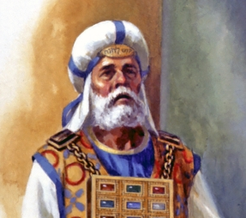
The Clothing of the High Priest
Ephod
(Exodus 39:2-7)

Slide 23
1 Peter 2:21-24 (NLT)
²¹ To this you were called, because Christ suffered for you, leaving you an example, that you should follow in his steps. ²² “He committed no sin, and no deceit was found in his mouth.”﻿²³ When they hurled their insults at him, he did not retaliate; when he suffered, he made no threats. Instead, he entrusted himself to him who judges justly. ²⁴ He himself bore our sins in his body on the tree, so that we might die to sins and live for righteousness; by his wounds you have
been healed.

Slide 24
^{1 John 2:2}
^{1 Timothy 2:5-6}
^{John 1:29}
^{Ephesians 5:1-2}
^{Galatians 1:4}
^{1 Peter 3:18}
^{2 Corinthians 5:21}

Slide 26
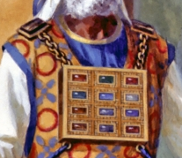
The Clothing of the High Priest
Breastpiece
(Exodus 39:8-21)
One piece of material folded as a sling-pouch
12 precious stones, each containing the name of one of the twelve tribes
Made of the same material as the Ephod

Slide 27
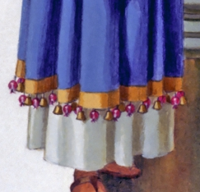
The Clothing of the High Priest
Bells
(Exodus 39:25-26)
Made of pure gold
Alternated between the pomegranates made of fine yarn
Jingled as the priest walked and carried out his duties

