Slide 2
Dealing With Tough Stuff
(Acts 6:8- 7:53)

Slide 3
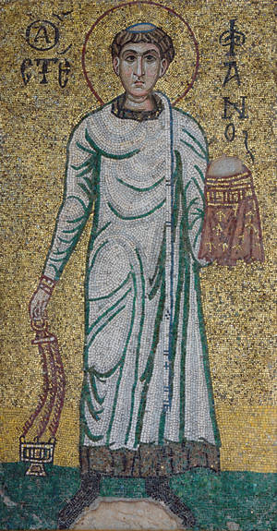
Meet Stephen…
His character:
Acts 6:5,8 ⁵…They chose Stephen, a man full of faith and of the Holy Spirit… ⁸ Now Stephen, a man full of God’s grace and power, did great wonders and miraculous signs among the people.

Slide 4
Meet Stephen…
opposition-
The act of opposing or resisting
The condition of being in conflict
Something that serves as an obstacle
Opposition always tests character

Slide 5
Meet Stephen…
How he faced adversity, persecution, and false accusations was Christ-like
We can’t always control what happens, but we can control how we react!

Slide 6
We are interconnected
Joyce
Doug
Me
Dan

Slide 7
We are interconnected
Matthew 5:44 (NKJV) But I say to you, love your enemies, bless those who curse you, do good to those who hate you, and pray for those who spitefully use you and persecute you

Slide 8
We are interconnected
Joyce
Doug
Me
Dan

Slide 9
2 Corinthians 1:3-7 (NLT)
³ All praise to God, the Father of our Lord Jesus Christ. God is our merciful Father and the source of all comfort. ⁴ He comforts us in all our troubles so that we can comfort others. When they are troubled, we will be able to give them the same comfort God has given us. ⁵ For the more we suffer for Christ, the more God will shower us with his comfort through Christ.

Slide 10
2 Corinthians 1:3-7 (NLT)
⁶ Even when we are weighed down with troubles, it is for your comfort and salvation! For when we ourselves are comforted, we will certainly comfort you. Then you can patiently endure the same things we suffer. ⁷ We are confident that as you share in our sufferings, you will also share in the comfort God gives us.

Slide 11
Stephen…
Acts 7:1-53
⁵¹ “You stiff-necked people! Your hearts and ears are still uncircumcised. You are just like your ancestors: You always resist the Holy Spirit!”

Slide 12
Christianity can never truly coexist with being comfortable
How we deal with discomfort is through God’s grace
How we respond to discomfort says a lot about our character and trust in Jesus
How we respond can be a reflection of Christ to others!

