Slide 2
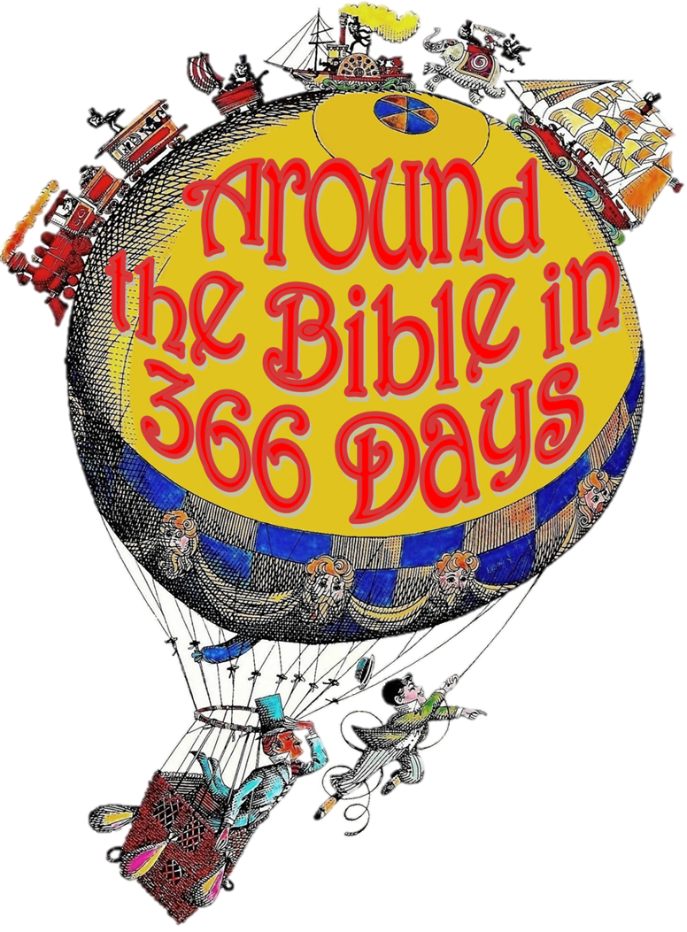
Week 20:
Who Do We Rely On?
(2 Chronicles 14-16)

Slide 3
Asa, King of Judah

Slide 4
Rest
*no more war

Slide 5
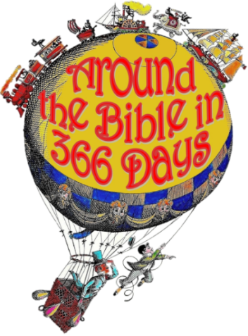
Romans 13:14
Rather, clothe yourselves with
the Lord Jesus Christ, and do
not think about how to gratify
the desires of the flesh
Luke 24:49
“I am going to send you what my Father has promised; but stay in the city until you have been clothed with power from on high.”

Slide 6
Jeremiah 17:5-6
⁵ This is what the Lord says:
“Cursed is the one who trusts in
man, who draws strength from
mere flesh and whose heart turns away from the Lord.
⁶ That person will be like a bush in the wastelands; they will not see prosperity when it comes. They will dwell in the parched places of the desert, in a salt land where no one lives.”

Slide 7
2 Chronicles 16:9
For the eyes of the Lord range throughout the earth to strengthen (to show His might) those whose hearts are fully committed to him (wholly relying on him)…

