Slide 2
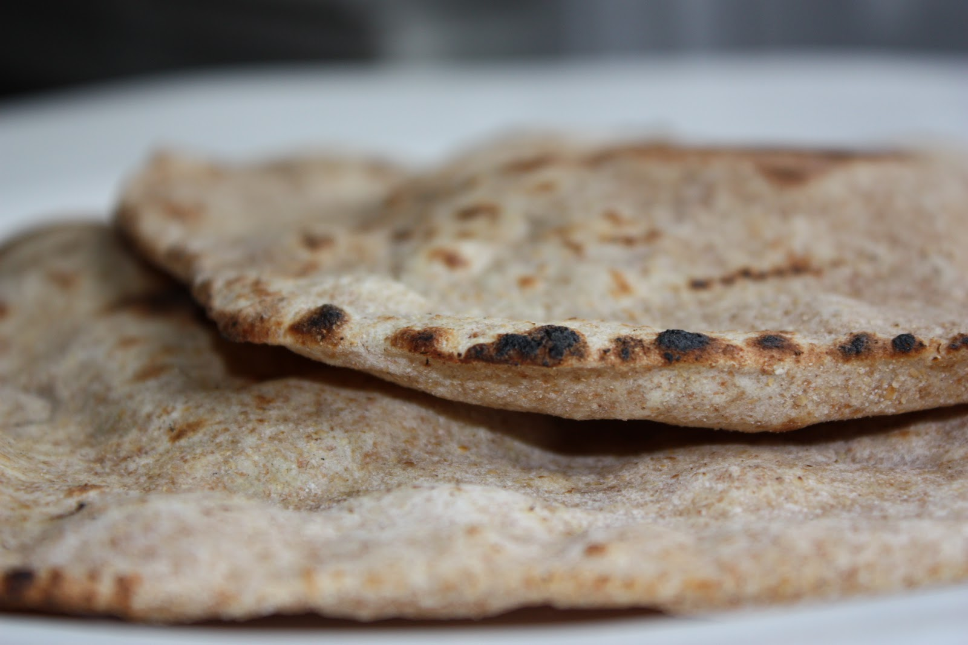
Conversations With John
The Bread of Life
John 6:25-59

Slide 3
John 6:25-35

Slide 4
Galatians 3:1-5
You foolish Galatians, who has bewitched you, before whose eyes Jesus Christ was publicly portrayed as crucified? This is the only thing I want to find out from you: did you receive the Spirit by the works of the Law, or by hearing with faith? Are you so foolish? Having begun by the Spirit, are you now being perfected by the flesh? Did you suffer so many things in vain—if indeed it was in vain? So then, does He who provides you with the Spirit and works miracles among you, do it by the works of the Law, or by hearing with faith?
NASB

Slide 5
The Metaphor of Manna
Manna and Jesus
Both sent by God from Heaven,
Manna was physical food to give life – Jesus’ sacrifice offers all of us everlasting life
Manna was temporary – Salvation through Jesus is permanent

Slide 6
John 6:34-35

Slide 7
Communion Luke 22:14

Slide 8
John 6:36-59

Slide 9
Romans 1:20
For since the creation of the world His invisible attributes, His eternal power and divine nature, have been clearly seen, being understood through what has been made, so that they are without excuse
NASB

Slide 10
John 6:36-59

Slide 11
John 6:56-58
⁵⁶ Whoever eats my flesh and drinks my blood remains in me, and I in him. ⁵⁷ Just as the living Father sent me and I live because of the Father, so the one who feeds on me will live because of me. ⁵⁸ This is the bread that came down from heaven. Your forefathers ate manna and died, but he who feeds on this bread will live forever
NIV

Slide 12
Meno – “Remain”
John 1:32 - Then John gave this testimony: “I saw the Spirit come down from heaven as a dove and remain on him.
John 14:10 - Don’t you believe that I am in the Father, and that the Father is in me? The words I say to you are not just my own. Rather, it is the Father, living in me, who is doing his work.
NIV

Slide 13
John 6:56-58
⁵⁶ Whoever eats my flesh and drinks my blood remains in me, and I in him. ⁵⁷ Just as the living Father sent me and I live because of the Father, so the one who feeds on me will live because of me. ⁵⁸ This is the bread that came down from heaven. Your forefathers ate manna and died, but he who feeds on this bread will live forever
NIV

Slide 14
Ministry Time

