Slide 2
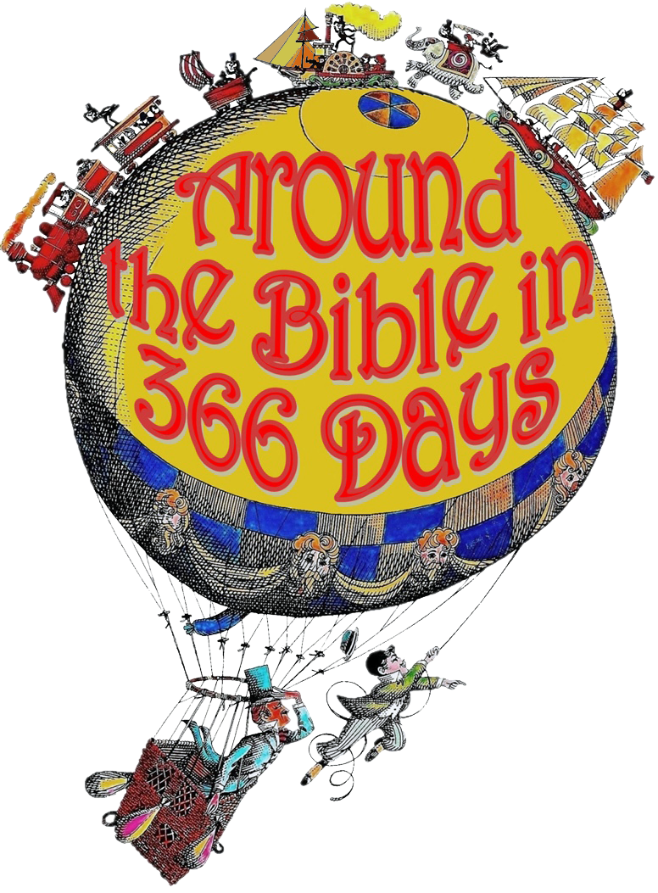
Week 21 Lessons from Josiah (2 Chronicles 34)

Slide 3

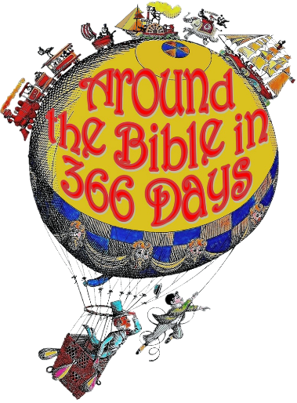
Josiah
Age 8 becomes king
King of Judah for 31 years
Grandfather- Manasseh
Father- Amon
Age 16 began to seek God
No godly model to follow in his immediate family
Age 20 began purging Judah of idols

Slide 4
Josiah
Age 26 ordered the rebuilding of the temple of the Lord
Book of the Law found!
He grieved because it wasn’t passed on to the next generation
He read to all of Judah
He renewed the Covenant

Slide 5
Josiah
2 Kings 23:25
Neither before nor after Josiah was there a king like him who turned to the Lord as he did—with all his heart and with all his soul and with all his strength, in accordance with all the Law of Moses.

Slide 6
Lessons from Josiah
Lived in order to please God
Had spiritual disciplines
Made a decision to not deviate
His heart was responsive
He humbled himself before God
He passed to the next generation

Slide 7
Deuteronomy 6:4-9 (NLT)
⁴ “Listen, O Israel! The Lord is our God, the Lord alone. ⁵ And you must love the Lord your God with all your heart, all your soul, and all your strength. ⁶ And you must commit yourselves wholeheartedly to these commands that I am giving you today. ⁷ Repeat them again and again to your children.

Slide 8
Deuteronomy 6:4-9 (NLT)
Talk about them when you are at home and when you are on the road, when you are going to bed and when you are getting up. ⁸ Tie them to your hands and wear them on your forehead as reminders. ⁹ Write them on the doorposts of your house and on your gates..

Slide 9
Psalm 78:3-8 (CEV)
³ These are things we learn from our ancestors, ⁴ and we will tell them to the next generation. We won’t keep secret the glorious deeds and the mighty miracles of the Lord. ⁵ God gave his Law to Jacob’s descendants, the people of Israel. And he told our ancestors to teach their children,

Slide 10
Psalm 78:3-8 (CEV)
⁶ so that each new generation would know his Law and tell it to the next. ⁷ Then they would trust God and obey his teachings, without forgetting anything God had done. ⁸ They would be different from their ancestors, who were stubborn, rebellious, and unfaithful to God.

