Slide 2
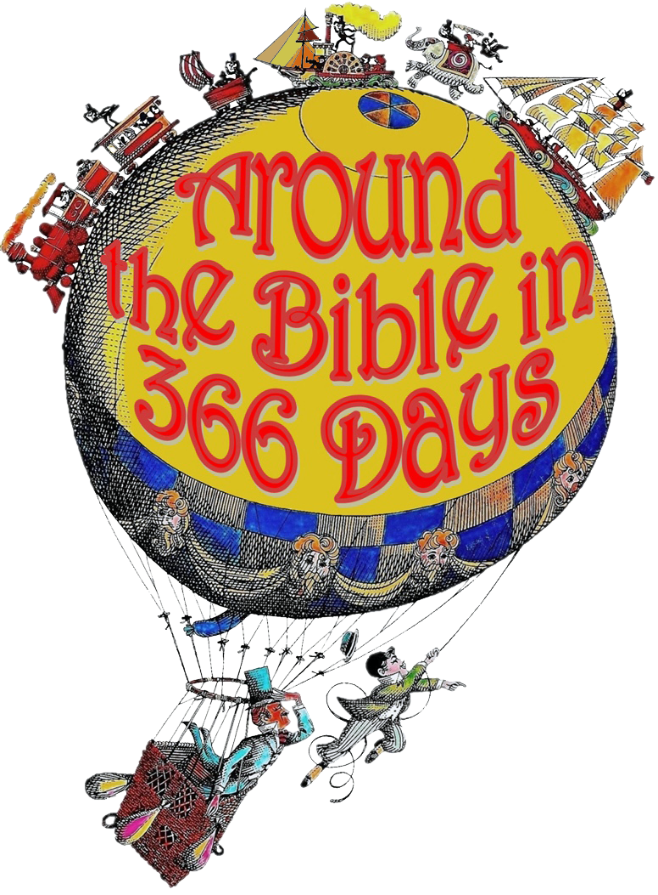
Week 23 I Will Worship! (Job 1)

Slide 3
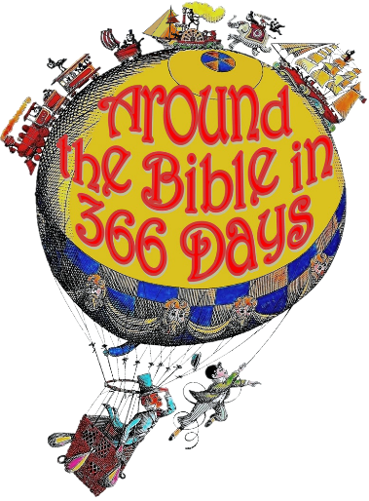
Job 1:20-21
²⁰ At this, Job got up and tore his robe and shaved his head. Then he fell to the ground in worship ²¹ and said: “Naked I came from my mother’s womb, and naked I will depart. The Lord gave and the Lord has taken away; may the name of the Lord be praised.”

Slide 4
Worship is…
a lifestyle
a choice
a process
PRAISE
Joyful Appreciation
Thanksgiving
What God Has Done
WORSHIP
Reverent Adoration
Surrender
Who God Is

Slide 5
Psalm 100:1-5
¹ Shout for joy to the Lord, all the earth. ² Worship the Lord with gladness; come before him with joyful songs. ³ Know that the Lord is God. It is he who made us, and we are his; we are his people, the sheep of his pasture. ⁴ Enter his gates with thanksgiving and his courts with praise; give thanks to him and praise his name.

Slide 6
Psalm 100:1-5
⁵ For the Lord is good and his love endures forever; his faithfulness continues through all generations.
Psalm 95: 6-7
⁶ Come, let us bow down in worship, let us kneel before the Lord our Maker; ⁷ for he is our God and we are the people of his pasture, the flock under his care.

Slide 7
“Missions is not the ultimate goal of the church. Worship is. Missions exists because worship doesn't. Worship is ultimate, not missions, because God is ultimate, not man. When this age is over, and the countless millions of the redeemed fall on their faces before the throne of God, missions will be no more.
It is a temporary necessity. But worship abides forever.” -John Piper (Let the Nations Be Glad)

Slide 8
John 4:23
²³ Yet a time is coming and has now come when the true worshipers will worship the Father in the Spirit and in truth, for they are the kind of worshipers the Father seeks.
Worship (proskuneo)
Spirit (pneuma)
Truth (alethia)

Slide 9
Ways to Worship:
obedience
spiritual disciplines
relationships
formal worship service
------ in spirit
------ in truth

Slide 10
Romans 11:36 (NLT)
For everything comes from him and exists by his power and is intended for his glory. All glory to him forever! Amen.

Slide 11
“I think we delight to praise what we enjoy because the praise not merely expresses but completes the enjoyment. It is not out of compliment that lovers keep on telling one another how beautiful they are; the delight is incomplete till it is expressed.”
- C.S. Lewis

