Slide 2
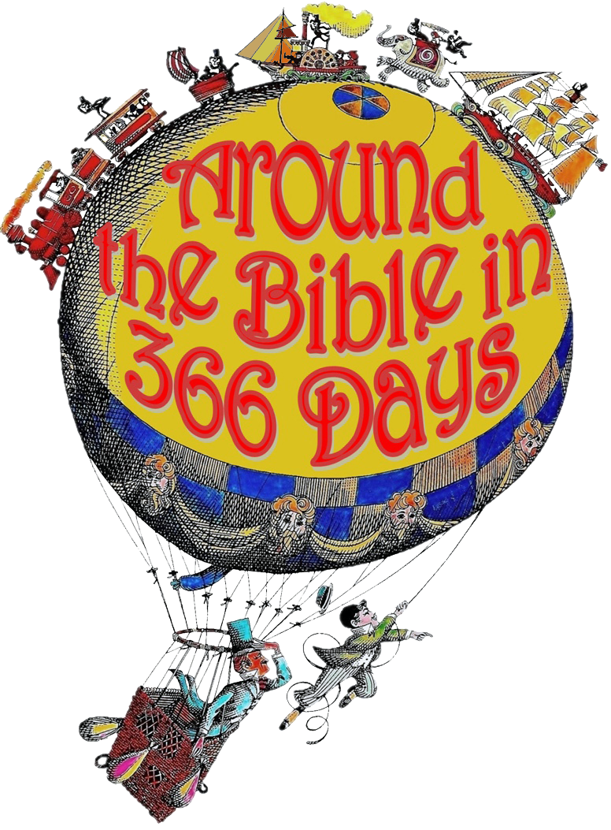
Week 24 A Friend in Need is a Friend Indeed (Job 1-42)

Slide 3
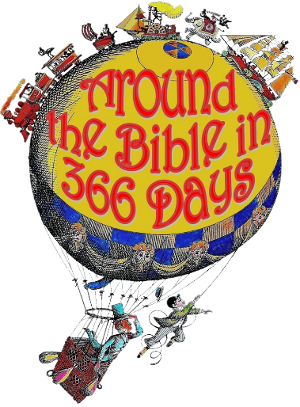
Job 2:11-13
They determined to sympathize and comfort him
They wept at the sight of him
They sat with him
Job: cursed ever being born, “why didn’t I die?” “I have no peace, no rest, only turmoil!”

Slide 4
Eliphaz:
“You must’ve been doing evil to be punished like this.”
He insinuates that Job is self-righteous, above reproach and may even think he is greater than God Himself
“We have examined this, and it is true. So hear it and apply it to yourself.”

Slide 5
Eliphaz:
He accuses Job of giving the weary no food or water and stripping people of their clothing; leaving them naked. Though he was a rich powerful man he did nothing for widows or orphans

Slide 6
Job:
“A despairing man should have the devotion of his friends but mine are undependable.”
6:14 “To him who is afflicted, kindness should be shown by his friend, Even though he forsakes the fear of the Almighty.”
21 “Now you too have proved to be of no help; you see something dreadful and are afraid”

Slide 7
Job:
22 Have I ever said, ‘Give something on my behalf… 23 deliver me from…rescue me from… 24 “Teach me… show me where I have been wrong. 25 How painful are honest words! But what do your arguments prove? 26 Do you mean to correct what I say, and treat my desperate words as wind?

Slide 8
Bildad:
“If you haven’t sinned why are you going through this?”
“Turn to God and plead. God will not reject a blameless man.”
“When will you end these speeches?” “Be sensible, then we can talk.”
He continues to talk of the man who is evil and knows not God.

Slide 9
Zophar:
“Will no one rebuke you?”
“Know this: God has even forgotten some of your sin.”
Said he hears a rebuke that dishonors him
Insinuates that oppressing the poor are some of Job’s sins

Slide 10
Job:
“I have become a laughingstock to my friends, though I called on God and he answered—a mere laughingstock, though righteous and blameless!”
“Those who are at ease have contempt for misfortune”
He shares that God is in control and powerful. (What his friends should’ve been saying.)

Slide 11
Job:
13:5 “If only you would be altogether silent! For you, that would be wisdom.”
He then asks them why they are speaking for God or arguing the case for God
15 “Though he slay me, yet will I hope in him…”
Asks God to withdraw His hand and allow him to speak

Slide 12
Elihu:
Job’s three friends are wrong:
They believe suffering is only because someone has sinned
It is only God’s anger, not His love
They condemned Job
Job is wrong because:
He is self-righteous
God is not ignoring, punishing, or striking him
Prepared the way for the Lord!

Slide 13
How can we be a good friend?

