Slide 1
Righteous Judgment
JOHN 7:14-24

Slide 2
“Don’t judge a book by its cover!”

Slide 3
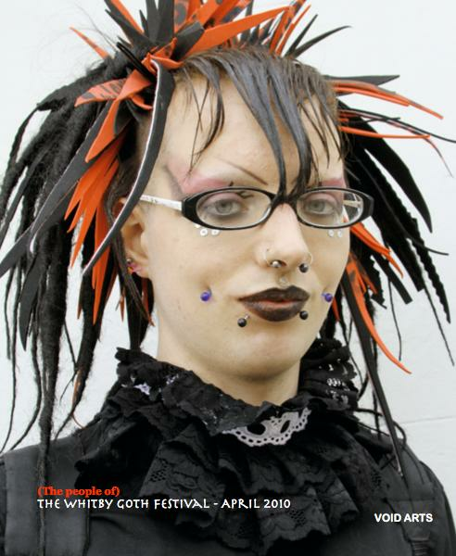

Slide 4
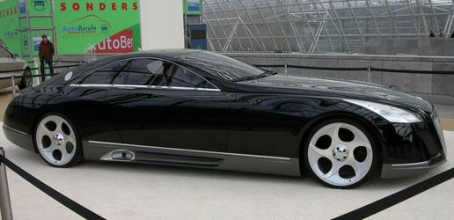

Slide 5
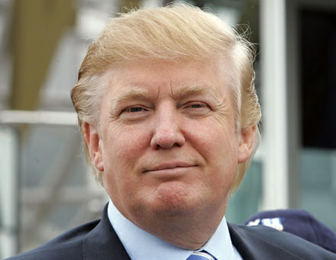

Slide 6
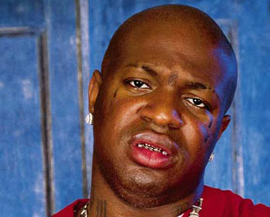

Slide 7
John 7: 18
He who speaks on his own authority seeks to win honor for himself. He whose teaching originates with himself seeks his own glory. But He Who seeks the glory and is eager for the honor of Him Who sent Him, He is true; and there is no unrighteousness or falsehood or
deception in Him.

Slide 8
How do you judge Success?
1. Appearance: clothing, hairstyle, grooming
2. Job, career, business
3. Money
4. Possessions
5. Social status – How many FB friends you have?
All of these things can be faked, or they may easily fail, very quickly

Slide 9
True Success looks more like this
A person who chooses to be happy and content wherever God has blessed you
The measure of the love you give to and receive from others
A sincere generosity toward others, both materially and relationally
A life of integrity and good character – A good name
A life of love, joy, peace, free of worry, doubt, and fear

Slide 10
John 7: 24
Do not judge according to appearance, but judge with righteous judgment.

Slide 11
Matthew 7:1-6
“Judge not, that you be not judged. For with what judgment you judge, you will be judged; and with the measure you use, it will be measured back to you. And why do you look at the speck in your brother’s eye, but do not consider the plank in your own eye? Or how can you say to your brother, ‘Let me remove the speck from your eye’; and look, a plank is in your own eye? Hypocrite! First remove the plank from your own eye, and then you will see clearly to remove the speck from your brother’s eye. “Do not give what is holy to the dogs; nor cast your pearls before swine, lest they trample them under their feet, and turn and tear you in pieces.

Slide 12
Matthew 7:16-18
You will know them by their fruits. Do men gather grapes from thorn-bushes or figs from thistles? Even so, every good tree bears good fruit, but a bad tree bears bad fruit. A good tree cannot bear bad fruit, nor can a bad tree bear good fruit. Every tree that does not bear good fruit is cut down and thrown into the fire. Therefore by their fruits you will know them.

Slide 13
Galatians 5:19
Now the works of the flesh are evident, which are: adultery, fornication, uncleanness, lewdness, idolatry, sorcery, hatred, contentions, jealousies, outbursts of wrath, selfish ambitions, dissensions, heresies, envy, murders, drunkenness, revelries, and the like; of which I tell you beforehand, just as I also told you in time past, that those who practice such things will not inherit the kingdom of God.
But the fruit of the Spirit is love, joy, peace, longsuffering, kindness, goodness, faithfulness, gentleness, self-control. Against such there is no law.
And those who are Christ’s have crucified the flesh with its passions and desires, If we live in the Spirit, let us also walk in the Spirit. Let us not become conceited, provoking one another, envying one another.

Slide 14
Timing:
Judge nothing before the time…1 Cor 4:5

Slide 15
For the time has come for judgment to begin at the house of God; and if it begins with us first, what will be the end of those who do not obey the gospel of God?
I Peter 4:17

Slide 16
! Corinthians 6
If any of you has a dispute with another, do you dare to take it before the ungodly for judgment instead of before the Lord’s people? Or do you not know that the Lord’s people will judge the world? And if you are to judge the world, are you not competent to judge trivial cases? Do you not know that we will judge angels? How much more the things of this life! Therefore, if you have disputes about such matters, do you ask for a ruling from those whose way of life is scorned in the church? I say this to shame you. Is it possible that there is nobody among you wise enough to judge a dispute between believers?

