Slide 2


Slide 3
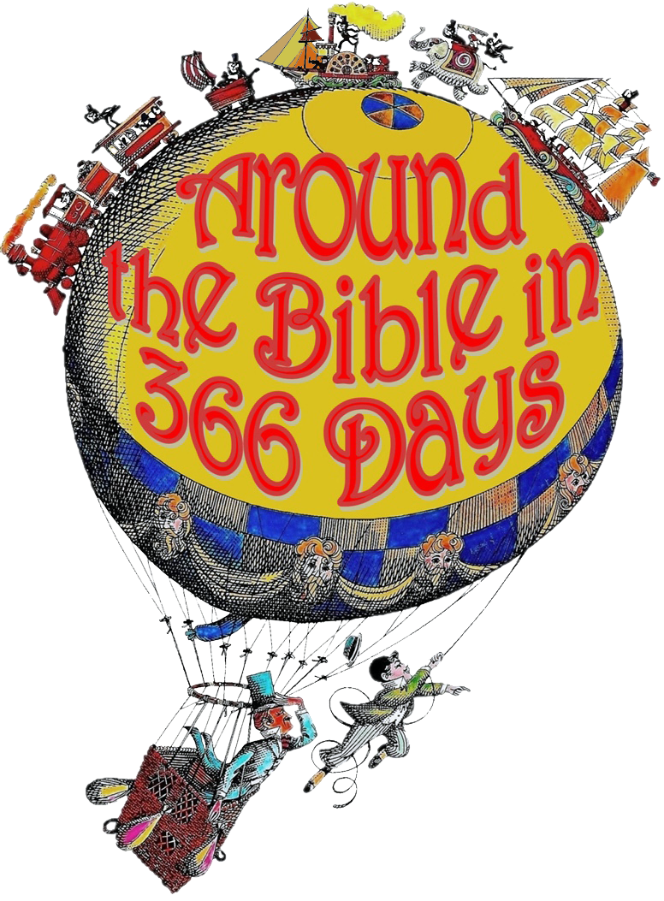
Week 25 God Our Father (Psalm 23)

Slide 4
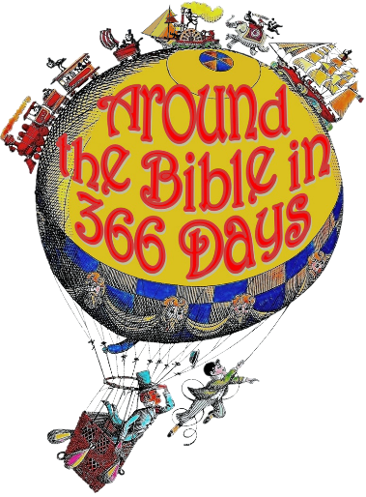
Psalm 23
¹ The Lord is my shepherd;
feeds, guides, and protects
He is with me
David speaks from experience
relationship

Slide 5
Psalm 23
¹ The Lord is my shepherd; I shall not want.
I have all that I need
I lack nothing in Him
HE is all I need
confidence

Slide 6
Psalm 23
¹ The Lord is my shepherd; I shall not want. ² He makes me lie down in green pastures;
I find my rest in Him
the grass is NOT greener on any other side!

Slide 7
Psalm 23
¹ The Lord is my shepherd; I shall not want. ² He makes me lie down in green pastures; He leads me beside the still waters.
to drink from, to partake of
He says peace be still to the waters of life!

Slide 8
Psalm 23
¹ The Lord is my shepherd; I shall not want. ² He makes me lie down in green pastures; He leads me beside the still waters. ³ He restores my soul;
He renews my strength
He refreshes my life
He brings me back

Slide 9
Psalm 23
¹ The Lord is my shepherd; I shall not want. ² He makes me lie down in green pastures; He leads me beside the still waters. ³ He restores my soul; He leads me in the paths of righteousness
sends me in the right direction

Slide 10
Psalm 23
¹ The Lord is my shepherd; I shall not want. ² He makes me lie down in green pastures; He leads me beside the still waters. ³ He restores my soul; He leads me in the paths of righteousness for His name’s sake.
bringing honor to his name
for His glory

Slide 11
Psalm 23
⁴ Yea, though I walk through the valley of the shadow of death,
even when I walk through the hardest times
through despair, fear, and doubt
under attack

Slide 12
Psalm 23
⁴ Yea, though I walk through the valley of the shadow of death, I will fear no evil;
fear is not from God!
NO KIND of evil

Slide 13
Psalm 23
⁴ Yea, though I walk through the valley of the shadow of death, I will fear no evil; for You are with me;
I’m not afraid when you walk with me
I am fearless
He comes through for me

Slide 14
Psalm 23
⁴ Yea, though I walk through the valley of the shadow of death, I will fear no evil; for You are with me; Your rod and Your staff, they comfort me.
rod- to protect and correct
Your Word defends me
staff- to guide & pull from danger
makes me feel secure

Slide 15
Psalm 23
⁵ You prepare a table before me in the presence of my enemies;
a feast; preparations are made
You honor me as your guest
even in front of those who don’t like me
in the center of trouble, in the midst of it

Slide 16
Psalm 23
⁵ You prepare a table before me in the presence of my enemies; You anoint my head with oil;
You revive and refresh
You give me Your power and anointing

Slide 17
Psalm 23
⁵ You prepare a table before me in the presence of my enemies; You anoint my head with oil; My cup runs over.
You fill until it is full and overflowing!
I have more than enough
You abundantly provide

Slide 18
Psalm 23
⁶ Surely goodness and mercy shall follow me
will pursue me and overtake me
Your mercy will not run out

Slide 19
Psalm 23
⁶ Surely goodness and mercy shall follow me all the days of my life;
He continues to pursue
I will serve Him all my life

Slide 20
Psalm 23
⁶ Surely goodness and mercy shall follow me all the days of my life; and I will dwell in the house of the Lord forever.
in the presence of the Lord
forever cared for, forever loved
security

Slide 21
I’m not out here on my own!
There’s nothing in this world that God isn’t walking us through!

