Slide 3

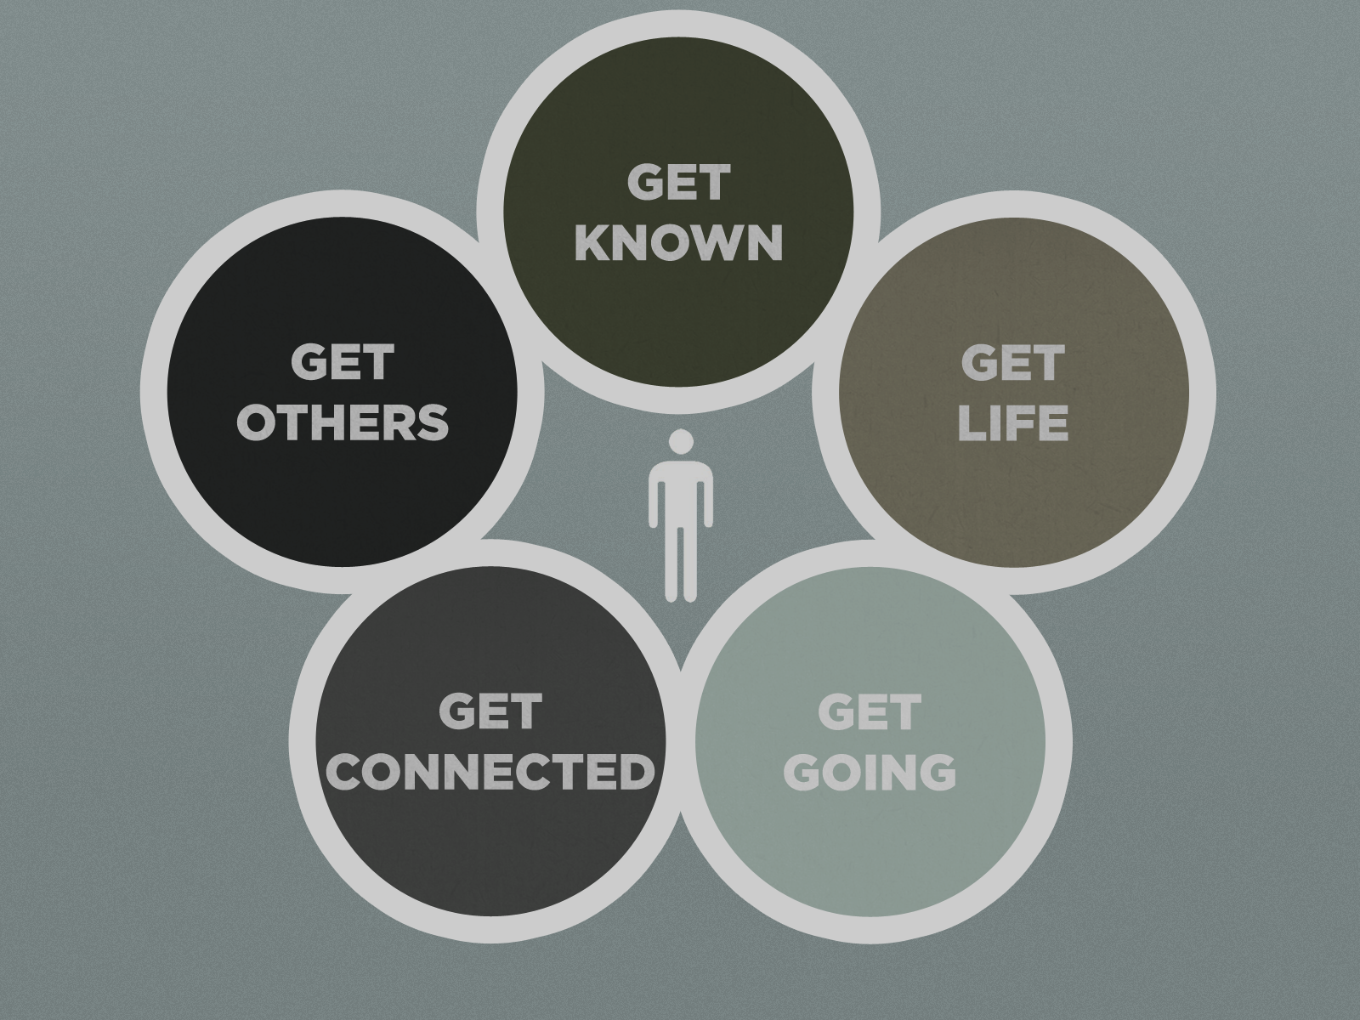




Circles of
Discipleship

Slide 8


Slide 9


Paul: A Believer on Fire
(Acts 9:20-31)

Slide 10

Acts 9:20-31

Slide 11
Timeline
Saul persecutes the church Stephen Stoned Early 34 AD
Saul first referred to as ‘Paul’ (Acts 13:9)
38 AD
Saul spends 3 years in Arabia (Galatians 1:17)
30 - 33 AD
34 AD
34 - 37 AD
38 AD
Jesus Crucified
30 AD
Saul’s conversion on the road to Damascus
Late 34 AD
Saul meets Apostles in Jerusalem
Late 37 AD

Slide 12
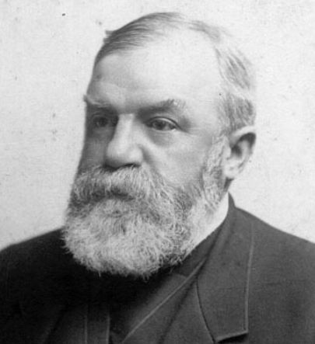
A Believer on Fire
Proclamation of Jesus as Lord – vs. 20
Share what you know
You don’t need all the answers
Share it boldly
People will see the passion in you
1 John 5:10-12
D.L. Moody

Slide 13
A Believer on Fire
Increasing in Faith – vs. 22
True believers are growing in their Faith
There is no treading water Spiritually
Faith is built in many ways – difficult times seem to be the most powerful tests of our faith as well as strengthens our faith.
Ephesians 6:13 - Therefore put on the full armor of God, so that when the day of evil comes, you may be able to stand your ground, and after you have done everything to stand.
It is FAITH that enables you to stand!

Slide 14
A Believer on Fire
A Life that Reflects the ‘Change’ – vs. 27
Your actions speak louder than your words
Ephesians 4:17-24 – The ‘new life’
2 Corinthians 5:17 – The ‘new creation’
Matthew 5:14 – The ‘Light of the world’, the ‘City on a hill’

Slide 15
A Believer on Fire
Proclamation of Jesus as Lord
Increasing in Faith
A Life Reflecting the ‘change’

Slide 16
Am I a Believer on Fire?
Do I Truly Want to be on Fire?
Examine your life for sin, unrepentance or un-forgiveness (These all separate us from God)
Recommit your life to serving God – Not yourself
Immerse yourself in His word and recommit yourself to prayer
Ask God daily to rekindle the fire in you

