Slide 2
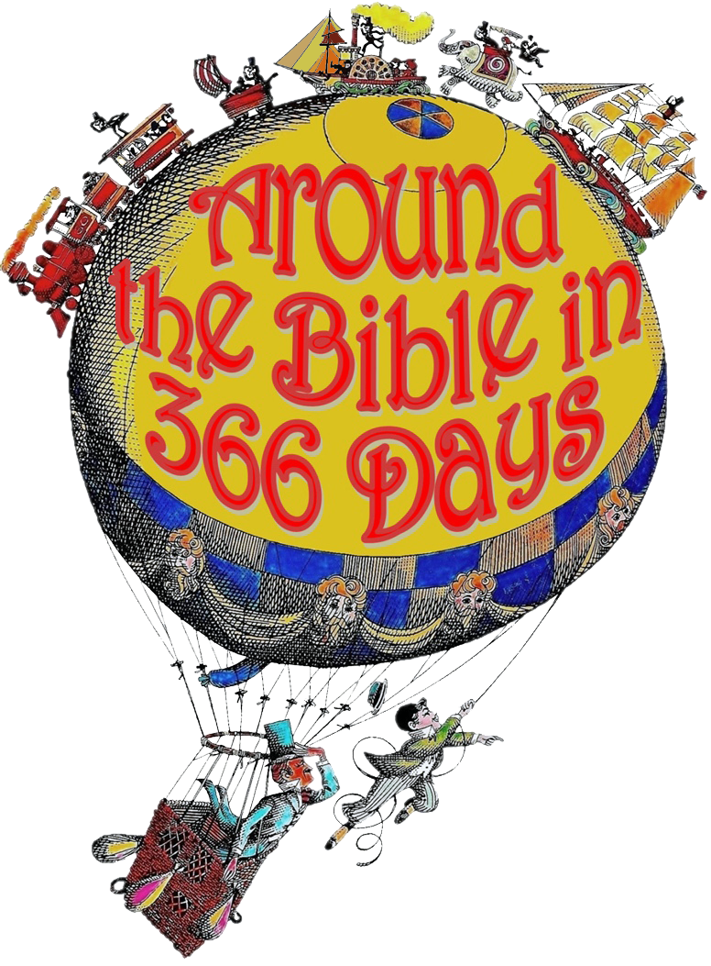
Week 27 When God is Silent (Psalm 77)

Slide 3
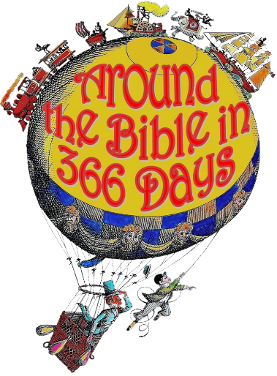
Psalm 77
Vs. 1-2 Cry for help!
(NLT) ¹ I cry out to God; yes, I shout. Oh, that God would listen to me!
(MSG) ¹ I yell out to my God, I yell with all my might, I yell at the top of my lungs…
repeated to show that he prayed again and again

Slide 4
Psalm 77
Vs. 1-2 Cry for help!
in distress he sought the Lord
stretched out “untiring hands”
didn’t experience comfort
wasn’t immediate
no answer

Slide 5
Psalm 77
Vs. 3-6 Remembers being close to God
(NLT) ³ I think of God, and I moan, overwhelmed with longing for his help
spiritual exhaustion instead of comfort
he remains restless because of the distance between him and God

Slide 6
Psalm 77
Vs. 7-9 Questions!
Why doesn’t He rescue us?
Why are we allowed to continue to suffer?
Why doesn’t He hear our prayers, our pleas?
Why doesn’t He speak?
Why can we not hear Him?

Slide 7
Psalm 77
Vs. 7-9 Questions!
Doubts and questions are expressed by the greatest saints

Slide 8
Psalm 77
Joshua 23:14 (MSG)
“As you can see, I’m about to go the way we all end up going. Know this with all your heart, with everything in you, that not one detail has failed of all the good things God, your God, promised you. It has all happened. Nothing’s left undone—not so much as a word.

Slide 9
Psalm 77
Vs. 10-12 Remembers God’s mighty deeds
“Then I thought…”
“I will remember the deeds of the Lord…I will remember your miracles”
“I will meditate on all your works and consider all your mighty deeds”

Slide 10
Psalm 77
Vs. 10-12 Remembers God’s mighty deeds
as a means to remove his doubts, despondency, and unbelief, and to strengthen his faith
he not only calls them to mind, but dwells upon them (meditates)

Slide 11
Our Thought Life
Proverbs 16:3 Commit your works to the LORD, and your thoughts will be established.
Commit:
to put into charge or trust
to obligate or bind
to pledge or assign
to place into prison or institution
to carry into action deliberately

Slide 12
Psalm 77
Vs. 13-20 Confidence in God’s help
God is the creator, sustainer, and finisher!
God always places people in our lives.
God will always lead His people

Slide 13
How can we be confident in our thought life?
1) God does it!
Jeremiah 31:33 I will put My law in their minds, and write it on their hearts; and I will be their God, and they shall be My people.

Slide 14
How can we be confident in our thought life?
2) We have to do it!
1 Corinthians 14:20 Brothers, stop thinking like children. In regard to evil be infants, but in your thinking be adults.
Peter 1:13 Therefore, prepare your minds for action; be self-controlled; set your hope fully on the grace to be given you when Jesus Christ is revealed.

Slide 15
How can we be confident in our thought life?
3) Refocus our priorities
Colossians 3:1-3 If then you were raised with Christ, seek those things which are above, where Christ is, sitting at the right hand of God. Set your mind on things above, not on things on the earth. For you died, and your life is hidden with Christ in God.

Slide 16
How can we be confident in our thought life?
4) Control it!
2 Corinthians 10:4-5 For the weapons of our warfare are not carnal but mighty in God for pulling down strongholds, casting down arguments and every high thing that exalts itself against the knowledge of God, bringing every thought into captivity to the obedience of Christ.

Slide 17
When God is silent…

