Slide 2
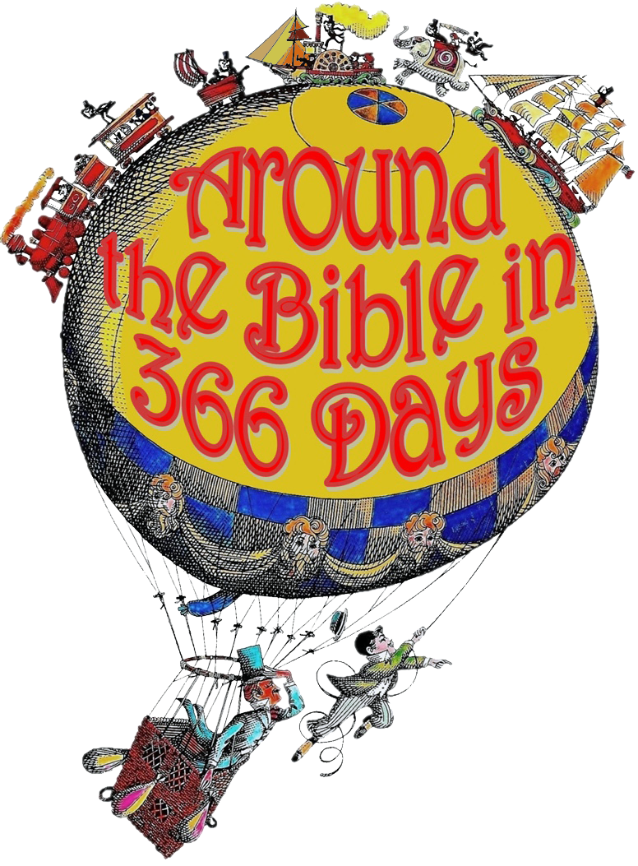
Week 28
As Far as the East is from the West
(Psalm 103)

Slide 3
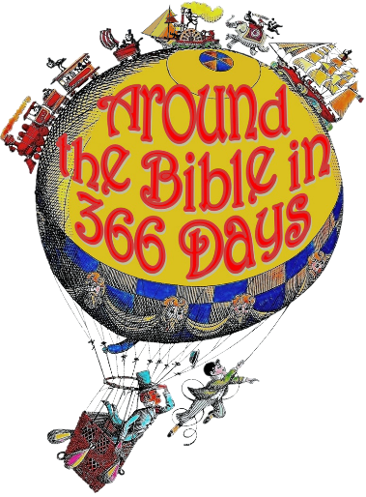
Psalm 103
God’s all cannot be praised with less
than our ALL!

Slide 4
Psalm 103
To be clear, sin is:
to transgress or step across a
boundary or limit
to miss the mark
separation from God

Slide 5
Psalm 103
To be clear, sin is:
1 John 3:4
Whoever commits sin also
commits lawlessness, and sin is
lawlessness.
James 4:17
Therefore, to him who knows
to do good and does not do it,
to him it is sin.

Slide 6
Psalm 103
God alone can reveal Himself
He wants to make Himself known!
Jesus was made known:
John 5:46
“If you believed Moses, you
would believe Me, for he
wrote about Me.”

Slide 7
Psalm 103
2 Timothy 1:9-10 (NLT)
⁹ For God saved us and called us to live a holy life. He did this, not because we deserved it, but because that was his plan from before the beginning of time—to show us his grace through Christ Jesus.
¹⁰ And now he has made all of this plain to us by the appearing of Christ Jesus, our Savior. He broke the power of death and illuminated the way to life and immortality through the Good News.

Slide 8
Psalm 103
The Gospel has 3 main functions:
Removes the penalty of sin. (Justification)
Removes the separation caused by sin. (Reconciliation)
Removes the power of sin (Sanctification)
All are concerned with the
human condition: sin

Slide 9
Psalm 103
Romans 8:1-2 (NLT)
¹ So now there is no condemnation for those who belong to Christ Jesus. ² And because you belong to him, the power of the life-giving Spirit has freed you from the power
of sin that leads to death.

Slide 10
Psalm 103
He knows our frailty
He knows the corruption of our
nature
He knows how prone we are to sin
He knows our mental and
emotional make-up
He knows our weaknesses
He knows our fears, our
thoughts, and our dreams

Slide 11
Psalm 103
1 John 1:9
If we confess our sins, He is faithful and just and will forgive us our sins and purify us from all unrighteousness.

Slide 12
Praise the Lord, O my soul; all my inmost being, praise His holy name!

