Slide 2
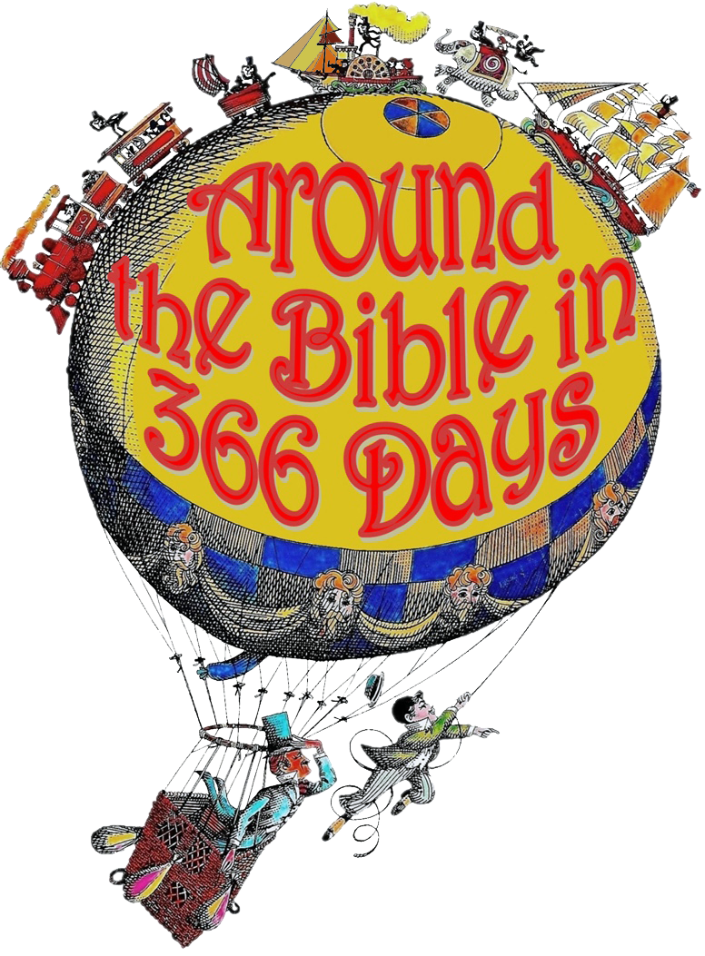
Week 29
You Know My Anxious Thoughts
(Psalm 139)

Slide 3
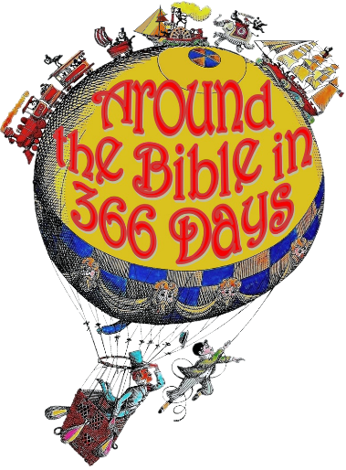
Reason we worry:
We try to take control
Worry is a form of
idolatry!

Slide 4
Matthew 6:25-34
²⁵ “Therefore I tell you, do not worry about your life, what you will eat or drink; or about your body, what you will wear. Is not life more than food, and the body more than clothes? ²⁶ Look at the birds of the air; they do not sow or reap or store away in barns, and yet your heavenly Father feeds them. Are you not much more valuable than they? ²⁷ Can any one of you by worrying add a single hour to your life?

Slide 5
Matthew 6:25-34
²⁸ “And why do you worry about clothes? See how the flowers of the field grow. They do not labor or spin. ²⁹ Yet I tell you that not even Solomon in all his splendor was dressed like one of these. ³⁰ If that is how God clothes the grass of the field, which is here today and tomorrow is thrown into the fire, will he not much more clothe you—you of little faith?

Slide 6
Matthew 6:25-34
³¹ So do not worry, saying, ‘What shall we eat?’ or ‘What shall we drink?’ or ‘What shall we wear?’ ³² For the pagans run after all these things, and your heavenly Father knows that you need them. ³³ But seek first his kingdom and his righteousness, and all these things will be given to you as well. ³⁴ Therefore do not worry about tomorrow, for tomorrow will worry about itself. Each day has enough trouble of its own.

Slide 7
Matthew 6:25-34
Worry- merimnao
formed by two root words ‘divided’ and ‘mind’
pulled apart (in different directions), distracted

Slide 8
Reasons we shouldn’t worry:
God commands it—worry is sin
God cares for his creation, even
more so for His people
God knows what we need
Worry stems from lack of
faith and trust
Worry & anxiety originate
from unhealthy thoughts

Slide 9
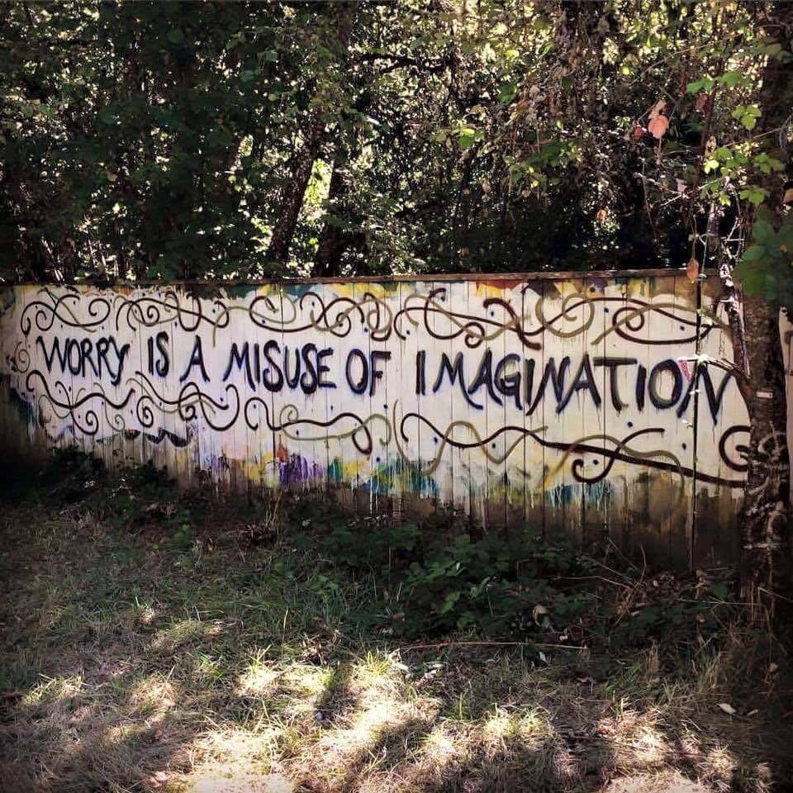

Slide 10
Philippians 4:6-9
⁶ Do not be anxious about anything, but in every situation, by prayer and petition, with thanksgiving, present your requests to God. ⁷ And the peace of God, which transcends all understanding, will guard
your hearts and your minds
in Christ Jesus.

Slide 11
Philippians 4:6-9
⁸ Finally, brothers and sisters, whatever is true, whatever is noble, whatever is right, whatever is pure, whatever is lovely, whatever is admirable—if anything is excellent or praiseworthy—think about such things.
⁹ Whatever you have learned or received or heard from me, or
seen in me—put it into practice.
And the God of peace will be with you.

Slide 12
The Peace of God
will guard your hearts
(emotional control)
will guard your minds
(mental stability)
our thought life affects
our peace

Slide 13
The Peace of God
Isaiah 26:3
You will keep him in perfect peace,
whose mind is stayed on You,
because he trusts in You.
Peace requires trust

Slide 14
Psalm 139:23-24
²³ Search me, God, and know my heart; test me and know my anxious thoughts.
²⁴ See if there is any offensive
way in me, and lead me in
the way everlasting.

