Slide 2
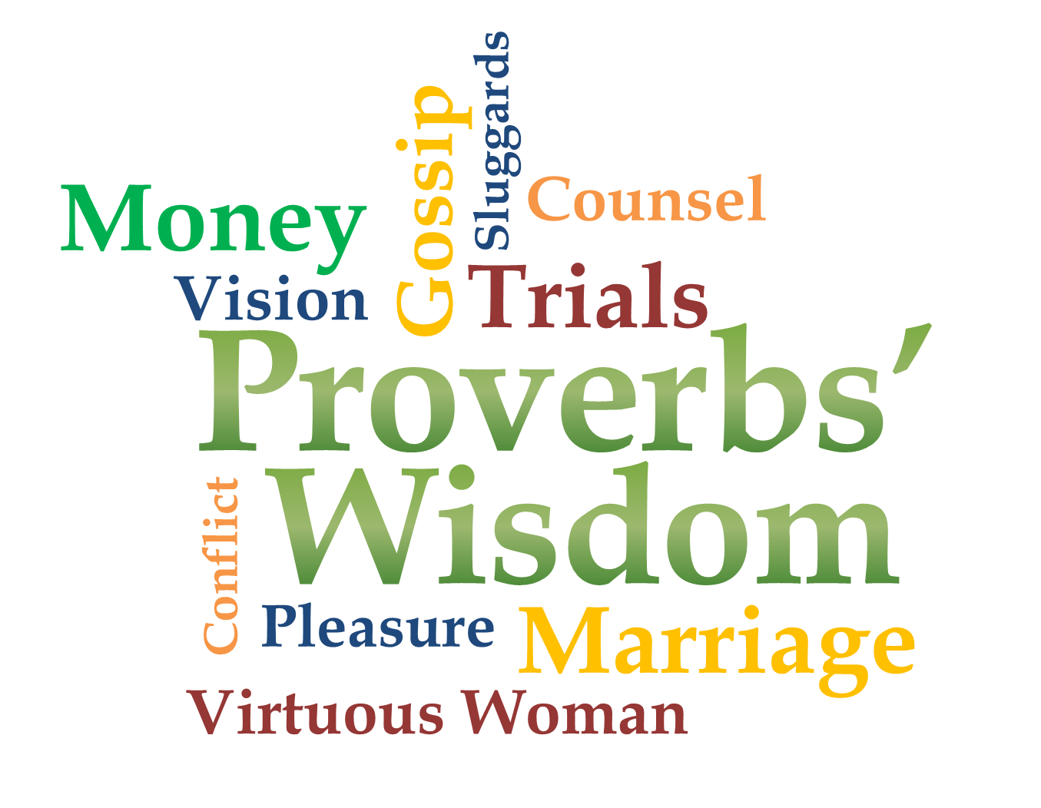
Week 3
Conflict

Slide 3
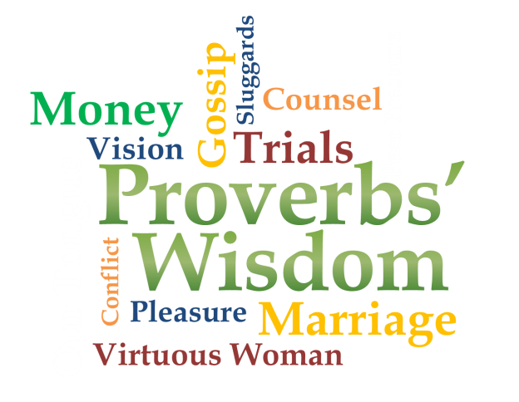
Conflict Does Damage
Proverbs 6:16-19
¹⁶ There are six things the Lord hates, seven that are detestable to him: ¹⁷ haughty eyes, a lying tongue, hands that shed innocent blood, ¹⁸ a heart that devises wicked schemes, feet that are quick to rush into evil, ¹⁹ a false witness who pours out lies and a person who stirs up conflict in the community.

Slide 4
Conflict Does Damage
Proverbs 17:14
Starting a quarrel is like breaching a dam; so drop the matter before a dispute breaks out.
Proverbs 20:3
It is to a man's honor to avoid strife, but every fool is quick to quarrel.

Slide 5
Conflict Does Damage
Proverbs 26:17-21
¹⁷ Like one who seizes a dog by the ears is a passer-by who meddles in a quarrel not his own. ¹⁸ Like a madman shooting firebrands or deadly arrows ¹⁹ is a man who deceives his neighbor and says, “I was only joking!”

Slide 6
Conflict Does Damage
Proverbs 26:17-21
²⁰ Without wood a fire goes out; without gossip a quarrel dies down. ²¹ As charcoal to embers and as wood to fire, so is a quarrelsome man for kindling strife.

Slide 7
Conflict Does Damage
James 4:1-2
¹ What causes fights and quarrels among you? Don't they come from your desires that battle within you? ² You want something but don't get it. You kill and covet, but you cannot have what you want. You quarrel and fight. You do not have, because you do not ask God.

Slide 8
Offense
Proverbs 18:19 (NLT)
An offended friend is harder to win back than a fortified city.
Arguments separate friends like a gate locked with bars.
Proverbs 19:11
A man's wisdom gives him patience; it is to his glory to overlook an offense.

Slide 9
Offense
Luke 17:1-5 (NKJV)
¹ Then He said to the disciples, “It is impossible that no offenses should come, but woe to him through whom they do come! ² It would be better for him if a millstone were hung around his neck, and he were thrown into the sea, than that he should offend one of these little ones…

Slide 10
Offense
Offense- skandalon (“scandal”)
Trap; snare; to trip up (figuratively, cause of displeasure or sin) -Strong’s
The trigger of a trap on which the
bait is placed, and which, when touched by the animal, springs and causes it to close causing entrapment.
-Zodhiates’ Complete Word Study Dictionary

Slide 11
Offense
Luke 17:1-5 (NKJV)
…³ Take heed to yourselves. If your brother sins against you, rebuke him; and if he repents, forgive him. ⁴ And if he sins against you seven times in a day, and seven times in a day returns to you, saying, ‘I repent,’ you shall forgive him.” ⁵ And the apostles said to the Lord, “Increase our faith.”

Slide 12
Offense
Offense is a misguided sense of justice
When we retain an offense in our hearts, we filter everything through it

Slide 13
Let the Lord Handle It!
1 Peter 2:21-23
To this you were called, because Christ suffered for you, leaving you an example, that you should follow in his steps. "He committed no sin, and no deceit was found in his mouth." When they hurled their insults at him, he did not retaliate; when he suffered, he made no threats. Instead, he entrusted himself to him who judges justly.

Slide 14
Let the Lord Handle It!
Proverbs 20:22
Do not say, “I'll pay you back for this wrong!” Wait for the LORD, and he will deliver you.
Proverbs 15:18
A hot-tempered man stirs up dissension, but a patient man calms a quarrel.
Proverbs 25:28
Like a city whose walls are broken down is a man who lacks self-control.

Slide 15
Matthew 18:15-18
Step 1: Person to person (directly)
Step 2: Person to person with one or two others
Step 3: Church leader participation
Step 4: Release from relationship
The goal is reconciliation

Slide 16
Our Prayer for Conflict
Our desire to be right or win is often sinful
Motives
Forgiveness
Reconciliation & Restoration
“If it is possible, as far as it depends on you, live at peace with everyone.” (Romans 12:18)

