Slide 2
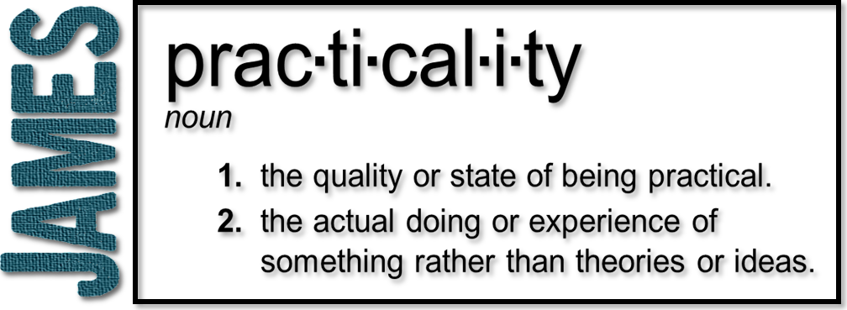
Week 3: Overcoming Temptation
(James 1:13-18)

Slide 3
Temptation
Inducement to sin placed before the mind with the implied promise of greater good to be derived from following the way of disobedience
Where does it stem from?
What does it lead to?
How do we overcome temptation?

Slide 4
Temptation NOT from God
“When Scripture ascribes blindness or hardness of heart to God, it does not assign to him the beginning of the blindness, nor does it make him the author of sin, so as to ascribe to him the blame.” –John Calvin
Proverbs 19:3 (NLT) People ruin their lives by their own foolishness and then are angry at the Lord.

Slide 5
Satan
‘adversary’ - “to accuse” or “to oppose”
“the devil” “serpent” “Beelzebub” “ruler of this world” “prince of power of the air” “the thief” “the evil one” “the enemy”
“murderer from the beginning” “a liar and the father of all lies” “sinned from the beginning” “the accuser of our brothers and sisters”

Slide 6
Satan
Ephesians 6:11-12
¹¹ Put on the full armor of God, so that you can take your stand against the devil’s schemes. ¹² For our struggle is not against flesh and blood, but against the rulers, against the authorities, against the powers of this dark world and against the spiritual forces of evil in the heavenly realms.

Slide 7
Satan
The tactics of Satan:
lies
deception
murder
destruction
blind people from the gospel
theft
bondage/addiction
doubt
guilt
fear
confusion
sickness
envy
greed
gluttony
slander… etc.

Slide 8
Satan
“Satan rose up against Israel and incited David to take a census of Israel.”
(1 Chronicles 21:1)
Satan tempts God tests
(incites us to sin) (uses all things for us)

Slide 9
James doesn't mention Satan here
“by his own evil desire” – fallen nature
Romans 7:14-15 ¹⁴ We know that the law is spiritual; but I am unspiritual, sold as a slave to sin. ¹⁵ I do not understand what I do. For what I want to do I do not do, but what I hate I do.
Within us exists a bent to oppose God, to hide from God, to disobey

Slide 10
James doesn't mention Satan here
“he is dragged away and enticed”
Ecclesiastes 8:8 As no one has power over the wind to contain it, so no one has power over the time of their death. As no one is discharged in time of war, so wickedness will not release those who practice it.
Emphasis of the NT is on telling believers not to sin more than on Satan’s activity

Slide 11
Desire Births Sin
Sin is:
Lawlessness or transgression of God's will, either by omitting to do what God's law requires or by doing what it forbids.
The transgression can occur in thought, word, or deed
A falling away from or missing the right path. To miss the mark

Slide 12
Don’t be
deceived!

Slide 13
Overcoming Temptation
1 Corinthians 10:13
No temptation has overtaken you except such as is common to man; but God is faithful, who will not allow you to be tempted beyond what you are able, but with the temptation will also make the way of escape, that you may be able to bear it.
1) You’re not the only one

Slide 14
Overcoming Temptation
1 Corinthians 10:13
No temptation has overtaken you except such as is common to man; but God is faithful, who will not allow you to be tempted beyond what you are able, but with the temptation will also make the way of escape, that you may be able to bear it.
2) He is greater!

Slide 15
Overcoming Temptation
1 Corinthians 10:13
No temptation has overtaken you except such as is common to man; but God is faithful, who will not allow you to be tempted beyond what you are able, but with the temptation will also make the way of escape, that you may be able to bear it.
3) You can escape

Slide 16
Overcoming Temptation
Psalm 119:11
Your word I have hidden in my heart, That I might not sin against You.
4) The Word of God

Slide 17
Overcoming Temptation
Psalm 119:11
Your word I have hidden in my heart, That I might not sin against You.
Luke 22:40
When He came to the place, He said to them, “Pray that you may not enter into temptation.”
5) Prayer

Slide 18
Overcoming Temptation
Hebrews 4:15-16 (NLT)
¹⁵ This High Priest of ours understands our weaknesses, for he faced all of the same temptations we do, yet he did not sin. ¹⁶ So let us come boldly to the throne of our gracious God. There we will receive his mercy, and we will find grace to help us when we need it.
5) Prayer

Slide 19
Overcoming Temptation
James 4:7-8
⁷ Submit yourselves, then, to God. Resist the devil, and he will flee from you.
⁸ Come near to God and he will come near to you. Wash your hands, you sinners, and purify your hearts, you double-minded.
6) Submit and resist

