Slide 3
Hebrews 10:1-10
¹ The law is only a shadow of the good things that are coming-not the realities themselves. For this reason it can never, by the same sacrifices repeated endlessly year after year, make perfect those who draw near to worship.

Slide 4
Week Three:
OT Foreshadows of Jesus

Slide 5
Foreshadow/Typology
‘Light’ shines on an object creating a forward shadow (or outline) of what is to come
The image comes into focus as it draws closer

Slide 6
Foreshadow/Typology
Typology is the name we give to the places in the Bible where God foreshadows the Plan
The OT picture and the NT fulfillment

Slide 7
Foreshadow/Typology
Colossians 2:16-17
¹⁶ Therefore do not let anyone judge you by what you eat or drink, or with regard to a religious festival, a New Moon celebration or a Sabbath day. ¹⁷ These are a shadow of the things that were to come; the reality, however, is found in Christ.

Slide 8
Foreshadow/Typology
A ‘type’ is a real person, place, object, or event ordained by God to act as a predictive pattern or resemblance of Jesus’ person and work, or of opposition to both

Slide 9
Foreshadow/Typology
Not a made-up allegory
If someone was a type of Jesus at one time in his life, it doesn’t mean he was a type in all parts of his life

Slide 10
Foreshadow/Typology
“A picture is worth a thousand words”

Slide 11
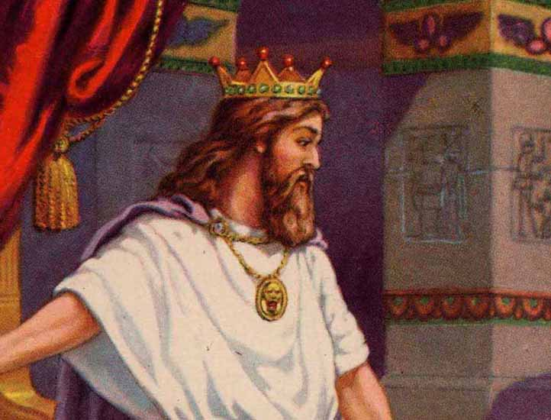
Foreshadows of Jesus

Slide 12
Acts 2:30-36
³⁰ But he (David) was a prophet and knew that God had promised him on oath that he would place one of his descendants on his throne. ³¹ Seeing what was to come, he spoke of the resurrection of the Messiah, that he was not abandoned to the realm of the dead, nor did his body see decay…

Slide 13
Acts 2:30-36
…³⁴ For David did not ascend to heaven, and yet he said, “‘The Lord said to my Lord: “Sit at my right hand ³⁵ until I make your enemies a footstool for your feet.”’ (Psalm 110:1) ³⁶ “Therefore let all Israel be assured of this: God has made this Jesus, whom you crucified, both Lord and Messiah.”

Slide 14
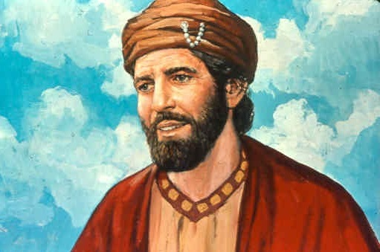
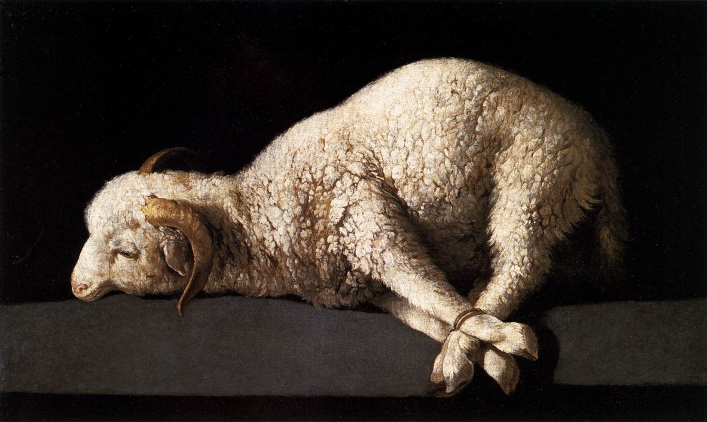
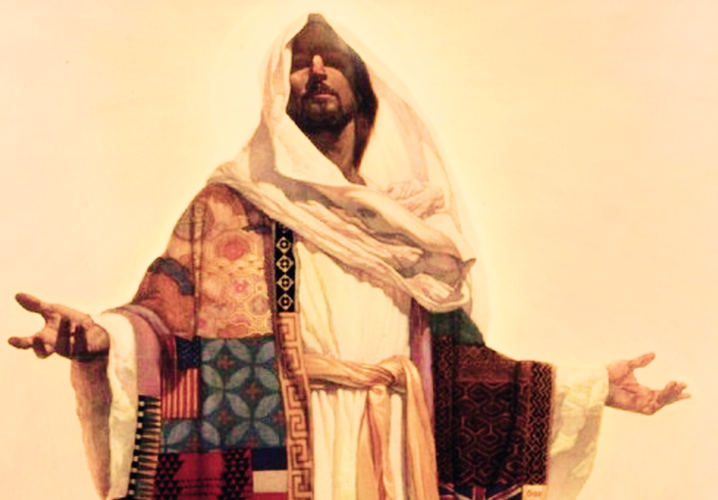
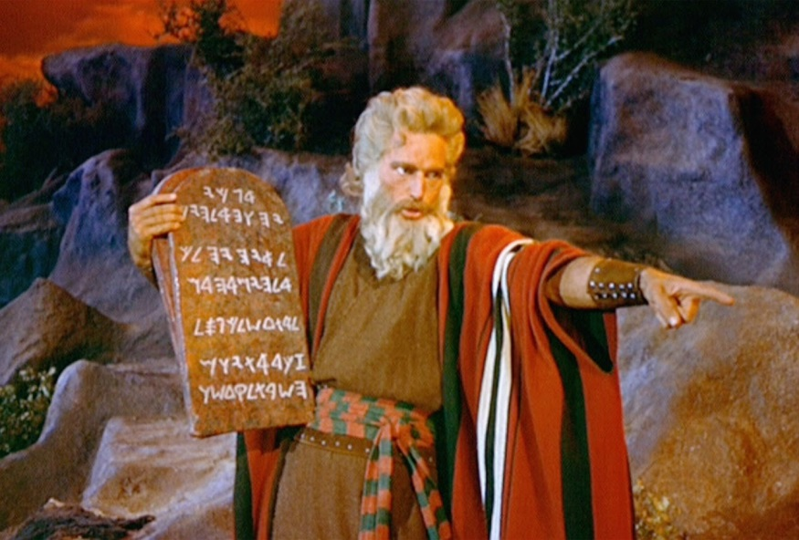
Foreshadows of Jesus
1 Corinthians 5:7b For Christ, our Passover lamb, has been sacrificed.

Slide 15
Luke 22:14-20
¹⁴ When the hour came, Jesus and his apostles reclined at the table. ¹⁵ And he said to them, “I have eagerly desired to eat this Passover with you before I suffer. ¹⁶ For I tell you, I will not eat it again until it finds fulfillment in the kingdom of God.” ¹⁷ After taking the cup, he gave thanks and said, “Take this and divide it among you.

Slide 16
Luke 22:14-20
¹⁸ For I tell you I will not drink again from the fruit of the vine until the kingdom of God comes.” ¹⁹ And he took bread, gave thanks and broke it, and gave it to them, saying, “This is my body given for you; do this in remembrance of me.” ²⁰ In the same way, after the supper he took the cup, saying, “This cup is the new covenant in my blood, which is poured out for you.”

