Slide 1
“Once I was Blind, but now I see!”
John 9:8-34

Slide 2
It is His story!
Our story is within His story.

Slide 3
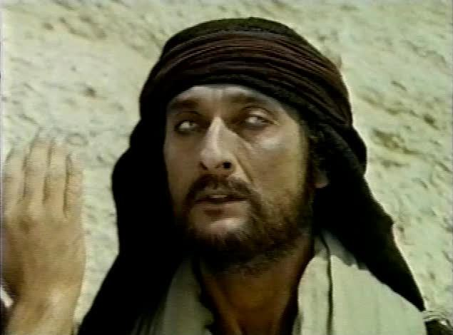
Meet the blind man…
“Isn’t this the man that used to…?”

Slide 4
Our Story
People can see change
They want to know about it

Slide 5
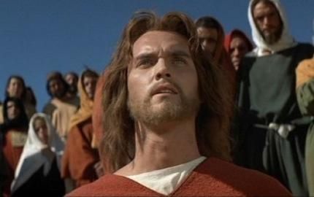
“Meet Jesus…”
“He did this, and then I could see.”

Slide 6
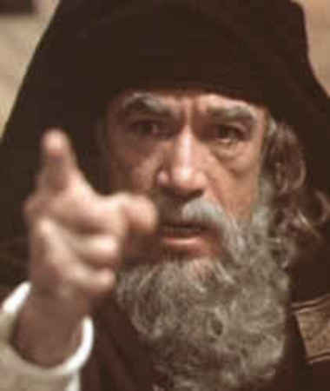
Meet the Pharisees…
“What have you to say about Him? It was your eyes He opened.”

Slide 7
Our Story
People need your firsthand account
People will check up on all aspects of your life to see if it matches

Slide 8
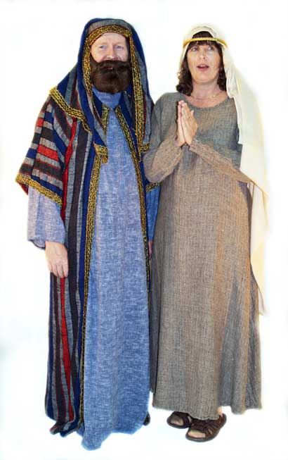
Meet the parents…
They were afraid of being put out of the synagogue.

Slide 9
John 12:42-43 (NIV)
Yet at the same time many even among the leaders believed in him. But because of the Pharisees they would not confess their faith for fear they would be put out of the synagogue; for they loved praise from men more than praise from God.

Slide 10
Our Story
“One thing I do know, I was blind but now I see.”
You don’t have to know everything

Slide 11
Our Story
Not everyone will believe
You may be insulted, threatened and abused

Slide 12
We are invited to participate in His story.
To receive His salvation, His power, His healing
To tell others about it as well

Slide 13
Acts 4:29-31 (NIV)
Now, Lord, consider their threats and enable your servants to speak your word with great boldness. Stretch out your hand to heal and perform miraculous signs and wonders through the name of your holy servant Jesus.”

Slide 14
Acts 4:29-31 (NIV)
After they prayed, the place where they were meeting was shaken. And they were all filled with the Holy Spirit and spoke the word of God boldly.

Slide 15
The same people who received the filling of the Spirit in Acts chp.2, needed it again to have boldness to share Christ

Slide 16
Let’s make this our prayer…
Now, Lord, consider their threats and enable your servants to speak your word with great boldness. Stretch out your hand to heal and perform miraculous signs and wonders through the name of your holy servant Jesus.”

